Slide 1
Boundary layer ventilation by mid-latitude cyclones
Victoria Sinclair, Stephen Belcher, Suzanne Gray

Slide 2
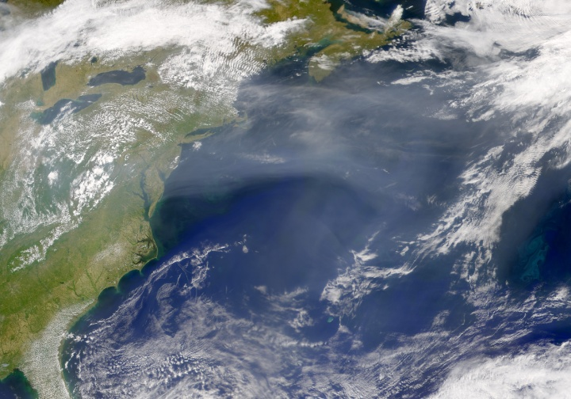
Motivation
Aerosol
θ
Pollution is mainly emitted near the surface and can be trapped by an inversion
  Affects human health
  Affects vegetation
  Corrodes buildings
Dry deposition only occurs in the boundary layer
At upper levels particles affect the radiation budget
Chemical reaction rates linked to temperature
In the free troposphere pollutants can be transported much further
Garrett
May 4th 2001, SeaWiFS, NASA

Slide 3
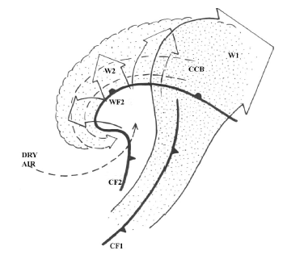
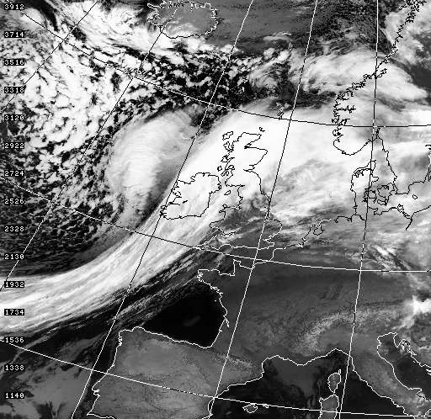
How can pollution be ventilated?
Orography
Sea Breezes
Convection
Synoptic weather systems and their fronts

Slide 4
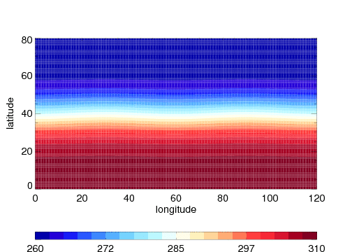
Experiments
Simulate idealised weather systems
  Use Met Office Unified Model in idealised mode (channel configuration)
Include a constant source of a passive tracer near the surface to represent pollution.
Can change the background state and hence the characteristics of the weather systems
Surface pressure and potential temperature at 1km. Pressure contours greater than 1000mb are dashed. Each frame is 1 day apart

Slide 5
What controls the amount of ventilation?
The amount of turbulent mixing within the boundary layer?
  Pollutants need to be mixed up to near the top of the boundary layer for ventilation to occur
Horizontal transport within the boundary layer?
  Convergence and divergence
  Only certain regions of the boundary layer can be ventilated
The large scale vertical motion associated with the cyclone?
  The final step in ventilation
  The most important?

Slide 6
Quasi-Geostrophic Omega equation
Thermal advection forcing term
Differential vorticity advection forcing term
Assume that at low levels thermal advection dominates
Scaling arguments, and the use of thermal wind balance, lead to:
This implies that the amount of ventilation by a cyclone depends only on large scale variables

Slide 7
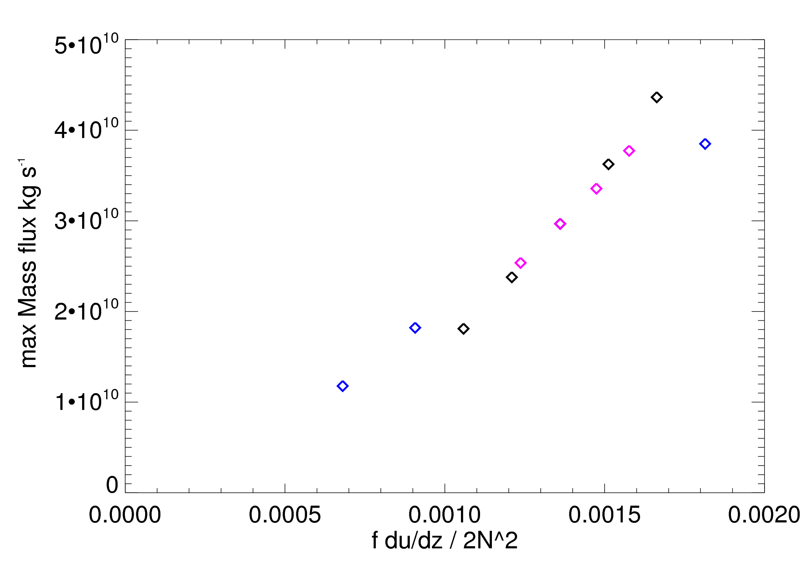
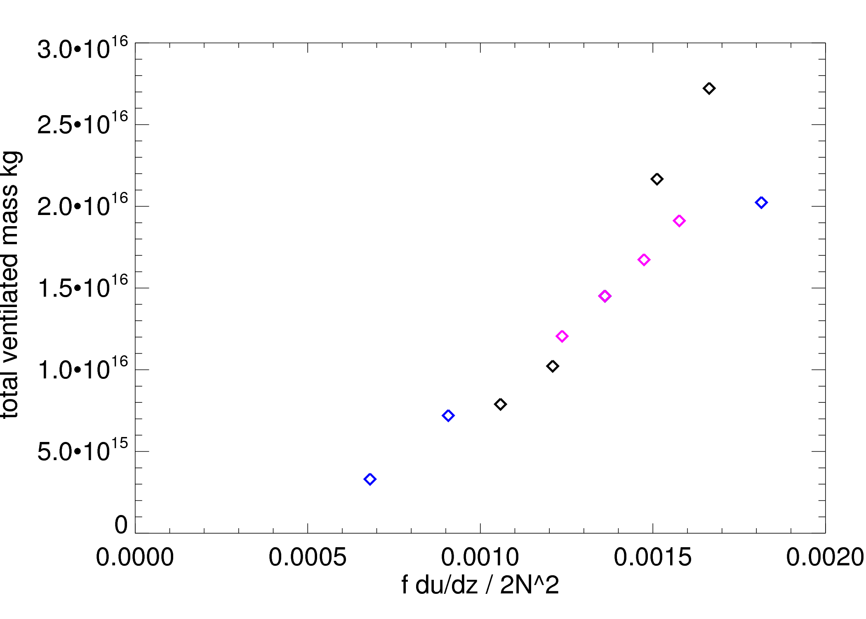
Mass fluxes
Maximum mass flux over the cyclones life cycle
Total mass fluxed out of the boundary layer
The maximum rate of ventilation and the total amount of ventilation are strongly correlated to the ascent predicted by the Quasi-Geostrophic omega equation

Slide 8
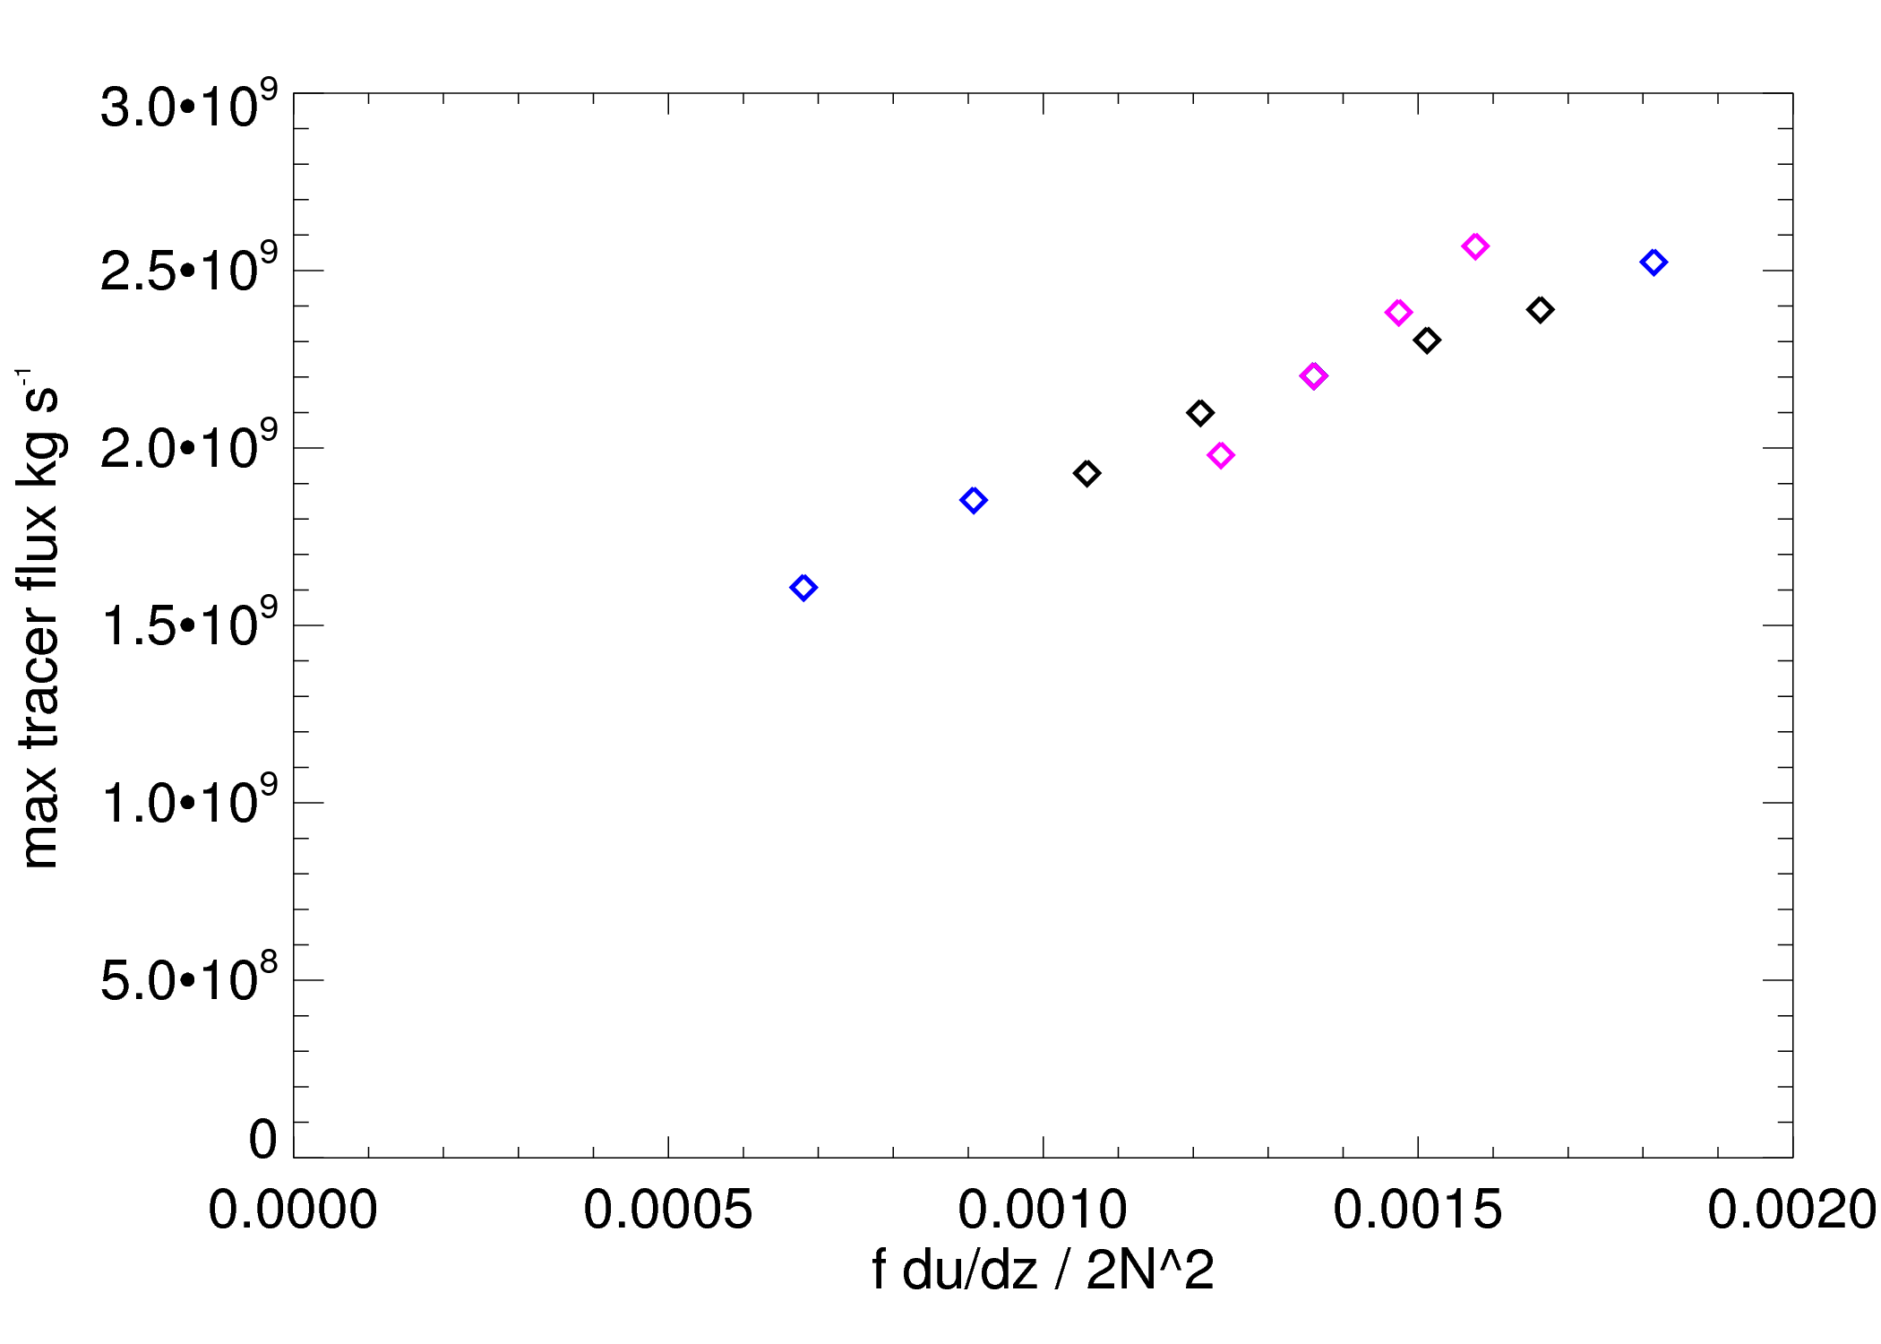
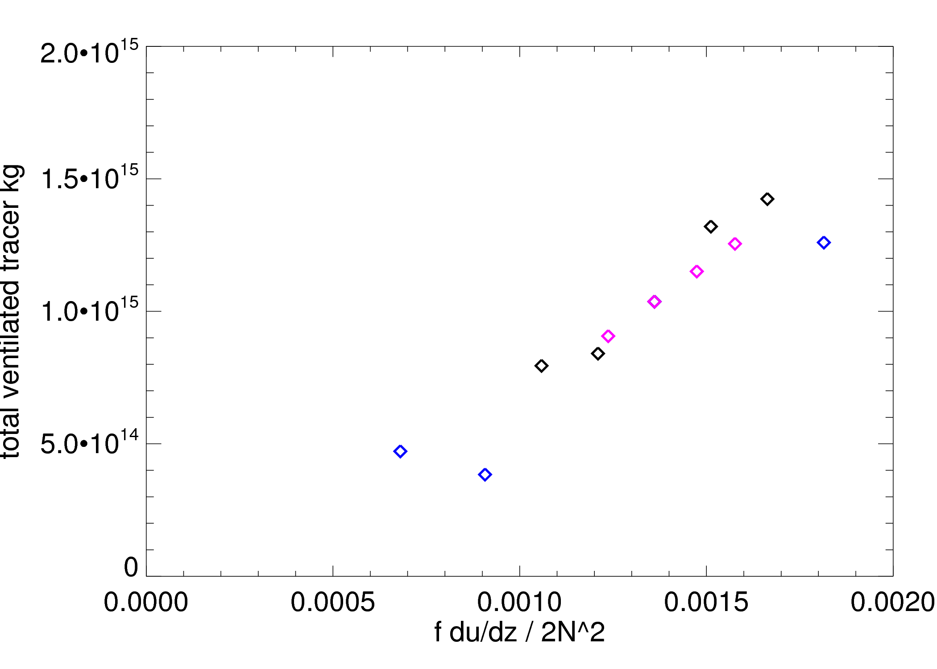
Tracer fluxes
Maximum tracer flux over the cyclones life cycle
Total tracer mass fluxed out of the boundary layer
Tracer may differ from mass as it is possible to run out of tracer, but not mass
Still see a strong linear relation
Mass can be used as a proxy for tracer

Slide 9
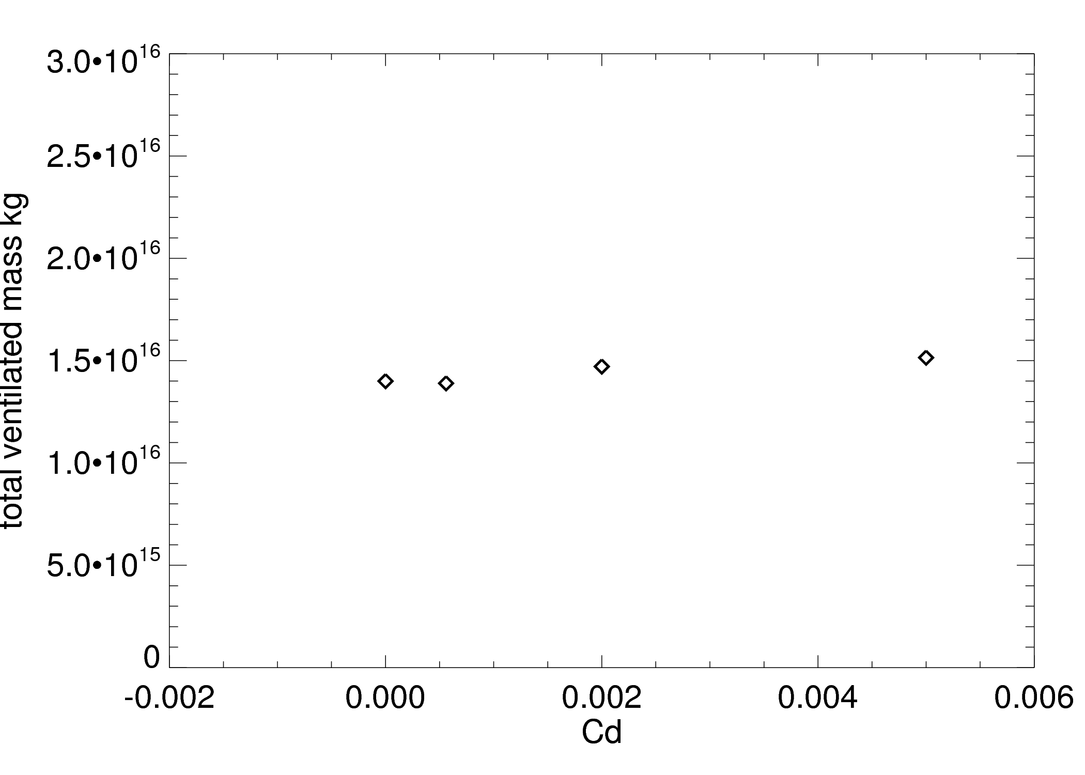
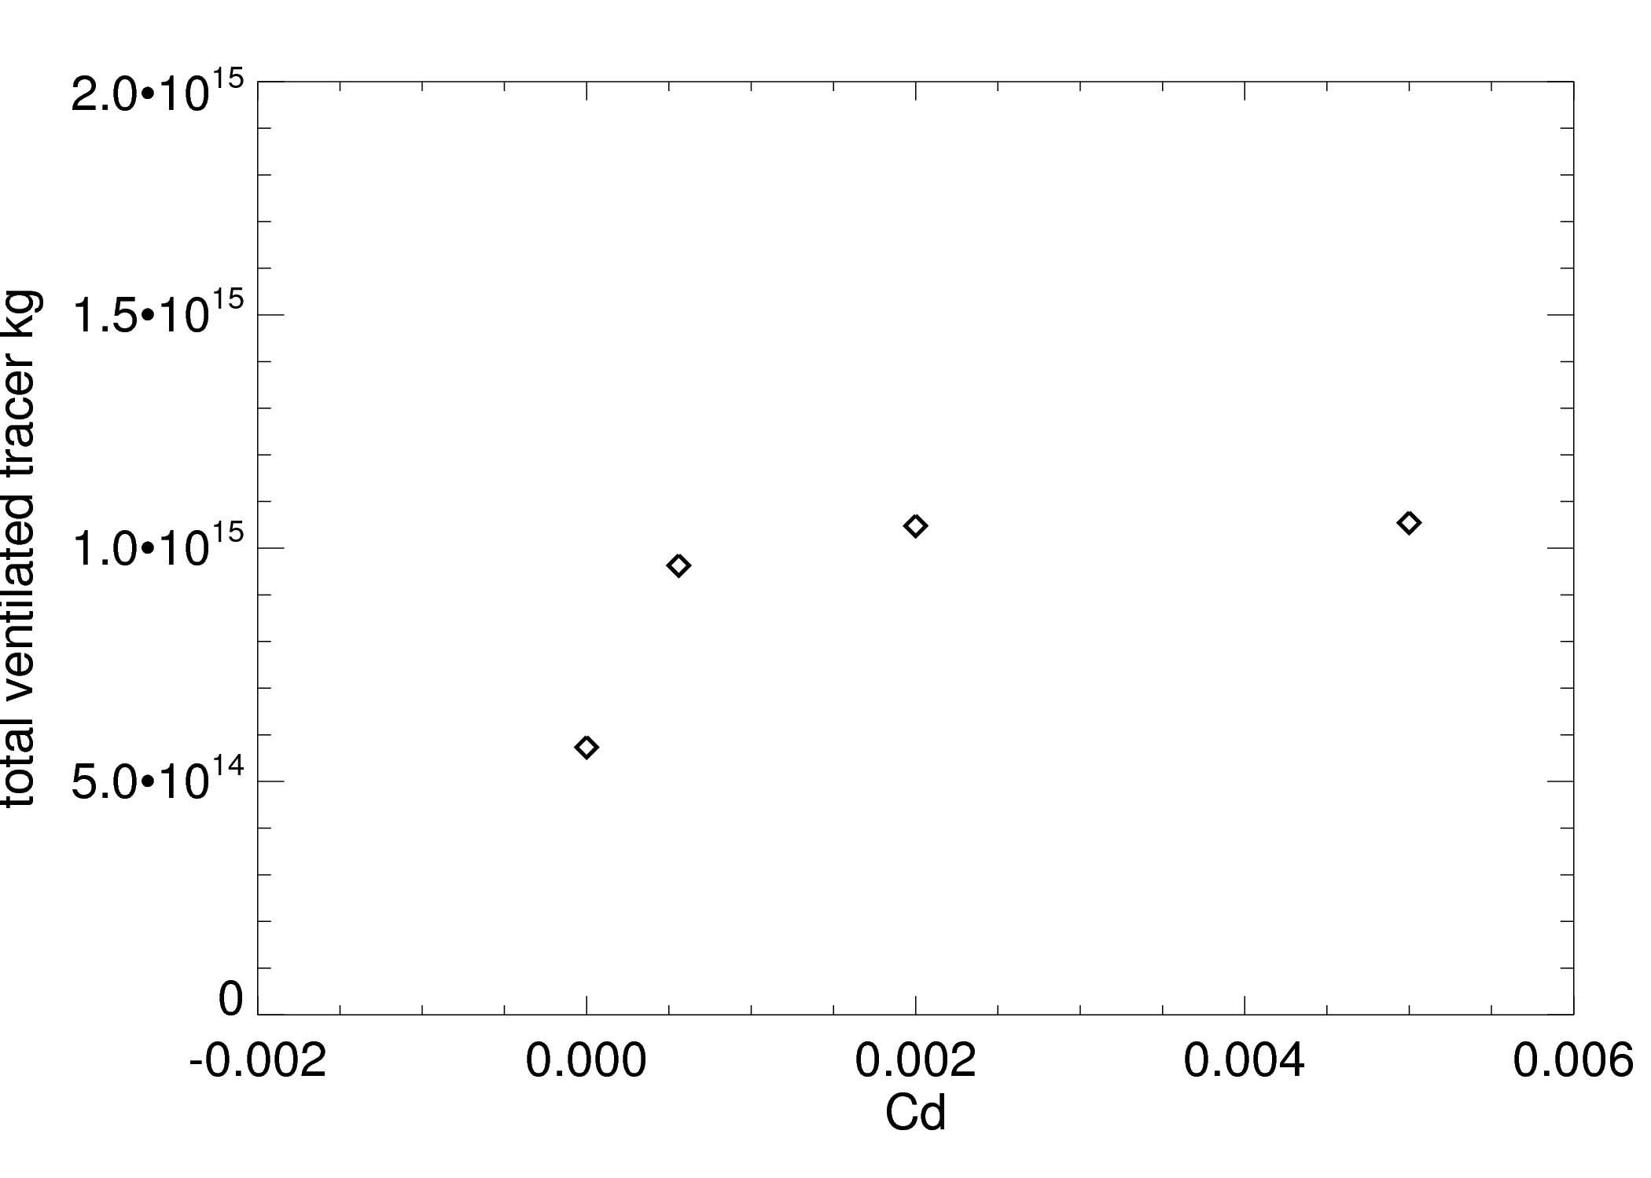
Effect of surface drag on ventilation
Surface type has little affect of the amount of mass ventilated out of the boundary layer
When no boundary layer acts, the tracer flux differs significantly to the mass flux.
Boundary layer transport processes are important

Slide 10
Conclusions
Quasi-Geostrophic theory does a good job at predicting the amount of boundary layer ventilation by cyclones
  Useful for climatology studies as these variables are commonly stored in datasets e.g. ERA-40
The surface type (ocean or land) has a much weaker effect on the amount of ventilation compared to variations in large-scale variables
However we can not neglect the boundary layer. When no surface drag was included results switched into a different mode of behaviour
  Hypothesis that without drag, tracer does not converge into the source regions within the boundary layer

Slide 11
Questions? v.a.sinclair@reading.ac.uk www.met.reading.ac.uk/~swr05vas

Slide 13

Pollution in the free troposphere
At upper levels particles affect the radiation budget
Chemical reactions are often strongly linked to temperature
Can be transported large distances
May 4th 2001
SeaWiFS, NASA

