Slide 1
Cosmology
Fall 2018

Slide 2
Cosmology
The course lasts for the fall term.
http://www.helsinki.fi/~syrasane/cosmo/
Lecturer Syksy Räsänen can be reached at syksy.rasanen@helsinki.fi.
Lectures on Saturdays 14.00-16.50.
Exercise sessions at a time to be agreed upon.
Homework problems appear on the website by Saturday 14.00. They are due at the following lecture.
  Late homework will not be accepted.
The grade is based 20% on exercises, 40% on midterm exam and 40% on final exam.

Slide 3
Content
Introduction
Basics of general relativity
Friedmann-Robertson-Walker (FRW) models
Thermal history of the universe
Big Bang nucleosynthesis (BBN)
Dark matter
Inflation

Slide 4
Observations: basics
Electromagnetic radiation
  Radio waves
  Microwaves
  IR
  Visible light
  UV
  X-Rays
  Gamma rays
Massive particles
  Cosmic rays (protons, antiprotons, heavy ions, electrons, antielectrons)
  Neutrinos
Gravitational waves (since 2015)
Composition of the solar system

Slide 5
Observations in practice
Motion of galaxies
Distribution of galaxies (large scale structure)
Abundances of light elements
Cosmic microwave background
Luminosities of distant supernovae
Number counts of galaxy clusters
Deformation of galaxy images (cosmic shear)
...

Slide 6
Laws of physics
General relativity
Quantum field theory
  Atomic physics, nuclear physics, Standard Model of particle physics, and beyond
Statistical physics and thermodynamics

Slide 7
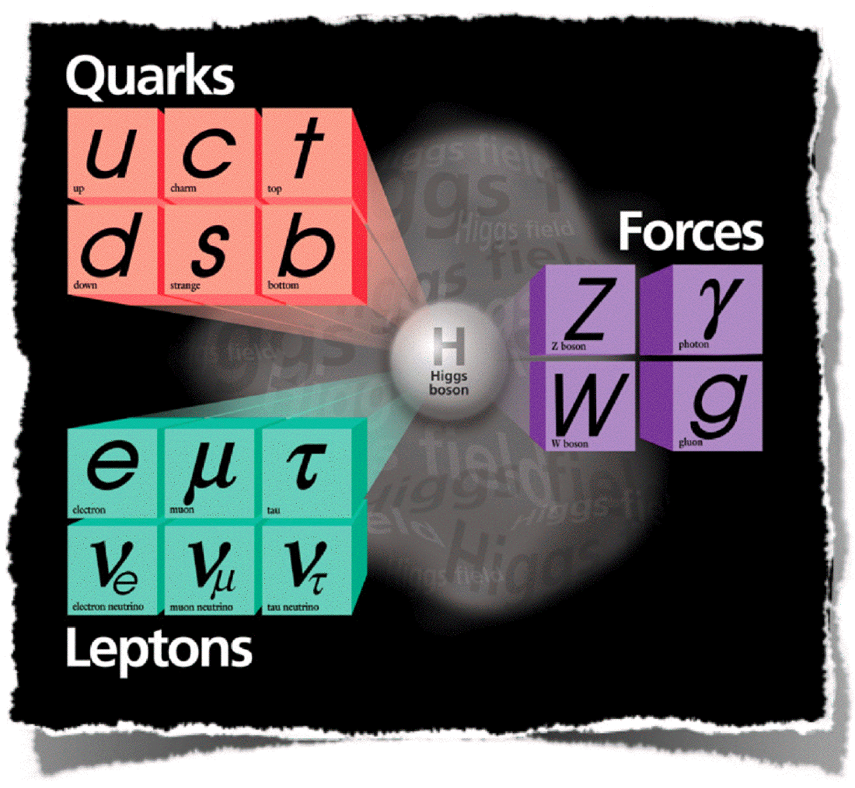
The Standard Model
Matter particles
Quarks and leptons (3 families)
Gauge bosons
Photon: EM interaction
Gluons (8): strong interaction
W⁺, W⁻, Z: weak interaction
Higgs boson
Gives masses to W, Z and fermions

Slide 8
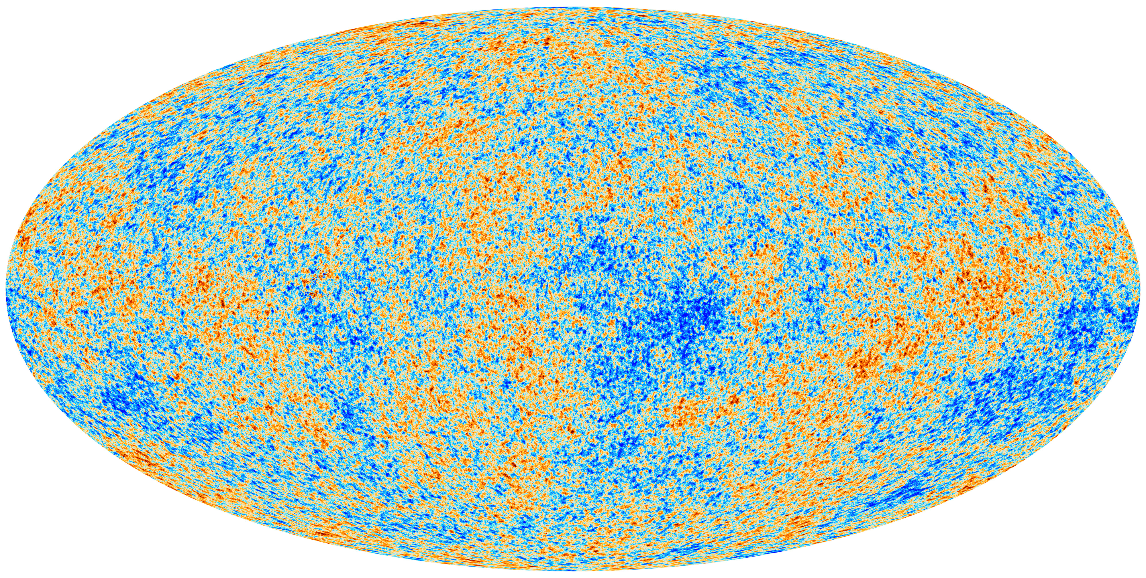
Homogeneity and isotropy: observations
http://sci.esa.int/planck/51553-cosmic-microwave-background-seen-by-planck/

Slide 9
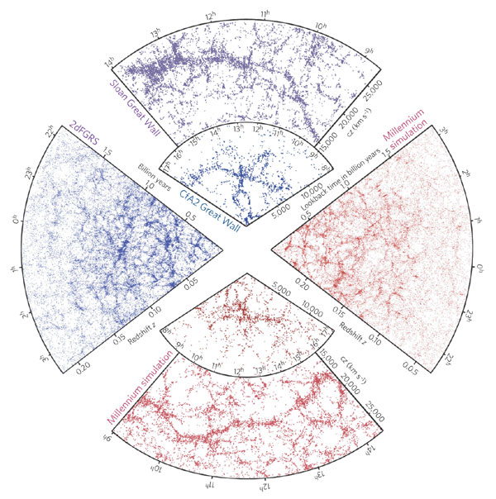
Homogeneity and isotropy: observations
arXiv:astro-ph/0604561

Slide 10
Homogeneity and isotropy: observations
http://arxiv.org/abs/1306.1700

Slide 11
Homogeneity and isotropy: theory
Observed statistical homogeneity and isotropy motivates theory with exact H&I: Friedmann-Robertson-Walker model
The expansion of the universe is described by the scale factor a(t)
Extrapolating the known laws of physics we find that 14 billion years ago
a → 0, ρ → ∞, T → ∞

Slide 12
The Big Bang
The early universe was
  Hot
  Dense
  Rapidly expanding
Homogeneity and isotropy plus thermal equilibrium
⇒ easy to calculate
High T ⇒ high energy ⇒ quantum field theory

Slide 13
Timeline of the universe
t (∝ E⁻²) E
14 Gyr 10⁻³ eV present day
8 Gyr 10⁻³ eV expansion accelerates (dark energy)
400 Myr 10⁻² eV reionisation
40 Myr 10⁻¹…10⁻² eV first structures form
380 000 yr 0.1 eV light and baryonic matter separate;
atoms and the CMB form
50 000 yr 1 eV matter overtakes radiation
3-30 min 0.1 MeV Big Bang Nucleosynthesis
1 s 1 MeV neutrino decoupling
10⁻⁵ s 100 MeV QCD transition (?)
10⁻¹¹ s 100 GeV electroweak transition (?)
10⁻¹³…10⁻³⁶ s 10³…10¹⁶ GeV baryogenesis?
10⁻¹³…10⁻³⁶ s 10³…10¹⁶ GeV inflation?
10⁻¹³…10⁻⁴² s 10³…10¹⁸ GeV quantum gravity?

Slide 14
Structure formation
CMB shows the initial conditions
  The early universe is exactly homogeneous except for small perturbations of 10⁻⁵
  Seeds of structure
Gravity is attractive
  ⇒ fluctuations grow into galaxies, clusters of galaxies, filaments, walls and voids, which form the large-scale structure of the universe

Slide 15
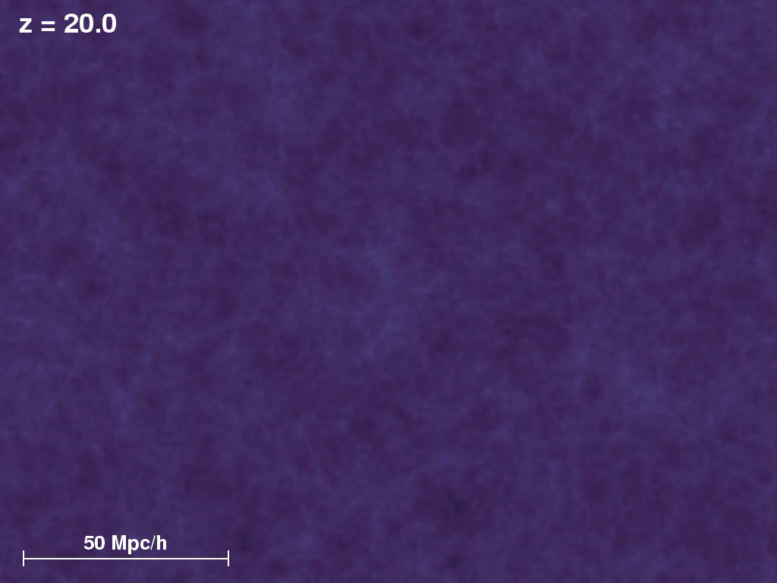
https://wwwmpa.mpa-garching.mpg.de/galform/virgo/millennium/#movies

Slide 16
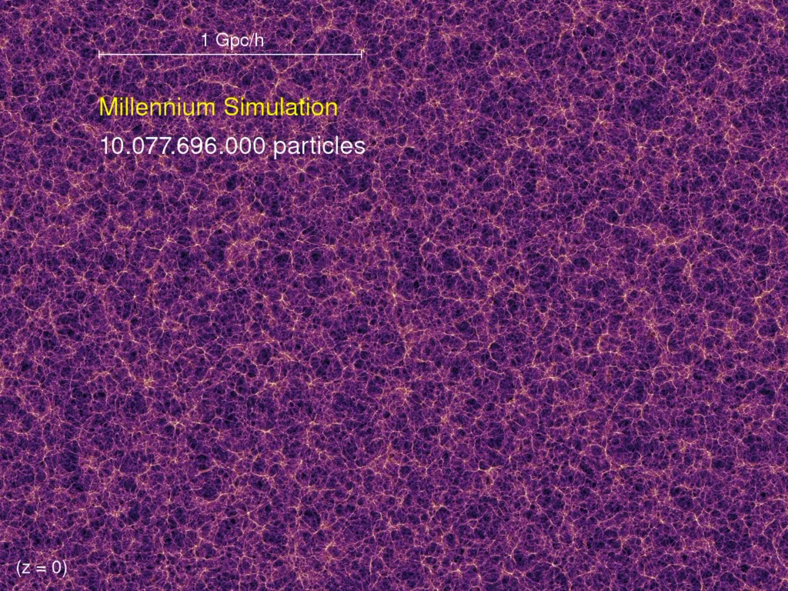
https://wwwmpa.mpa-garching.mpg.de/galform/data_vis/index.shtml

Slide 17
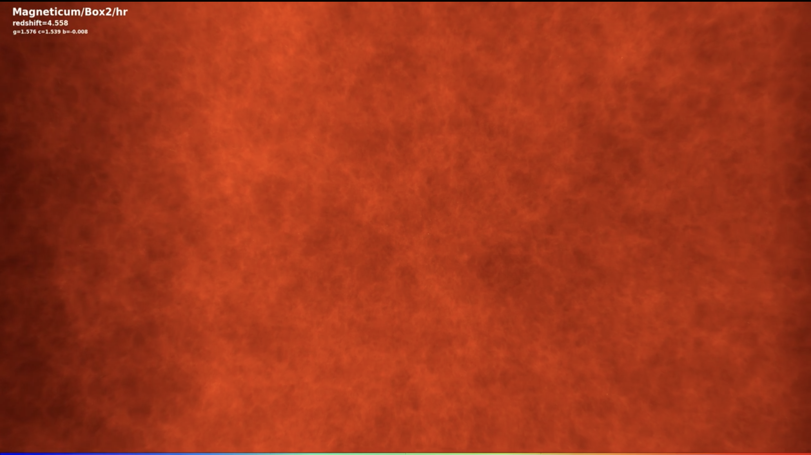
http://www.magneticum.org/media.html#MOVIES

Slide 18
Structure formation
Origin of fluctuations: inflation
  A period of accelerated expansion in the early universe
  Quantum fluctuations stretch and freeze
Growth of fluctuations
  Due to ordinary gravity
  Depends on the initial state plus the matter composition
  Baryonic matter is too smoothly distributed at last scattering

Slide 19
Dark matter
Luminous matter: stars, gas (plasma), dust
Large-scale structure, CMB anisotropies, motions of stars in galaxies, galaxies and gas in clusters, gravitational lensing, BBN, ...
⇒ there is invisible matter
Baryonic matter: cold and hot gas, brown dwarfs
However, the majority of matter (about 80%) is non-baryonic, either cold dark matter (CDM) or warm dark matter (WDM)
Neutralinos, technicolor dark matter, axions, right-handed neutrinos, ...

Slide 20
Dark energy
Exactly homogeneous and isotropic models with baryonic and dark matter don’t quite agree with the observations
Observed distances are longer and observed the expansion is faster than predicted by a factor of about 2.
Three possibilities:
  1) There is matter with negative pressure which makes the universe expand faster (dark energy)
  2) General relativity does not hold (modified gravity)
  3) The homogeneous and isotropic approximation is not good enough

Slide 21
Dark energy
Dark energy is the preferred option.
Dark energy:
  Has large negative pressure.
  Is smoothly distributed.
  Has an energy density about three times that of baryonic plus dark matter today.
The most natural candidate is vacuum energy.

Slide 22
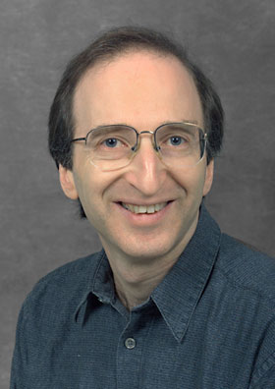


Physics Nobel prize 2011
“for the discovery of the accelerating expansion of the Universe through observations of distant supernovae”
Saul Perlmutter
Brian P. Schmidt
Adam G. Riess
“dark energy [...] is an enigma, perhaps the greatest in physics today”

