Slide 1
Univariate model
Karri Silventoinen
University of Helsinki
Osaka University

Slide 2
Univariate model in twin research
Univariate model offers information on the effects of genetic and environmental factors on one phenotype
In the historical context, the information produced by univariate models is very important
  For example, the effect of genetic factors on psychological and psychiatric traits
Currently only knowing the heritability of a trait is usually not a very interesting scientific question
  However there may be traits or populations where even this issue is still interesting
However, univariate modeling is the necessary first step in all genetic modeling
Univariate models give also useful information for molecular genetic (both linkage and association) studies
  How much there is genetic variation in the trait under study

Slide 3
Components of human variation
Additive genetic variation (A)
  Additive effects of alleles over all relevant loci
  Inherited from parents to offspring
Dominance genetic variation (D)
  Dominance of one allele over its pair (dominance)
  Interaction between different loci (epistasis)
  Genetic effect because of reshuffling of genes in offspring
Common environmental variation (C)
  All environmental factors which make family members similar
Specific environmental variation (E)
  All environmental factors which make individuals dissimilar
  Epigenetic heritability
  Measurement error is included in this part of variation in simple models

Slide 4
Model specification
Structural equation modeling (SEM) is not the only but in many way superior method for genetic twin studies
  The advantages are seen especially in complex modeling
We need someway to describe the SEM model for the computer
First, we can define paths
  The logic is easy to understand intuitively, because it is based on graphical model
  However, complex models include a lot of paths and defining all of them can be very time consuming
  Also easy to make errors
Second, we can present the model using matrix algebra
  Expected variance-covariance matrixes are defined using the rules of path analyses
  Calculating them is not easy especially for complex models
  Fortunately variance-covariance matrixes are readily available for many twin models
  Working with the model is convenient when first specified
OpenMx allows both methods
  Usually matrix algebra is used because it offers many benefits
  Also in these lectures we follow this method

Slide 5
Path Diagram Conventions
Observed Variable
Latent Variable
Causal Path
Covariance Path

Slide 6
Genetic twin model for one trait
ACE model
1
1 / 0.5
1
1
1
1
1
1
A
C
E
A
C
E
c
c
a
e
a
e
BMI_{TWIN1}
BMI_{TWIN2}

Slide 7
Model specification
We need to specify the expected variance-covariance matrix for a twin pair
This can be done by using the rules of path analyses
Variance-covariance matrixes differ for MZ and DZ twins
This is important because it allows us to define more parameters than in normal SEM modeling
Pay attention that we use the same variance parameters for MZ and DZ twins
  Variances are the same for MZ and DZ twins as well as first and second co-twin
  These are important assumptions behind twin modeling

Slide 8
Rules of path analyses
Path analysis allows us to present the linear relationships between variables in diagrams and to derive predictions for the variances and covariances of the variables under the specified model
(i) Trace backward, then forward, or simply forward from one variable to another. NEVER forward then backward! Include double-headed arrows from the independent variables to itself. These variances will be 1 for latent variables
(i) Loops are not allowed, i.e. we can not trace twice through the same variable
(iii) There is a maximum of one curved arrow per path. So, the double-headed arrow from the independent variable to itself is included, unless the chain includes another double-headed arrow (e.g. a correlation path)

Slide 9
Genetic twin model for one trait
ACE model
1
1 / 0.5
1
1
1
1
1
1
A
C
E
A
C
E
c
c
a
e
a
e
BMI_{TWIN1}
BMI_{TWIN2}

Slide 10
Expected variance-covariance matrixes for MZ and DZ twins
 | Twin 1 | Twin 2
Twin 1 | a²+c²+e² | a²+c²
Twin 2 | a²+c² | a²+c²+e²
 | Twin 1 | Twin 2
Twin 1 | a²+c²+e² | 0.5*a²+c²
Twin 2 | 0.5*a²+c² | a²+c²+e²
MZ twins
DZ twins

Slide 11
What is OpenMx
OpenMx is a package in R
So it can take use of all features of R
However it includes several functions very useful for genetic twin modeling
You can get information on any OpenMx function by command help
  Example: help(mxAlgebra)
Writing scripts for genetic twin modeling can be quite complicated and OpenMx is not an exception
However, there are scripts available for many different models
Scripts need to be modified for the current purpose
  Needs good understanding of the syntax
  One of the major aims of this course

Slide 12
Essential OpenMx functions
mxData
  Creates a data object
  Can be raw data or covariance or correlation matrix
mxMatrix()
  Creates a matrix object
mxAlgebra()
  Creates a matrix algebra object using matrix objects already created
mxModel()
  Creates a model object including matrixes, matrix algebra and data objects
mxExpectationNormal()
  Defines the way that model expectations are calculated
  Multinomial normal distribution expected
mxFitFunctionML()
  Computes -2 log likelihood of the data given the best fitting values of the free parameters
mxRun()
  Execute the model

Slide 13
mxMatrix function
free
  Default is that all parameters are fixed (=F) but you can free them (=T)
  Creates automatically a matrix of the same size, but you can also manually define the matrix (some parameters can be fixed and some free)
lbound=, ubound=
  In the case of free parameters, you can estimate the limits for the estimated parameters
label
  You can give a label for each parameter
  If the same label is used for two parameters, they are fixed to be the same
  Important way to create sub-models!
values
  Give the values of the fixed parameters and starting values for the free parameters
  Creates automatically a matrix of the same size, but you can also manually give values for each parameter
name
  Name for the object
  Can be same or different than the created object
  Use of mxMatrix objects in an mxAlgebra or mxConstraint function requires reference by name

Slide 14
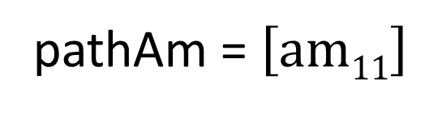
New object
Matrix type
All parameters
are free
Names of parameters
pathAm <- mxMatrix(type="Full", nrow=nv, ncol=nv, free=TRUE, values=7, label="am11", name="am")
Matrix function
Number of rows and columns
We have defined earlier that nv=1
Starting values of parameters
Name of object
pathAm = $\left[am11\right]$

Slide 15
mxAlgebra function
mxAlgebra function is a way to make matrix algebra calculations by OpenMx
It is used to create algebraic expressions that operate on one or more MxMatrix objects
You can find all matrix algebra operators and functions by typing help(mxAlgebra)
We now take a look to matrix multiplication
  Number of columns of the first matrix must be equal the number of rows of the second matrix
  Product will have as many rows as the first matrix and as many columns as the second matrix
  OpenMx symbol %*%
For exercise we will multiply the matrix A we just created by itself
  In Cholesky decomposition this method is used to square path coefficients, i.e., to calculate raw variances and co-variances

Slide 16
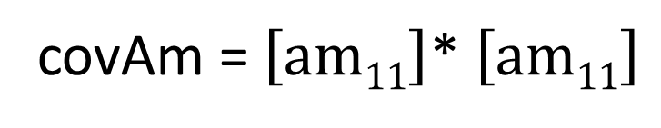
Multiply matrix a by its transposition
New object
covAm <- mxAlgebra (expression=am %*% t(am), name="Am")
Matrix algebra function
Name of object
covAm = $\left[am11\right]$* $\left[am11\right]$

Slide 17
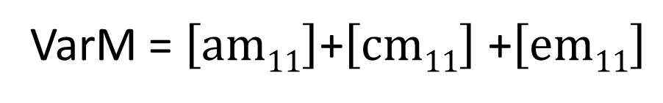
Add three matrixes together
New object
VarM <- mxAlgebra (expression= Am+Cm+Em, name="Vm")
Matrix algebra function
Name of object
VarM = $\left[am11\right]$+$\left[cm11\right]$ +$\left[em11\right]$

Slide 18
New object
Combine rows
Kroneker product
CovDZM <- mxAlgebra( expression= rbind( cbind(Vm, 0.5%x%Am+Cm),
cbind(0.5%x%Am+Cm, Vm)), name="expCovDZM" )
Name of object
Combine columns
Names of matrixes created above

Slide 19
Kroneker product
In the previous slide we used Kroneker product
It multiplies all elements of one matrix by all elements of another matrix
In twin modeling we use Kroneker product when we want to make sure that all elements are multiplied by one matrix or number
In the previous equation all elements in matrix “Am” are multiplied by 0.5
Since matrix Am has only one parameter, we could do it also by using matrix multiplication
However now this same argument can be used also for Cholesky decomposition

Slide 20
pathAm <- mxMatrix(type="Full", nrow=nv, ncol=nv, free=TRUE, values=7, label="am11", name="am")
pathCm <- mxMatrix(type="Full", nrow=nv, ncol=nv, free=TRUE, values=7, label="cm11", name="cm")
pathEm <- mxMatrix(type="Full", nrow=nv, ncol=nv, free=TRUE, values=7, label="em11", name="em")
covAm <- mxAlgebra (expression=am %*% t(am), name="Am")
covCm <- mxAlgebra (expression=cm %*% t(cm), name="Cm")
covEm <- mxAlgebra (expression=em %*% t(em), name="Em")
VarM <- mxAlgebra (expression= Am+Cm+Em, name="Vm")
CovMZM <- mxAlgebra( expression= rbind( cbind(Vm, Am+Cm),
cbind(Am+Cm, Vm)), name="expCovMZM" )
CovDZM <- mxAlgebra( expression= rbind( cbind(Vm, 0.5%x%Am+Cm),
cbind(0.5%x%Am+Cm, Vm)), name="expCovDZM" )

Slide 21
Defining variance-covariance matrixes
These command lines are used to define expected variance-covariance matrixes for MZ and DZ twins
First three 1*1 matrixes are created to include a, c and e path coefficients in the figure
Then they are multiplied by themselves to create variance components
Then these variance components are added together to calculate total variance
Finally these variance components are used to create the expected variance-covariance matrixes in the above table

Slide 22
Defining means
In addition to variances, we need to define also means
This allows to take into account differences, for example, between sexes or zygosities
  Twin modeling expects only same variances in MZ and DZ twins, but means can also differ
If the same labels are used, then all mean parameters are forced to be the same
Using different labels allows estimation of different mean parameters
  This is seen in d.f. and number of estimated parameters

Slide 23
Number of rows and columns
We have defined earlier that ntv=2
Matrix algebra function
New object
Matrix type
meanMZM <- mxMatrix( type="Full", nrow=1, ncol=ntv, free=TRUE, values=c(0,0), labels=c("meanM","meanM"), name="expMeanMZM" )
Starting values
Labels
Same mean is expected for first and second twin
Name of the object

Slide 24
Reading data
We have now told OpenMx the expected variance-covariance matrix for MZ and DZ twins
However before that we have needed to read data into the OpenMx
This can be done using ASCII data or by using foreign package, for example, Stata format
Different data files will be created for each sex and zygosity groups
These data files will be then made OpenMx data files using mxData function

Slide 25
Fitting model
When we have read the data and defined variance-covariance and mean structures, we need to create a model
  mxModel function
Model parameters are estimated in a way that it minimizes maximum likelihood function
The model will be estimated using maximum likelihood estimator
  mxFitFunctionML function
Finally the model will be run
  mxRun function

Slide 26
Defines the expected covariance and means under the assumption of multivariate normality
objMZM <- mxExpectationNormal( covariance="expCovMZM", means="expMeanMZM", dimnames=selVars )
Creates a list including these elements which can be used later
pars <- list( pathAm, pathCm, pathEm, covAm, covCm, covEm, VarM)
Optimizes free parameter values such that the value of a cost function is minimized using maximum likelihood estimator
fitFunction <- mxFitFunctionML()
modelMZM <- mxModel( pars, meanMZM, CovMZM, dataMZM, objMZM, fitFunction, name="MZM" )
Creates the model including parameters, observed data and method to estimate free parameters

Slide 27
Exercise
Run the script “ACE univariate model.R”
What are path coefficients, raw variance components and standardized variances?
Try to modify the model for females and different age groups

Slide 28
Exercise data
FinnTwin16- data
Questionnaires at 16, 17, 18 ½ and, on average, 25 years of age
Zygosity
  1=MZ females, 2=MZ males, 3=DZ females, 4=DZ males and 5=opposite sex twins
Sex
  0=male, 1=female
ASCII data (code for missing values -99
  R can read also other formats using library(foreign) package
Self reported BMI and waist circumference
Physical activity (MET)
Need to be in wide format i.e. one pair per line

Slide 29
FinnTwin 16
Time line
Monthly contact 1991-1995 in month after 16th birthday
Monthly contact 1992-1996 in month after 17th birthday
Quarterly contact on average 6 months after 18th birthday
Twin Q. Age 16
Twin Q. Age 17
Twin Q. Age 18.5
Twin Q. Age 23-25
2371 men
2569 women
Response rate 88%
2200 men
2510 women
Response rate 90%
2180 men
2493 women
Response rate 95%
1924 men
2346 women
Response rate 88%

Slide 30
Condifence intervals
We can calculate also confidence intervals for parameters
  mxCI function
  Name is needed for those parameters for which CIs are calculated
  Default is 95% confidence intervals
CIs are calculated using maximum likelihood estimation
Intervals are not necessarily symmetric
  However non-symmetric CIs may indicate problems in model fitting
Estimation of confidence intervals based on maximum likelihood estimation is computationally very demanding
In large data sets or in complex models calculating CIs can take a lot of time
  Can takes hours, days or even weeks
Usually better first to estimate model without CIs and only in the final model estimate them

Slide 31
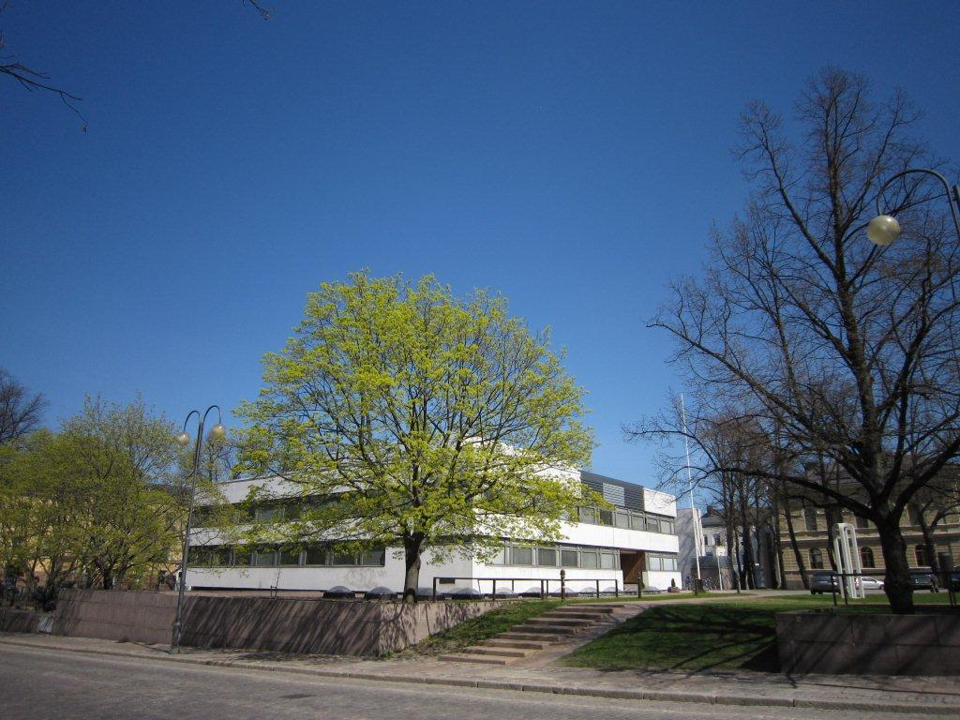
Population Research Unit
Department of Social Research
University of Helsinki

