Slide 1
Sub-models and sex-limitation model
Karri Silventoinen
University of Helsinki
Osaka University

Slide 2
Testing sub-models
Such as in all statistical modeling, also in twin modeling testing sub-models is important
Basically we want to test the probability that the value in the basic population is zero and we find the estimate only because of random
  Called as Type 1 error and measured as p-value
Different fit indexes can be used to test this
However, statistically non-significant value can also be because of small sample size
  Type 2 error
  Can be tested as power calculations
Especially separating common environmental effect from additive genetic effect needs large sample sizes
  This may be one reason why in many studies it is not detected
  In this case, using the most parsimonious model may lead to wrong conclusions

Slide 3
Nested and parallel models
When comparing models, it is important to make distinction between nested and parallel models
Two models are nested if one model includes all parameters of another model
  For example AE model is a nested model to ACE model
  In this case we can compare -2LL statistics
  The change follows χ²-distribution by the change of degrees of freedom
  Thus it is possible to calculate the statistical significance of the change
Two models are parallel if they include different parameters
  For example ACE and ADE models are parallel
  Akaike information criterion (AIC) or Bayesian information criterion can be used
  Smaller value indicate better fit of the model

Slide 4
Fixed and free parameters
Essential feature in matrixes is that the parameters can be free of fixed
In some type of matrixes only some of the parameters can be free and some are always fixed as zeros
  More about matrix algebra tomorrow
Fixed parameters are numbers and they cannot be changed
Free parameters are estimated in a way that the model best fits to the data
By fixing parameters, we can create submodels
The model having a fewer number of free parameters is called as a more parsimonious model
The base of all statistical modeling

Slide 5
Fixing parameters
omxSetParameters function can be used to modify the parameters of the model
So we create a new model without need to specify all parameters again
For example it can fix free parameters or give new labels
For example this function can be used to create AE sub-model
  Fix a free parameter C to be 0

Slide 6
Making nested model
Parameter
we want to modify
Model object
Modifies the attributes of parameters in a model
AEModel <- omxSetParameters( AEModel, labels="cm11", free=FALSE, values=0 )
Fix the parameter vale to be zero

Slide 7
Number of non-missing BMI values
A, C and E variance components and one mean parameter
observed statistics: 1386
estimated parameters: 4
degrees of freedom: 1382
-2 log likelihood: 5841.18
number of observations: 726
Information Criteria:
| df Penalty | Parameters Penalty | Sample-Size Adjusted
AIC: 3077.180 5849.18 NA
BIC: -3262.814 5867.53 5854.829
Observed statistics – estimated parameters
Number of twin pairs
-2LL+2*parameters
-2LL+parameters*ln(number of observations

Slide 8
Exercise
Take script “ACE univariate model.R”
Modify the model in a way that it calculates AE submodel
How to interpret the results?
Now modify the script in a way that you calculate ADE model instead
How to compare the fit of ACE and ADE models?

Slide 9
Genetic twin model for one trait
ADE model
1/0.25
1 / 0.5
1
1
1
1
1
A
D
E
A
D
E
c
c
a
e
a
e
BMI_{TWIN1}
BMI_{TWIN2}

Slide 10
Testing sex differences
In many cases we want to study sex differences in variance components
  Even if means differ between males and females, variance components may still be similar
In practice we force variance components to be the same in males and females and test -2LL values
  This model is a sub-model to the model having separate estimates for males and females
  In practice we give the parameters of path coefficients the same names for males and females thus forcing them to be the same
This question is interesting by itself
Also if we are able to fix variance components to be same, we save a lot of statistical power
This would allow to study more detailed questions with stronger statistical power

Slide 11
eqSexAceModel <- omxSetParameters( eqSexAceModel, label="am11", free=TRUE, values=7, newlabels="a11")
eqSexAceModel <- omxSetParameters( eqSexAceModel, label="cm11", free=TRUE, values=7, newlabels="c11")
eqSexAceModel <- omxSetParameters( eqSexAceModel, label="em11", free=TRUE, values=7, newlabels="e11")
eqSexAceModel <- omxSetParameters( eqSexAceModel, label="af11", free=TRUE, values=7, newlabels="a11")
eqSexAceModel <- omxSetParameters( eqSexAceModel, label="cf11", free=TRUE, values=7, newlabels="c11")
eqSexAceModel <- omxSetParameters( eqSexAceModel, label="ef11", free=TRUE, values=7, newlabels="e11")

Slide 12
Sex-limitation model
As mentioned, it is possible to test whether the size of genetic and environmental variations is similar in men and women only by using same sex pairs
However, this does not answer to the question whether there are the same genes affecting the trait in men and women
If we have information on opposite-sex twin pairs, we can study sex-specific genetic component
In practice we test whether the correlation of OSDZ twins is less than for SSDZ twins
We let OpenMx to estimate this correlation freely
  So the expected variance-covariance matrixes are different for SSDZ and OSDZ twins
Then we can fix this parameter to be 0.5 to see what is the effect for -2LL
  This is a sub model for the sex-limitation model
Usually we think that possible sex-specific effect is genetic, but it can also be common environmental
  In practice this is rarely tested because common environmental effects are usually much weaker than genetic effects

Slide 13
Opposite-sex DZ twins
0.5
A_{m}
A
E
A
E
Twin_{male}
Twin_{female}

Slide 14
Same-sex DZ twins
1 / 0.5
1 / 0.5
A_{m}
A
E
A_{m}
A
E
Twin_{male}
Twin_{male}

Slide 15
rados <- mxMatrix(type="Full", nrow=1, ncol=1, free=TRUE, values=0.5, label="rados", lbound=-1, ubound=1, name="ra")
This is a freely estimated parameter we have defined here
CovDOSFM <- mxAlgebra( expression= rbind( cbind(Vf, ((ra%x%(af%*%t(am)))+(cf%*%t(cm)))),
cbind((ra%x%(am%*%t(af))+(cm%*%t(cf))), Vm)), name="expCovDOSFM" )

Slide 16
ACEnosexModel <- omxSetParameters(ACEnosexModel, labels="rados", free=FALSE, values=0.5 )

Slide 17
Exercise
Study first parameter estimates for males and females by fixing them
Is there difference in these estimates between males and females?
Try next to drop a sex specific genetic effect
Is there evidence on sex specific genetic effect?
What is the best model?

Slide 18
Testing proportions of the variance components
In the previous models only the equality of the variance components was tested
However males and females may have different variances but still the proportions (heritability) can be similar
This may easily happen for example for anthropometric traits if the variance is higher in males due to higher mean values

Slide 19
mxConstraint function
The mxConstraint function defines relationships between mxAlgebra or mxMatrix objects
So it is possible to fix the value of two objects defined by mxAlgebra function to be similar in the model

Slide 20
Exercise
Run the script “Sex limitation model stanest.R”
Does fixing the heritability estimates for males and females decrease the fit of the models

Slide 21
Interpretation of the results
As you can see, even when the fit is poorer the number of estimated parameters is the same as in full sex-limitation model
However we can also consider that we lose only one degree of freedom because only sex difference is related to the scale of variance
So the results are not so straightforward as when testing the equality of variance components

Slide 22
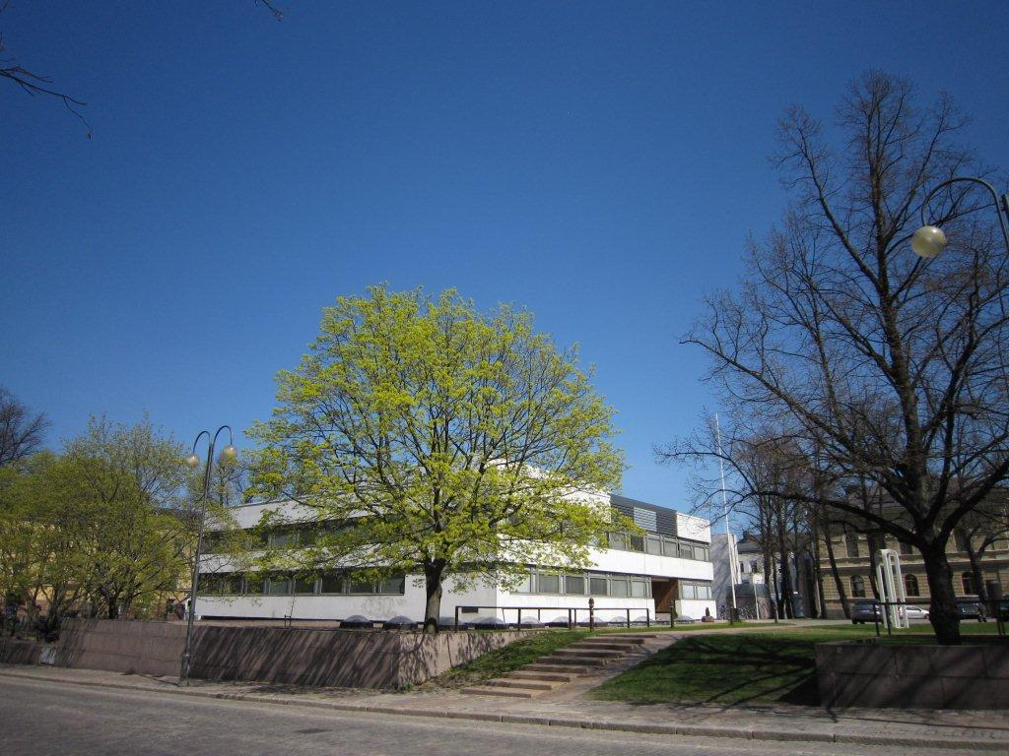
Population Research Unit
Department of Social Research
University of Helsinki

