Slide 1
Genetic modeling using twin and family data
Helsinki May 25th-29th 2015

Slide 2
Install OpenMx
You need to install the latest version of OpenMx (version 2.0.1)
source('http://openmx.psyc.virginia.edu/getOpenMx.R')
It includes new functions and thus exercises in this course do not work in older OpenMx versions!

Slide 3
Course material
All course material is available in internet
http://www.mv.helsinki.fi/home/silvento/Genetic_twin_modeling/
Data files may be someway modified and so not suitable for any research purposes
Data files will be deleted after this course

Slide 4
First exercise
Download file ACE univariate model.R from the folder Silventoinen
Do you get it work?
This script will be used in the practical afternoon

Slide 5
Resources in internet
OpenMx homepage
  http://openmx.psyc.virginia.edu/
Beginners Guide to OpenMx
  http://www.vipbg.vcu.edu/~hmaes/OpenMx/html/NewBeginnersGuide.html
Introduction to R
  http://faculty.washington.edu/tlumley/Rcourse/
R-homepage
  http://www.r-project.org/
Boulder Twin Course
  https://ibg.colorado.edu/dokuwiki/doku.php?id=workshop:start

Slide 6
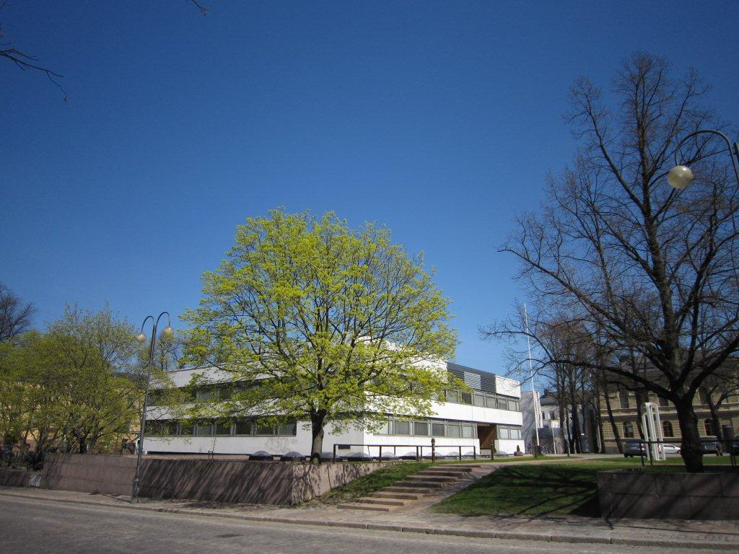
Population Research Unit
Department of Social Research
University of Helsinki

