Slide 1
Twin Studies in the ERA OF MOLECULAR GENETICS
JAAKKO KAPRIO
MD PhD, Professor in Genetic Epidemiology
Hjelt institute, dept of public health,
university of helsinki
Institute for Molecular Medicine (FIMM),
University of Helsinki
National Institute for Health & Welfare, Helsinki, Finland

Slide 2
Characteristics of complex traits and behaviors
Trait values are determined by complex interactions among numerous metabolic and physiological systems, as well as demographic and lifestyle factors
Variation in a large number of genes can potentially influence interindividual variation of trait values
The impact of any one gene is likely to be small to moderate in size
In the past 8 years, our knowledge of molecular genetics has expanded and we have an enormous amount of reported gene-trait associations (https://www.ebi.ac.uk/gwas/)
Our knowledge of the impact of genetic variation in different contexts is much more limited

Slide 3
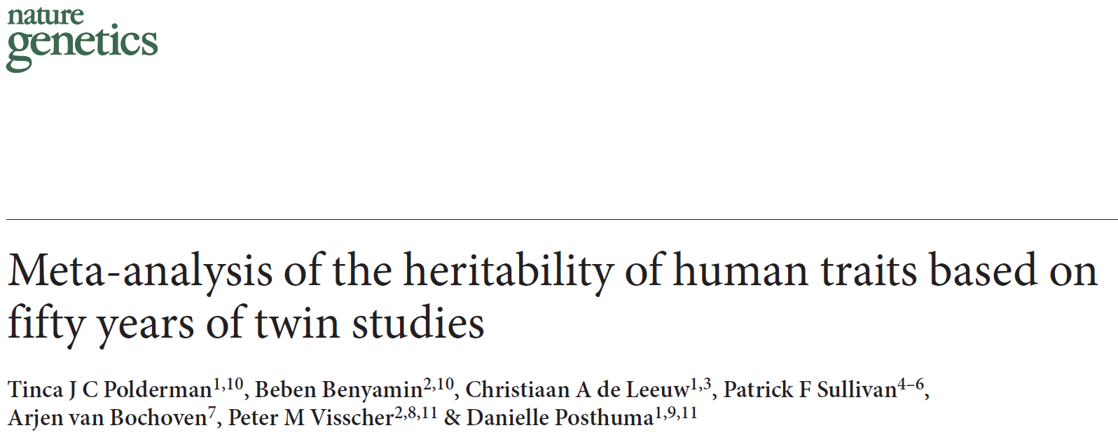
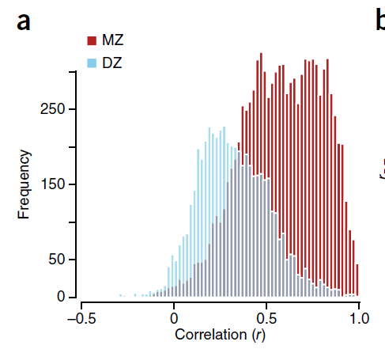
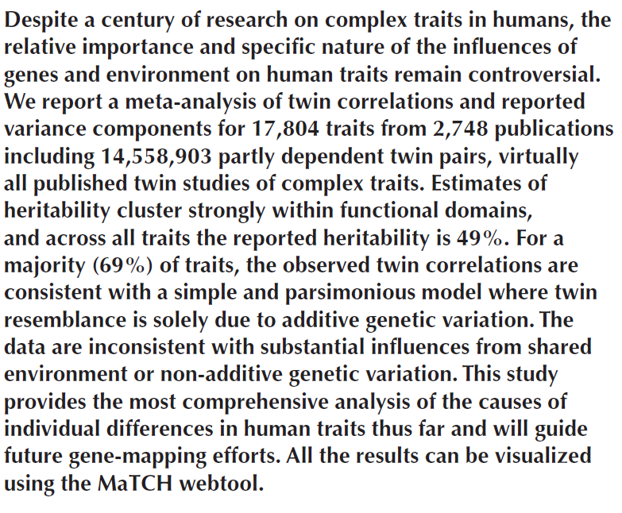

Slide 4
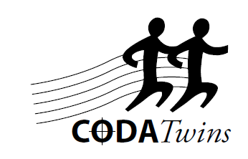
CODATwins project
Exploring macro-environmental variation in genetic and environmental effects
CODATwins Study Group
PI Karri Silventoinen

Slide 5
Heritability estimates and environment
“Heritability estimates are not constant but are dependent on environment”.
Surprisingly little is, however, known about the variation of heritability estimates between populations
What is the range of variation of heritability estimates?
Is there systematic patters of heritability estimates between populations?
Which factors explain the differences of heritability estimates?

Slide 6
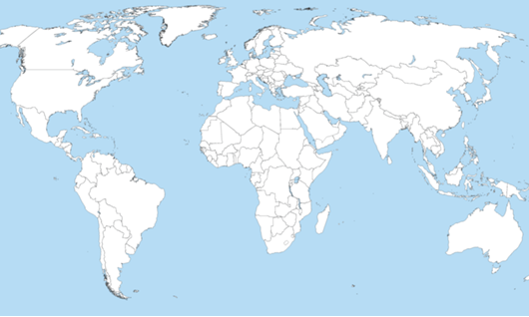
53 twin cohorts participate in the CODATwins project Database has 749,172 height and BMI measurements from age 1 to 99 years.

Slide 7
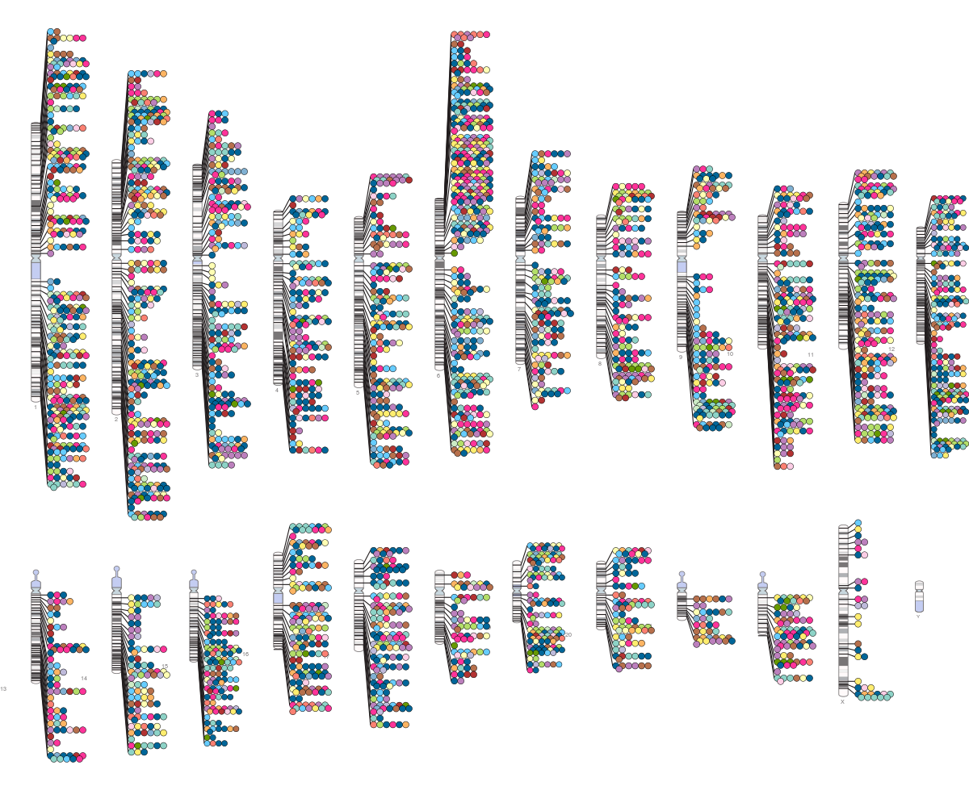
SNP-trait associations with p-value ≤ 5.0 × 10-8, published in the GWAS catalogue (http://www.genome.gov/gwastudies) up to the end of May 2014.

Slide 8
Using these findings
Identify biological mechanisms
Use associations to estimate what fraction of the variance is due to identified SNPs
Genome-wide significant snps
All measured snps (SNP heritability)
Compute Polygenic risk scores
Measures inherited liability to the trait
Use in gene-environment interaction analyses and Mendelian randomization analyses
Power issues
The environment is often not measured or poorly so

Slide 9
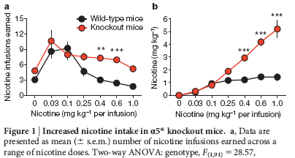
Smoking GWAS strongest finding: The CHRNA5 variant is functional
The CHRNA5 SNP
Accounts for 1% of the variance in cigarettes per day
but 4-5% of the variance in serum cotinine levels (Keskitalo et al, 2009, Munafo et al, 2012)
Associated with lung cancer in smokers only
Results in an amino acid change in the α5 subunit , D398N
The high risk α5 Asn 398 is associated with reduced permeability of Ca²⁺ et desensitises faster than the wildtype variant Asp 398(α4β2)₂ of α5 (Kuryatov 2011)
 | Genotype of rs1051730
 | GG | GT | TT
Cigarettes per day | 10.1 | 11.2 | 12.2
N | 5956 | 6287 | 1702
Fowler et al,
Nature 2011
Kuryatov, A., Berrettini, W. & Lindstrom, J. Acetylcholine receptor (AChR) a5 subunit variant associated with risk for nicotine dependence and lung cancer reduces (a4b2)2a5 AChR function. Mol. Pharmacol. 79, 119–125 (2011).
Nees et al. Genetic risk for nicotine dependence in the cholinergic system and activation of the brain reward system in healthy adolescents. Neuropsychopharmacology. 2013 Oct;38(11):2081-9.

Slide 10
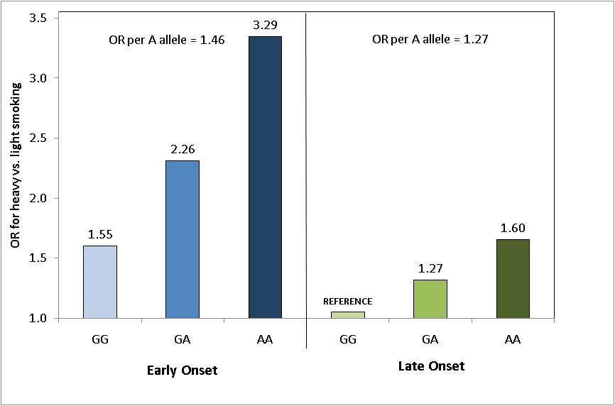
Meta-analysis of association between rs16969968 genotype and heavy (CPD > 20) vs. light (CPD ≤ 10) smoking, stratified by early-onset (onset ≤ 16) and late onset (onset > 16) smoking. Odds ratios are given relative to late-onset smokers with GG genotype (Hartz et al, Archives of General Psychiatry 2012)
Interaction between rs16969968 A allele and early-onset smoking on risk of heavy smoking, OR= 1.16, n=36,936, P=0.01

Slide 11
Smoking and lung cancer A study within the Nordic Twin Cancer Project (NorTwinCan)

Slide 12
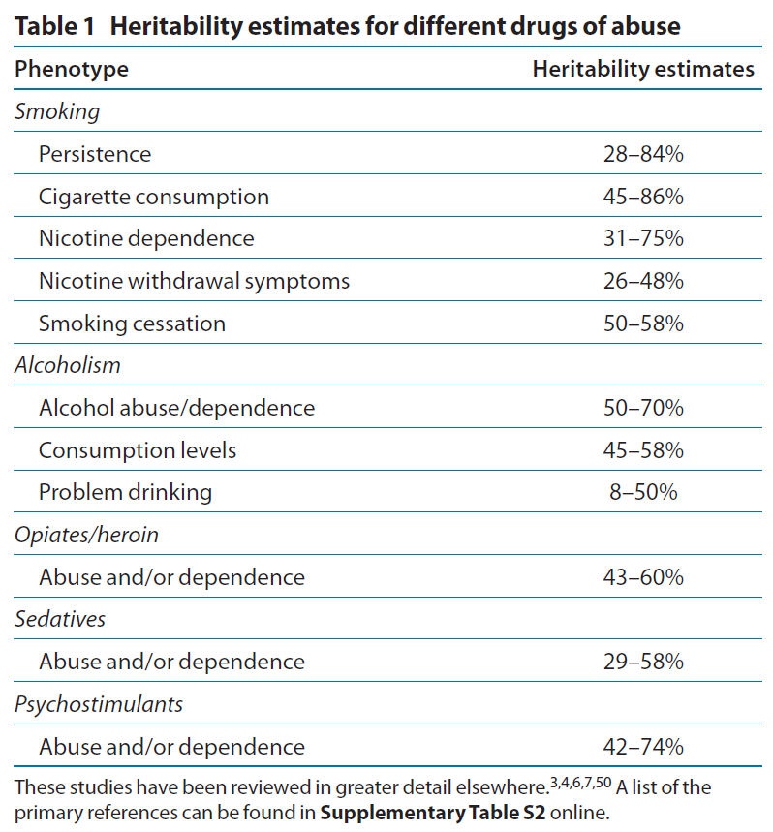
Twin, family and adoption studies in humans together with animal studies have provided the foundation for genetic effects on substance use, abuse and dependence.
Linkage studies were not useful
Ho MK, Goldman D, Heinz A, Kaprio J, Kreek MJ, Li MD, Munafò MR, Tyndale RF. Breaking barriers in the genomics and pharmacogenetics of drug addiction. Clin Pharmacol Ther. 2010 Dec;88(6):779-91.

Slide 13
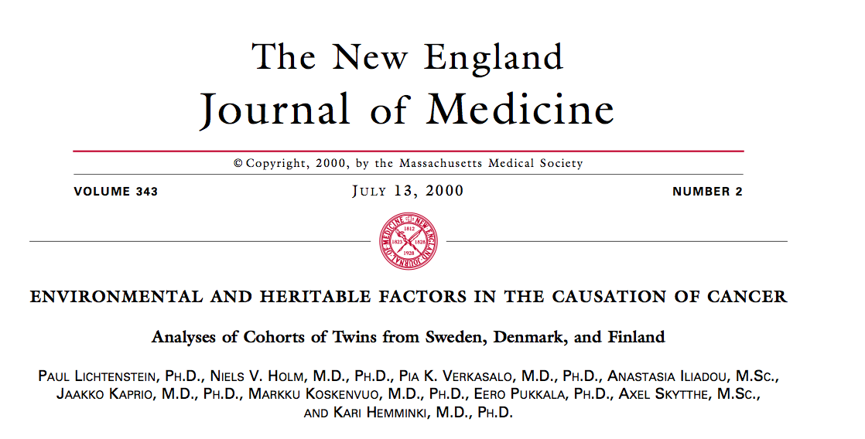

Slide 14
Estimates of heritability for cancer, 2000
Lichtenstein et al, 2000
Notes:
44,000 pairs; 10,803 cancers

Slide 15
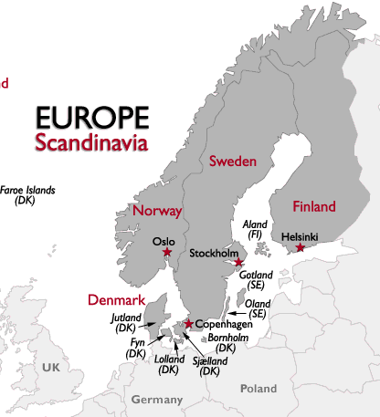
NorTwinCan
Population-based registries of twins and of cancer in Denmark, Finland, Norway and Sweden
→ 36,508 incident cancers
Country | Birth Cohort | Alive at | Mean follow-up | N Incident Cancers
Denmark | 1870-2004 | Jan 1943 | 35 years | 11,840
Finland | 1875-1957 | Feb 1974 | 29 years | 4,487
Norway | 1915-1979 | Jan 1964 | 40 years | 3,368
Sweden | 1886-2008 | Apr 1961 | 30 years | 16,813

Slide 16
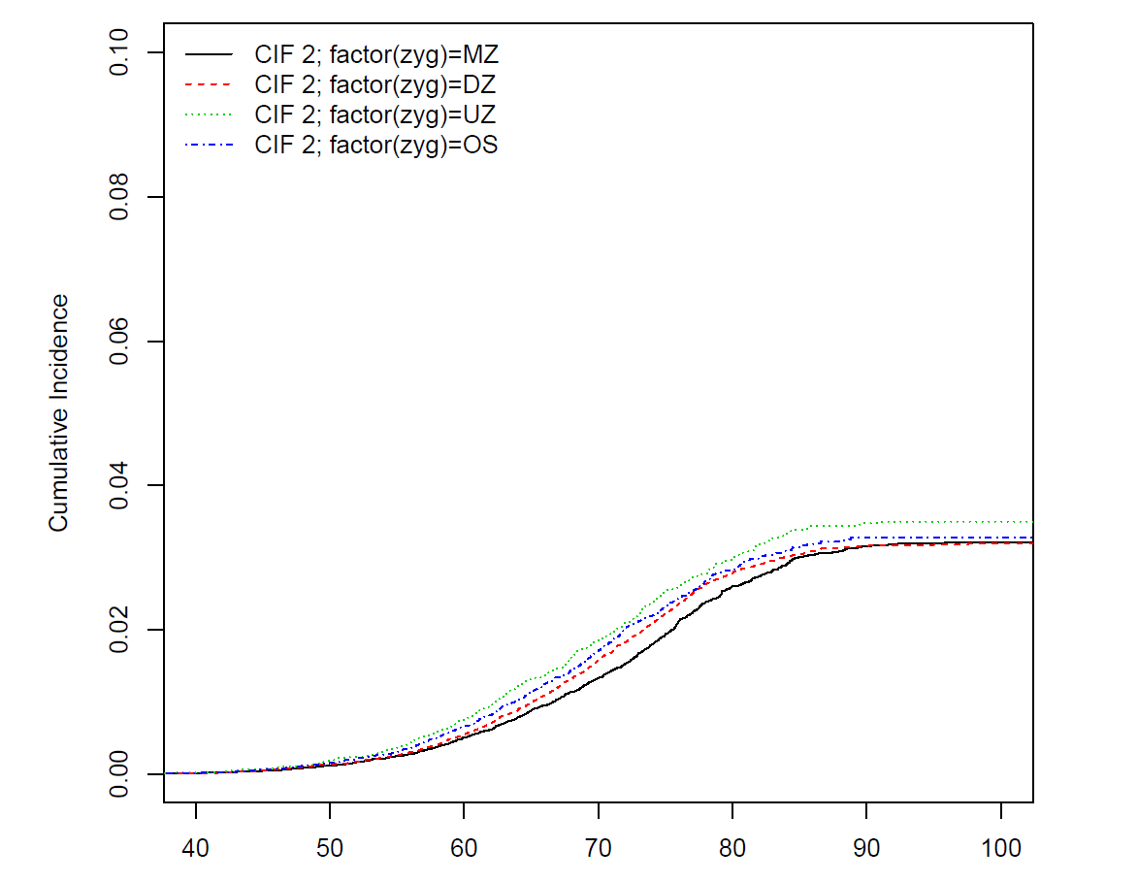
Incidences by zygosity very similar

Slide 17
Within-pair concordances for vital status at the end of follow-up (MZ pairs are in bold)
A. All twin pairs
MZ & DZ Status | Lung cancer | No cancer and dead | No cancer and alive
Lung cancer | 47 / 66 | 365 | 221
No cancer and dead | 746 | 6262 / 11564 | 3141
No cancer and alive | 487 | 7184 | 24630 / 34936
B. Twin pairs with smoking data
MZ & DZ Status | Lung cancer | No cancer and dead | No cancer and alive
Lung cancer | 29 / 26 | 219 | 140
No cancer and dead | 423 | 4538 / 8098 | 2104
No cancer and alive | 286 | 4494 | 10046 / 15073

Slide 18
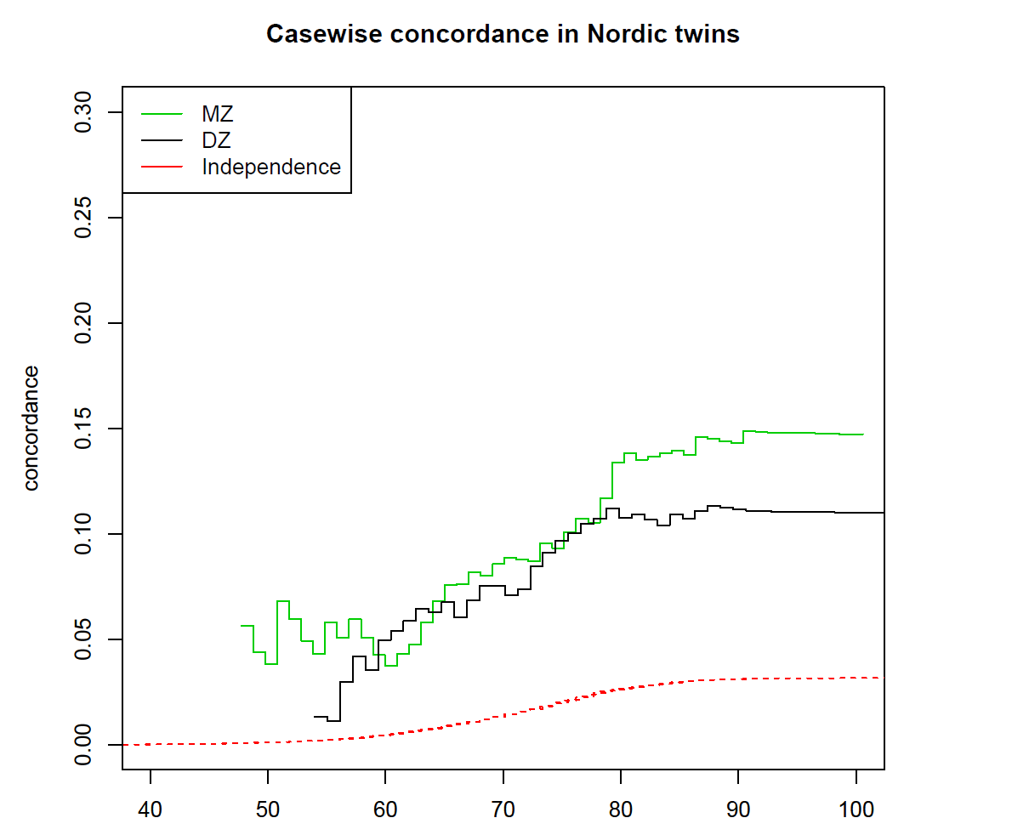
Concordance differs only slightly between MZ and DZ pairs in the entire data set

Slide 19
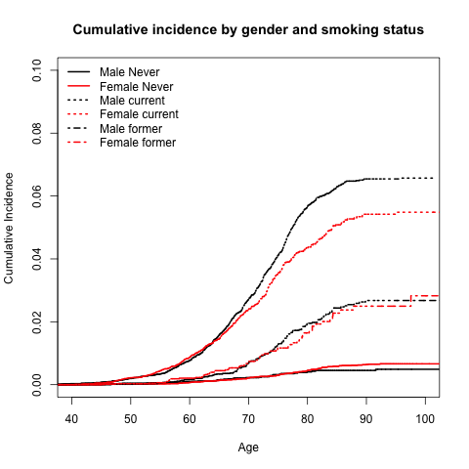
Smoking is major determinant of lung cancer based on 1356 cases among 102700 twins of known smoking status from Denmark, Finland and Sweden)
Cumulative incidence of lung cancer adjusted for censoring, delayed entry to cancer registration, and competing risk of death

Slide 20
Heritability estimates for lung cancer in different samples
Sample | Adjustment for smoking² | Number of complete pairs MZ/DZ | Number of cases | Case wise concordance rate |  | Estimates and Confidence Intervals
 |  |  |  | MZ | DZ | A | C | E
All¹ | N/A | 6674 12376 | 2057 | 0.23 0.18-0.28 | 0.17 0.14-0.21 | 0.23 0.07-0.52 | 0.22 0.10-0.43 | 0.54 0.45-0.63
Smoking data | No | 4786 8547 | 1356 | 0.24 0.18-0.31 | 0.13 0.10-0.18 | 0.42 0.17-0.73 | 0.06 0.00-0.81 | 0.51 0.40-0.63
Smoking data | Yes | 4786 8547 |  | - | - | 0.41 0.14-0.74 | 0.00 - | 0.58 0.45-0.70

Slide 21
Smoking and lung cancer
Among pairs in which neither had ever smoked (7145 MZ pairs and 10190 DZ pairs), there were 40 MZ discordant and one concordant MZ pair, 59 DZ discordant pairs and no concordant DZ pairs.
Absence of evidence for a genetic effect on lung cancer if not exposed to tobacco
Much larger, global samples would be needed

Slide 22
Pairwise concordance by smoking strata
Ever smokers at baseline
Current smokers at baseline

Slide 23
Heritability of lung cancer conditional on smoking
Ever smokers | Correlation 95% CI |  | A |  | C |  | E |  | AIC | ∆ AIC | p-value
 | MZ | DZ | Estimate | 95%CI | Estimate | 95%CI | Estimate | 95%CI
ACE | 0.42 0.27-0.50 | 0.23 0.10-0.35 | 0.37 | 0.10-0.74 | 0.05 | -² | 0.58 | 0.45-0.71 | 33859.42 | 0¹
AE |  |  | 0.43 | 0.31-0.54 | 0 | - | 0.57 | 0.45-0.68 | 33857.75 | 2.33 | 0.57
CE |  |  | 0 | - | 0.32 | 0.23-0.41 | 0.68 | 0.58-0.77 | 33868.69 | 9.27 | <0.001
Current smokers | Correlation 95% CI |  | A |  | C |  | E |  | AIC | ∆ AIC | p-value
 | MZ | DZ | Estimate | 95%CI | Estimate | 95%CI | Estimate | 95%CI
ACE | 0.48 0.33-0.60 | 0.24 0.17-0.30 | 0.48 | 0.35-0.61 | 0 | 0.0-0.0001 | 0.52 | 0.39-0.65 | 26363.25 | 0.078¹
AE |  |  | 0.48 | 0.35-0.61 | 0 | - | 0.52 | 0.39-0.65 | 26361.25 | 2.00 | 0.99
CE |  |  | 0 | - | 0.32 | 0.23-0.41 | 0.68 | 0.58-0.77 | 26378.91 | 15.65 | <0.001
¹Compared to saturated model, the other models are compared to ACE model.
² 95%CI for C effect here could not be estimated reliably

Slide 24
In smoking (ever) discordant pairs (2869 MZ pairs and 7616 DZ pairs), there were 22 MZ lung cancer discordant pairs, in which 20 cases were in smokers, and only two in the never-smoking cotwin of the pair. This is an OR of 10 (95% exact CI 2.43 – 88; p=0.00012)
For DZ smoking discordant pairs, there were 77 pairs also discordant for lung cancer. Among them 63 cases were in smokers (OR 4.5, p=1.41e-08), while in 14 pairs, the non-smoker was the case while the smoker was not diagnosed with lung cancer.
Second-hand smoke/environmental exposures were not assessed.

Slide 25
Summary of heritability estimates
All Twins A=.23
Smoking status available
A=.41
Never/
Ever
Never/Never ?
MZ OR=10
Ever/Ever A=.43
DZ OR=4.5
Current/Current A=.48

Slide 26
Conclusions and context
There is substantial heritability of lung cancer and genetic influences are conditional on exposure to tobacco and stable with increasing age.
Earlier family (Czene K et al 2002) and twin (Braun M et al. 1995, Lichtenstein P et al. 2000) studies suggest that the contribution of genetic factors is very modest. However, these studies have not taken the effect of smoking into account.
GWAS studies indicate that some associated loci are found in both smokers and non-smokers, while others are found only in smokers.
Genetic Influences on Lung Cancer: The Nordic Twin Study of Cancer
Hjelmborg J, Korhonen T et al, under review

Slide 27
Lorelei Mucci
Hans-Olov Adami
Kathryn Penney
David Havelick
Harvard School of Public Health
Axel Skytthe
Jacob Hjelmborg
Thomas Scheike
Niels Holm
Danish Twin Registry
The NorTwinCan Team
Jennifer Harris
Ingunn Brandt
Thomas Nilsen
Jaakko Kaprio
Eero Pukkala
Norwegian Twin Registry
Swedish Twin Registry
Tellervo Korhonen Kauko Heikkilä
Finnish Twin Cohort Study
Mikael Hartman
Kamila Czene
Juni Palmgren
Nancy Pedersen

Slide 28
WHAT HAVE WE LEARNED FROM GWA’s
Very large sample sizes are needed to achieve genome-wide significant results
Almost linear association between sample size and # of detected loci (Visscher et al. 2012)
Thorgeirsson et al. (Nature 2008) enrolled >10,000 smokers
CHRNA5-CHRNA3-CHRNB4 on 15q24-25: genome-wide significant association with CPD
GSCAN consortium is increasing sample size 5-10 fold
Sample heterogeneity is a strong confounder
Genetic differences between meta-analysis datasets may hide true associations (Ntanzi et al. 2011) → Focus on Finnish data sets
Important to improve phenotypic accuracy
Consideration of phenotype quality and precision may be more beneficial than recruitment of increasing numbers of subjects with crude phenotypes (Munafò et al. 2012)
Biomarkers of nicotine intake are better than self-reported cigarette/tobacco use (Keskitalo et al. 2009); how can we better measure dependence?
Improving coverage of the genome helps
Imputation to HapMap3 and 1000G data (e.g. Kettunen et al. 2012)
Even a small population-specific reference set improves SNP imputation and the power to detect associations (Surakka et al. 2010)
Use within and and between family contrasts to improve power (e.g. twins and siblings)

Slide 29
Novel findings
CLEC19A in 16p12.3: Cigarettes per day (CPD)
ERBB4 in 2q33: DSM-IV nicotine dependence diagnosis

Slide 30
STUDY AIM
Comprehensively portray the dimensions of smoking behavior
Utilize subjects from a genetically homogenous population
DISCOVER GENES UNDERLYING SMOKING BEHAVIOR AND NICOTINE DEPENDENCE USING GWA’s
Attention to signals not quite reaching genome-wide significance
Utilize convergent data from several sources

Slide 31
SAMPLE
The study sample was ascertained from the population-based Finnish Twin Cohort study consisting of adult twins born 1938-1957
Heavy smoking twin pairs were recruited together with sibs
Interviews and DNA collection between 2001 and 2006 as part of the Nicotine Addiction Genetics multisite study (PI P.A.F. Madden)
DNA extracted from venous blood samples
First analysis (Loukola et al, 2013) focused on 1,114 twin individuals with genotypes (one twin from MZ pairs and both twins from DZ pairs)
Ethical approval from Helsinki hospital district ethics board and Washington University IRB

Slide 32
PHENOTYPES
SMOKING INITIATION
Age at first puff
Age at first cigarette
Time to second cigarette
Age of onset of weekly smoking
Age of onset of daily smoking
First time sensations
NICOTINE DEPENDENCE
DSM-IV ND
DSM-IV ND symptom count
Binary FTND (≥4)
FTND score
FTND Time to first cigarette (TTF)
NDSS Drive/Priority factor
NDSS Stereotypy/Continuity factor
NDSS Tolerance factor
NDSS sum score
AMOUNT SMOKED
Cigarettes per day (CPD)
Maximum CPD
Telephone interviews using the diagnostic SSAGA protocol
Semi-Structured Assessment for the Genetics of Alcoholism; Bucholz et al. 1994
An additional section on smoking behavior and ND adapted from CIDI
Composite International Diagnostic Interview; Cottler et al. 1991
A supplemental questionnaire for the NDSS nicotine dependence scale
Notes:
17 binary, continuous, and categorical phenotypic measures were included to comprehensively portray the dimensions of smoking behaviour

Slide 33
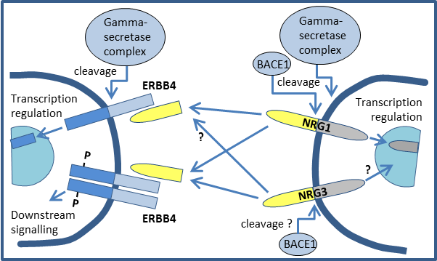
ERBB4 ASSOCIATION WITH DSM-IV ND
ERBB4 codes for a neuregulin receptor
Regulates neurite outgrowth, axonal guidance, synaptic signaling and plasticity
The neuregulin signaling pathway consist of gene products encoded by at least 10 distinct genes
NRG1, NRG3 and ERBB4 have been associated with schizophrenia (SZ)
Evidence from genetic, transgenic and post-mortem studies
Mouse models support the role of beta- and gamma-secretase in SZ
Multiple variants aggregating in the neuregulin signalin pathway may be needed to cause SZ (Hatzimanolis et al. 2013)
THE NEUREGULIN SIGNALING PATHWAY :
NRG1, NRG3 (neuregulins)
ERBB4 (neuregulin receptor)
BACE1 (beta-secretase)
PSEN1, PSEN2, APH1A, APH1B, PSENEN, NCSTN (gamma-secretase complex)
(Figure modified from Hatzimanolis et al. 2013 Transl Psychiatry)

Slide 34
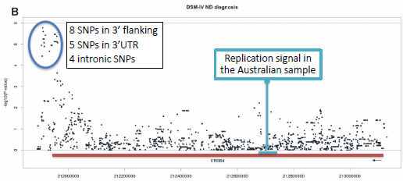
ERBB4 ASSOCIATION WITH DSM-IV ND
DSM-IV ND diagnosis
ERBB4
Multiple independent lines of evidence
Association in the Finnish twin sample (P_{min}=1.68x10⁻⁶)
Replication in an independent Australian sample
ERBB4 overlaps with relevant linkage loci
regular smoking locus in Finnish twin families (Loukola et al. 2008)
max CPD locus highlighted in a meta-analysis (Han et al. 2010)
ErbB4 and Nrg3 expression increases during nicotine exposure and withdrawal in a mouse model (Turner et al. 2013)
Nicotine withdrawal induced anxiety is abolished both in mice with a knock-down mutation in Nrg3, and in mice treated with an ErbB4 inhibitor (Turner et al. 2013)
NRG3 associates with smoking cessation success in a clinical trial (Turner et al. 2013)

Slide 35
ANALYSES IN AN EXTENDED SAMPLE
Study sample ascertained from the population-based Finnish Twin Cohort study consisting of adult twins born 1938-1957
Surveys conducted in 1975, 1981 and 1990 for the twin cohort
Heavy smoking twin pairs were recruited together with sibs
Diagnostic interviews and DNA collection between 2001 and 2006
Genotyped sample size extended from 1,114 → 2,029 individuals from 745 families
Includes twin pairs and all available family members
Marker coverage extended from HM2 imputation → 1000 Genomes imputation (reference set includes 86 Finns)
FAM 62547
FAM 58065

Slide 36
GENOTYPING AND ANALYSIS
Imputation by IMPUTE v2.1.0
1000Genomes Phase I integrated variant set release (v3) reference panel, posterior probability threshold 0.9 for ‘best-guess’ imputed genotypes
Standard quality controls
Genotyping
Human670-QuadCustom Illumina BeadChip (N=1,114) & Illumina HumanCoreExome chip (N=915)
Standard quality controls
Targeted analyses for the 10 genes within the neuregulin signalling pathway
Plink DFAM model (family-based) for binary traits, affecteds-only
Plink QFAM model (family-based) for quantitative traits, adaptive permutations (up to 1x10⁹)

Slide 37
RESULTS
ERBB4 – DSM-IV ND association remains but is diluted (P_{min}=8.8 x 10⁻⁵)
Original sample was ascertained based on heavy smoking twins
Additional family members smoke less and are less dependent
 | Original sample (N=1,114) | Additional sample (N=915) | Combined sample (N=2,029)
Females % | 38.0% | 60.7% | 48.2%
Mean age | 54.5 | 58.9 | 56.5
Regular smokers % | 98.3% | 64.6% | 83.3%
Average CPD * | 19.8 | 17.2 | 18.9
DSM-IV ND diagnosis % * | 53.5% | 31.5% | 42.3%
* Conditioned on regular smoking

Slide 38
RESULTS
Association between DSM-IV ND diagnosis and the 10 genes of the Neuregulin signaling pathway
ERBB4 P_{min}=8.8x10⁻⁵
BACE1 P_{min}=2.9x10⁻⁴
Gamma-secretase complex:
PSEN1
PSEN2
APH1A
APH1B
PSENEN
NCSTN
No association
NRG1 P_{min}=5.7x10⁻⁴
NRG3 P_{min}=4.7x10⁻³

Slide 39
ACKNOWLEDGEMENTS
The participating twin pairs and their family members for their contribution
Anja Häppölä, Kauko Heikkilä and Ulla Broms for their valuable contribution in recruitment, data collection, and data management
Interviewers: A-M Iivonen, K Karhu, H-M Kuha, U Kulmala-Gråhn, M Mantere, K Saanakorpi, M Saarinen, R Sipilä, L Viljanen, and E Voipio
E Hämäläinen and M Sauramo for their skilful technical assistance
The late Academician Leena Peltonen-Palotie for her indispensable contribution throughout the years of the study

