Slide 1
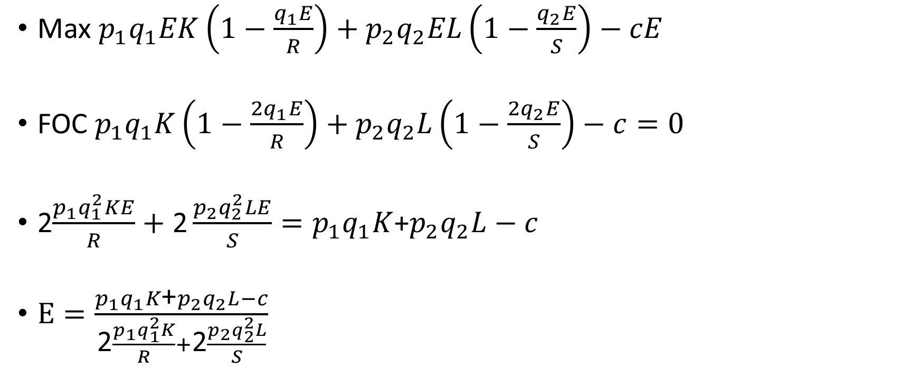
Kahden lajin optimi
Max $p_{1}q_{1}EK\left(1−\frac{q_{1}E}{R}\right)+p_{2}q_{2}EL\left(1−\frac{q_{2}E}{S}\right)−cE$
FOC $p_{1}q_{1}K\left(1−\frac{{2q}_{1}E}{R}\right)+p_{2}q_{2}L\left(1−\frac{{2q}_{2}E}{S}\right)−c=0$
2$\frac{p_{1}q_{1}^{2}KE}{R}+\text{2}\frac{p_{2}q_{2}^{2}LE}{S}=p_{1}q_{1}K$+$p_{2}q_{2}L−c$
$\text{E}=\frac{p_{1}q_{1}K\text{+}p_{2}q_{2}L−c}{\text{2}\frac{p_{1}q_{1}^{2}K}{R}+\text{2}\frac{p_{2}q_{2}^{2}L}{S}}$

