Slide 1
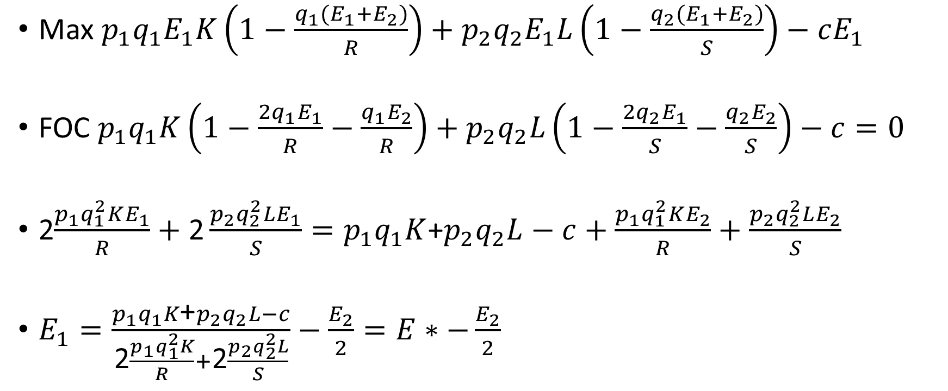
Kahden lajin duopoli
Max $p_{1}q_{1}E_{1}K\left(1−\frac{q_{1}(E_{1}+E_{2})}{R}\right)+p_{2}q_{2}E_{1}L\left(1−\frac{q_{2}(E_{1}+E_{2})}{S}\right)−cE_{1}$
FOC $p_{1}q_{1}K\left(1−\frac{{2q}_{1}E_{1}}{R}−\frac{q_{1}E_{2}}{R}\right)+p_{2}q_{2}L\left(1−\frac{{2q}_{2}E_{1}}{S}−\frac{q_{2}E_{2}}{S}\right)−c=0$
2$\frac{p_{1}q_{1}^{2}KE_{1}}{R}+\text{2}\frac{p_{2}q_{2}^{2}LE_{1}}{S}=p_{1}q_{1}K$+$p_{2}q_{2}L−c+\frac{p_{1}q_{1}^{2}KE_{2}}{R}+\frac{p_{2}q_{2}^{2}LE_{2}}{S}$
$E_{1}=\frac{p_{1}q_{1}K\text{+}p_{2}q_{2}L−c}{\text{2}\frac{p_{1}q_{1}^{2}K}{R}+\text{2}\frac{p_{2}q_{2}^{2}L}{S}}−\frac{E_{2}}{2}=E∗−\frac{E_{2}}{2}$

