Slide 1
Promoting Six-year-old Children’s Conceptions of Nature and
Being a Part of an Ecosystem by
Investigative Learning Outdoors
Ms Riitta Lunti, MEd, Pre-school Teacher
Puumala, Finland
&
Dr. Mauri Åhlberg,
Professor of Biology and Sustainability Education, University of Helsinki, Finland

Slide 2
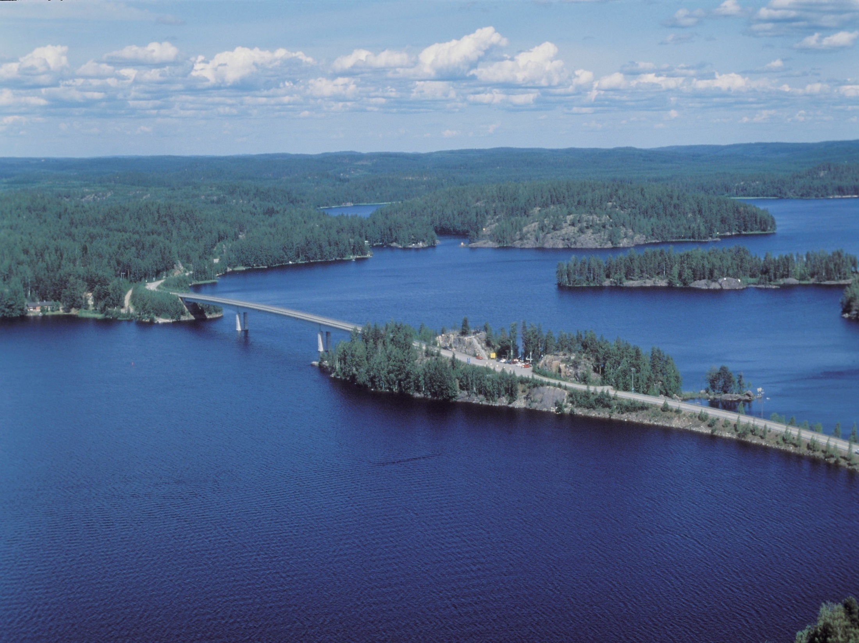

Slide 3
The main research problem
How does children’s understanding of nature change during their one year of pre-school education, when their education is based on the teacher’s own integrating theory of environmental education?

Slide 4
The second research goal
Do teachers’ conceptual maps of pre-school children’s knowledge help to evaluate their knowledge of nature?

Slide 5
CONTEXT
Pre-schooling in Finland is
for six-year old children
voluntary
free of charge

Slide 6
The Finnish Pre-school Curriculum
The National Board of Education (2000):
Objectives of Environment and Nature Studies:
help children to understand their environment and develop thinking and learning skills.
help children to learn and strengthen their experiential and emotional attitude towards nature and the environment
help children to develop an interest in nature and an understanding of their own dependence on and responsibility for nature

Slide 7
Theoretical background
Social constructivist theory of learning and knowledge
Learning encouraged through interaction with other children and the teacher

Slide 8
Conceptual change
investigated with the help of the theories of Vygotsky (1978; 1982) and other researchers e.g. Havu (2000), Tynjälä (2000), Vosniadou (2007).
Åhlberg’s (1990) improved concept mapping was used to collect data about children’s conceptual change process and accompanying learning and thinking

Slide 9
Lev Vygotsky (1896 – 1934)
According to Vygotsky, the zone of proximal development can be observed in learning . This is the stage of the learning process when an individual is unable to solve problems alone, but needs the help of a more experienced person.
Teaching facilitates learning most effectively when it creates a proximal development zone, and takes place in the initial stage of developing a new skill.

Slide 10
Lev Vygotsky (1896 – 1934)
According to Vygotsky, the zone of proximal development can be observed in learning. This is the stage of the learning process when an individual is unable to solve problems alone, but needs the help of a more experienced person.
Teaching supports learning most effectively when it creates a proximal development zone, and takes place in the initial stage of developing a new skill.

Slide 11
RESEARCH METHODS: Subject
a pre-school group of 15 children in a kindergarten
Riitta Lunti acted as both
teacher and researcher.

Slide 12
RESEARCH METHODS:
Data gathering
teacher-made concept maps of children’s knowledge, based on discussions with the children
research interviews.

Slide 13
Concept mapping
Concept maps are appropriate educational tools for pre-school teachers to monitor children’s knowledge before their pre-school years, and to explore which zones of proximal development children are operating within.

Slide 14
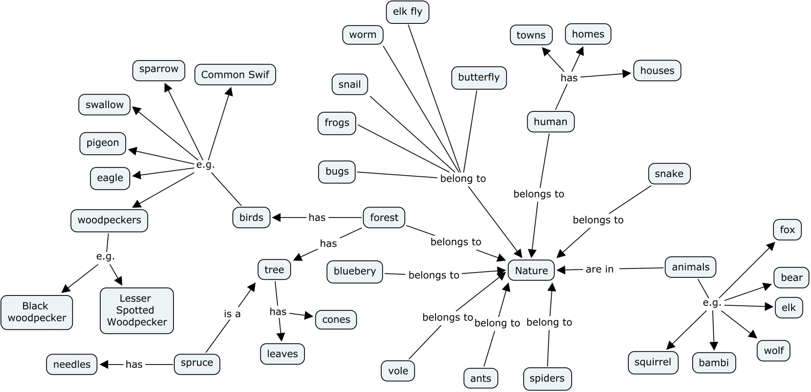
Concept map at the beginning of the pre-school year

Slide 15
Teaching during the year
Themes:
The forest as an ecological system; “living nature” and “non-living nature”; interactions between humans, plants, animals; what do plants and animals need to survive?
Water; states of water; the importance of water to ecological systems.
Time and space; the Sun and its importance for Earth; life on Earth as an ecological system
Humans as part of ecological systems; healthy food; the journey of bread from the field to the table.

Slide 16
The forest as a learning environment
The forest as a learning environment promotes children's interest in nature, and also increases their desire to learn. Their environmental sensitivity increases during trips to the forest.
The forest is an open learning environment (a “learnscape”) where children get personal experience of nature and can make observations, examine and learn, according to both their own interests and guided activities.

Slide 17
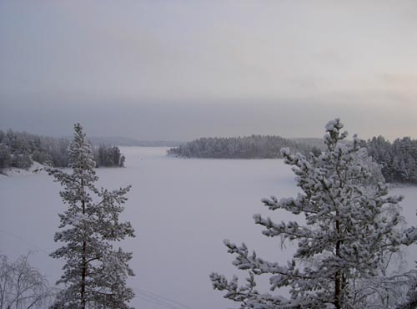
Outdoor education
Nature is an open learning environment, a “learnscape” where children can play and enjoy positive experiences . Trips to the forest or other natural areas are made approximately once a week.

Slide 18
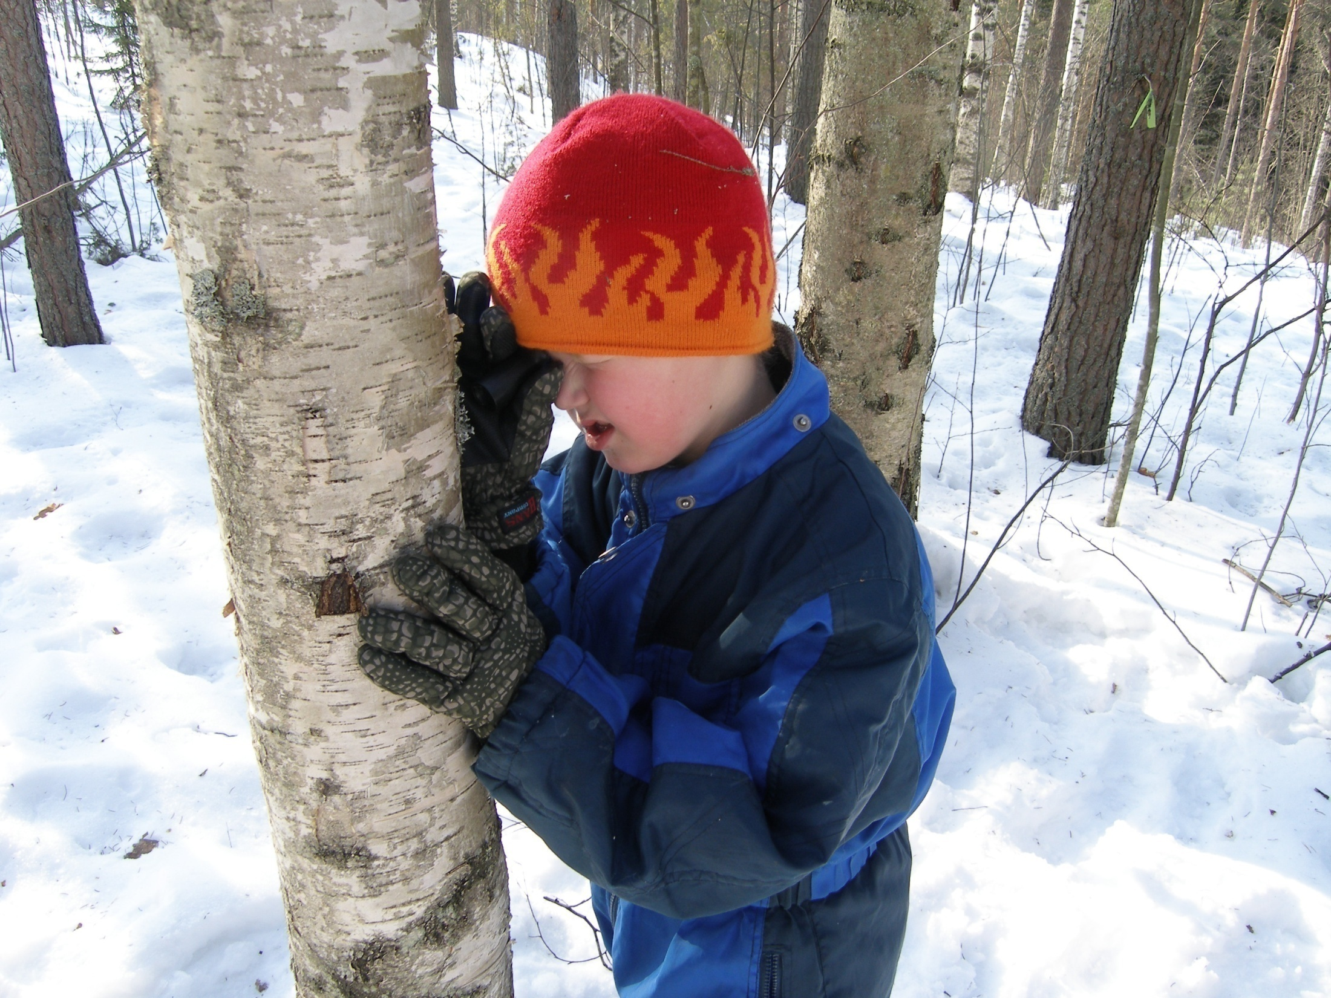
These trips aim to promote children's thinking and problem-solving; encourage them to observe and explore nature; and build up their knowledge of nature.

Slide 19
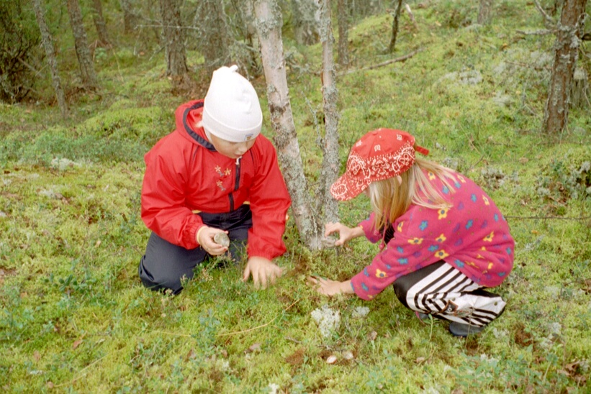
Children need their own personal experiences in natural settings in order to understand nature and discover the need to protect it.

Slide 20
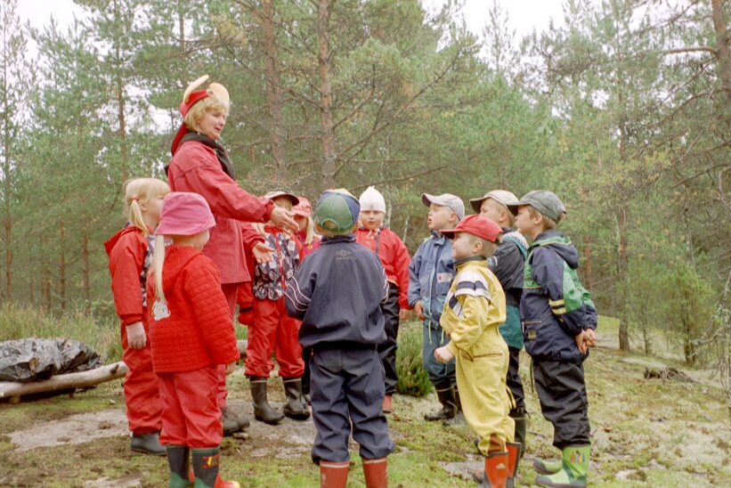
Every trip to the forest is planned beforehand.

Slide 21
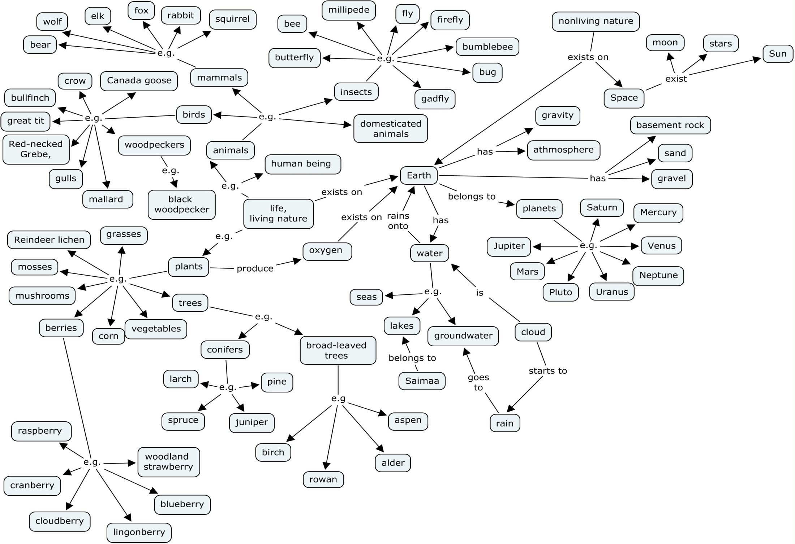

Slide 22
How well children acquire learned concepts

Slide 23
Results
With appropriate pre-school teaching methods, even a six-year-old can learn about nature, its basic concepts and natural phenomena.
Concept maps are appropriate educational tools for pre-school teachers to monitor children’s knowledge before their pre-school years, and to identify the zones of proximal development at which children are operating.

Slide 24
Problems in learning
The learning of key concepts in natural science has been problematic.
The main problem has been that learning of such concepts has not been deep enough to enable children to apply concepts in new situations.
According to many studies (Tynjälä 2000, Vosniadou 2007) children’s everyday knowledge about natural phenomena does not adapt easily to scientific conceptions.

Slide 25
Wider implications
Other pre-school teachers can probably also learn to use the outdoors as a learning environment, and become more sensitive to environmental issues themselves. This will make them better prepared to teach children to become sensitive to nature.
Other pre-school teachers could probably also learn to use concept mapping in a similar way, to get an overview of what children have learnt about nature.

Slide 26
A future option for learning to identify species and their ecosystems
The pre-school children in this study were able to name many plant and animal species.
A future option to continue this research programme: an opportunity to learn how to identify species quickly and easily through NatureGate’s Online Services, http://www.naturegate.net
IUCN information about NatureGate: http://www.iucn.org/about/union/commissions/cec/?2614/

Slide 27
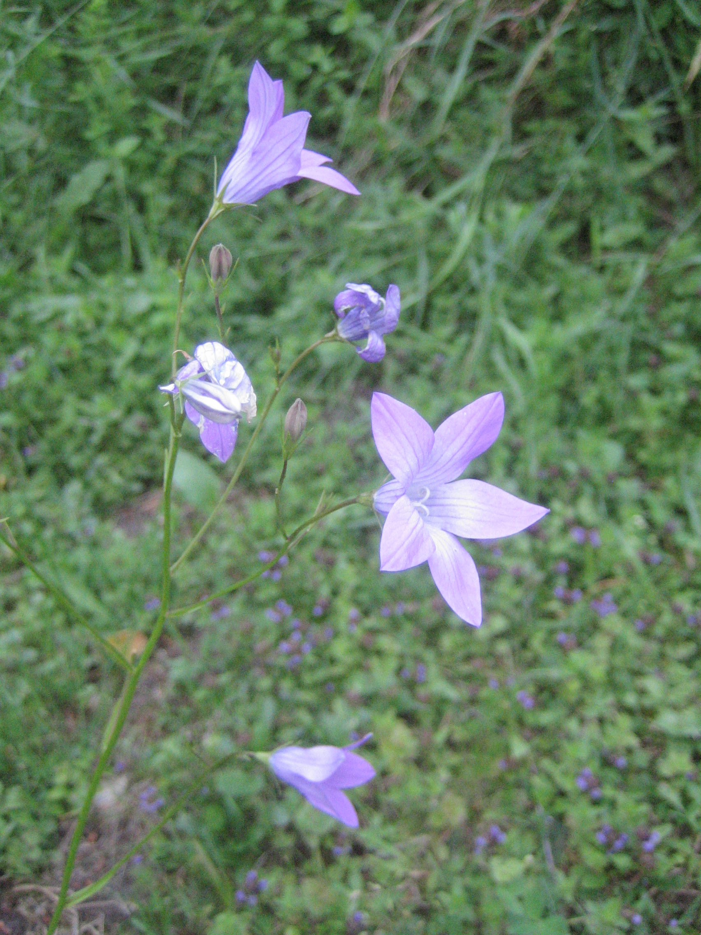
THANK YOU!
For more information
Riitta Lunti
Niskalammentie 14
52200 Puumala
Finland
riitta.lunti@pp.inet.fi

