Slide 1
Finnish teachers’ professionalism is built through research based teacher education and supported by the school site SIMO EDUCACIÓN 2015, Madrid from 28th to 30th October 2015
Jari Lavonen, Department of Teacher Education, University of Helsinki, Finland
Jari.Lavonen@Helsinki.Fi
Notes:
An Innovative School Model (ISM) is analysed theoretically and empirically especially how this model support the design and adoption of educational innovations. The ISM emphasises versatile leadership, teachers’ professionalism, meaningful learning, versatile physical and virtual learning environments and, moreover, the versatile use of networks and partnerships of the school. The model activates teachers, pupils, school principal, parents and other collaborators from the society nearby to generate ideas together for school development. Three teachers of one school, recognised as innovative, were interviewed in order to understand how teachers experienced the operations of the school operating according to the ISM. All interviewed teachers agree the importance of common values and versatile communication in the context of ISM
Thank you for your mail and invitation. I took a look for the web page of the conference and I find the topics very interesting. So, I am glad to accept the invitation. The topic sounds good for me. Perhaps I will frame my presentation in the frame of professional/effective teacher (these concepts have different meanings). In Finnish teacher education and school a child is in a focus . We really aim to offer equal possibilities for all children. The outcome of this policy is very well seen in the outcomes of PISA results. In Finland the low-achieving students perform much much better than, for example, in UK.

Slide 2
Republic Finland
In northern Europe, area of 340 000 km² (70% of Spain)
5,4 million people (12% of Spain)
Success in - welfare - education

Slide 3
Content of the presentation 1. Finnish Educational Context 2. Education of professional Teacher at the University of Helsinki 3. Examples of continuous improvement of education by the professional teachers at the school site 3. How do school site supports the professionalism of teachers

Slide 4
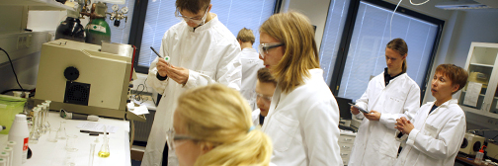
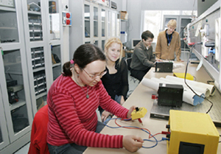
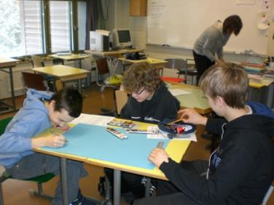
1. Finnish education context
4

Slide 5
Characteristics of Finnish Education Laukkanen (2008), Niemi et al. (2012), Sahlberg (2011)
Common, consistent and long-term policy
- models for teacher and compulsory education are 40 years old - teachers are qualified and committed - support to the development of broad literacy
Educational equality (especially in comprehensive school) - education is free, including books, meals, health care, … - schools do not select their students (school districts) - well-organised special education (inclusion) and counselling
3. Devolution of decision power to the local level - a headmaster is a pedagogical leader (leadership) - local authorities (together with the teachers) plan local curriculum, allocate resources, ... - school based and encouraging assessment
The culture of trust and co-operation: national level – district – school – families - no inspectors, no national exams … - no private tutoring or evening schools
Common, consistent and long-term policy
Educational equality - education is free in first and second scyles - well-organised special education (inclusive education/ personalised learning) and counselling
Decentralisation - leadership and management at school level - no inspectors and testing (comprehensive school) - teachers are responsible to prepare a local curriculum and classroom based assessment
The culture of trust and co-operation:

Slide 6
 | Outcome based –model | Finnish –model
Aims as | Learning outcomes | Broad aims for teaching/ learning
Important level | National/district level planning and assessment | Assessment and planning at the level of a school and classrooms
 | +a learner knows what he/she should learn - competitive school culture: ranking of students and schools - “teaching to the test” | +co-planning +a teacher conducts assessment for enhancing learning processes - problematic to compare the quality of learning outcomes and select students to next level
Notes:
*Spelling correction for district
*removed “Too” from the focus for outcome based-model
*The format on here might be too large for the slide?

Slide 7
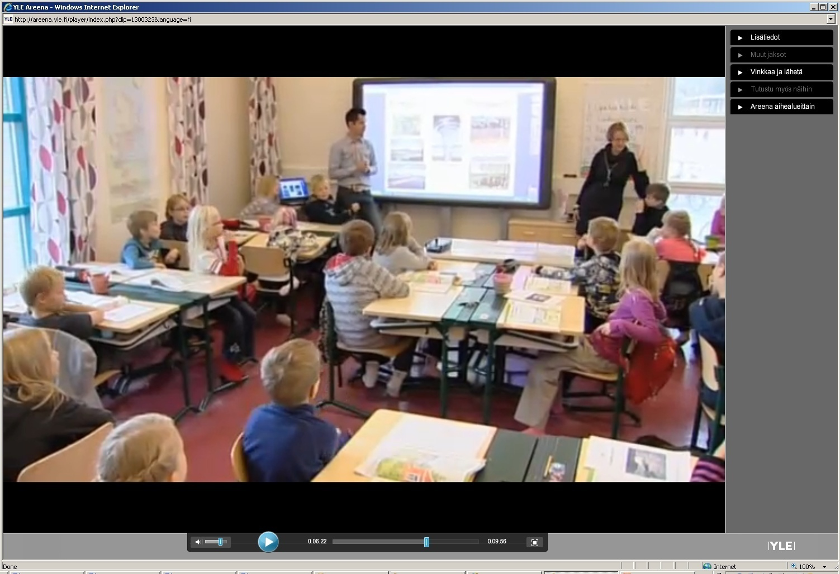
32 pupils at 3rd grade science class
4 special need pupils are integrated to the classroom
Teacher 1
Teacher 2

Slide 8
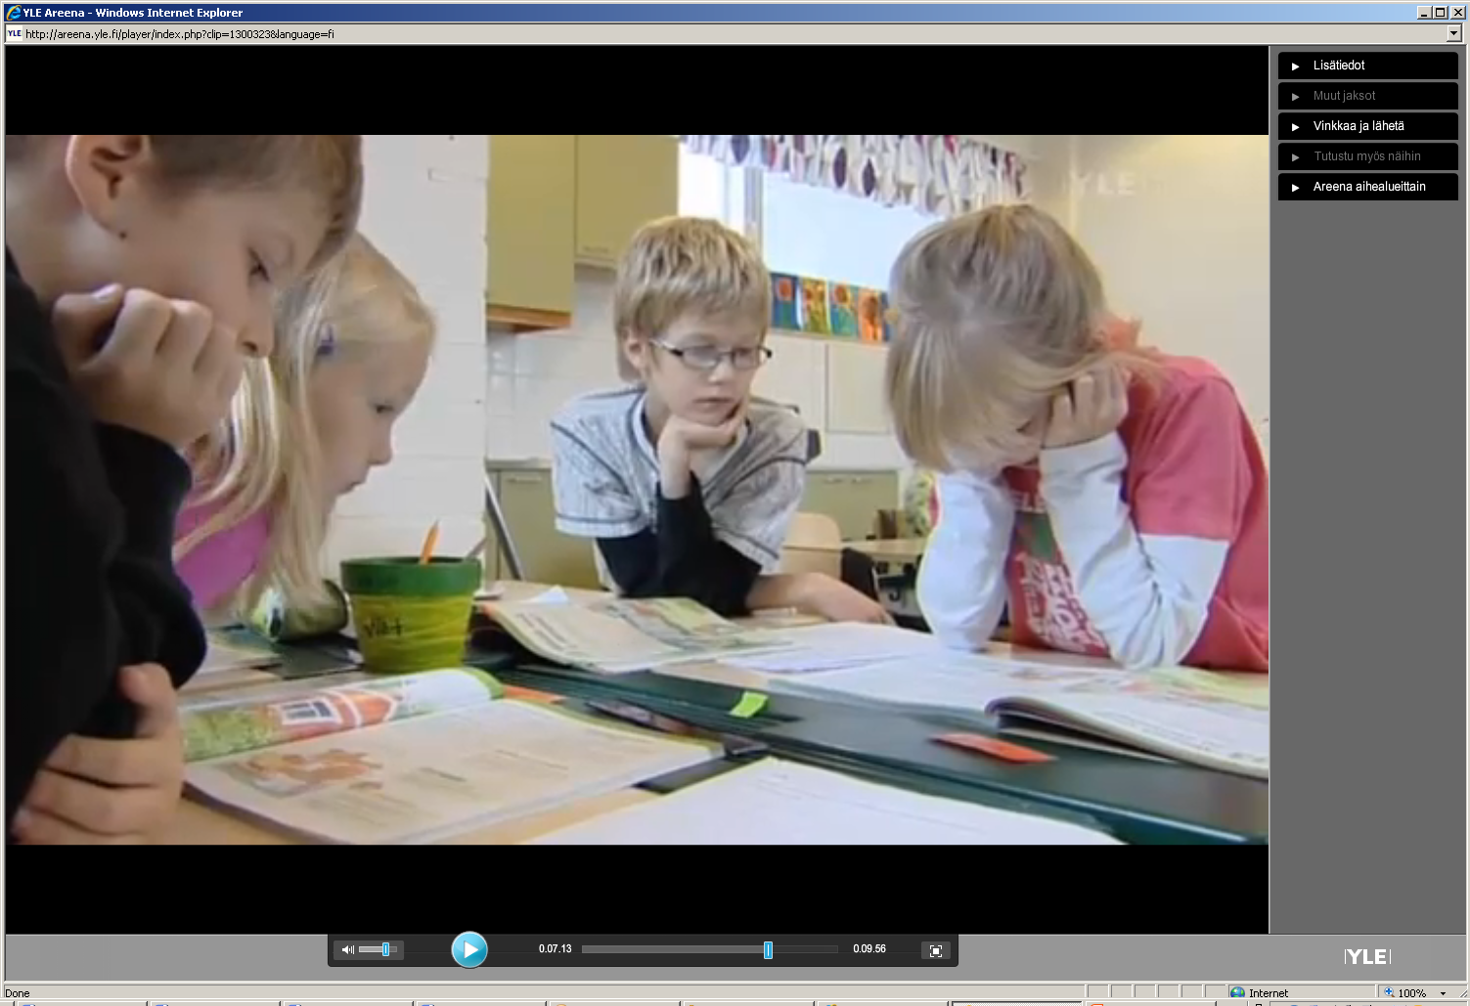
In an inclusive classroom: - Learning in a small Collaborative group
- Pupils have different Competencies and “background” and support each others learning

Slide 9
A teacher is supporting and encouraging a special need student.

Slide 10
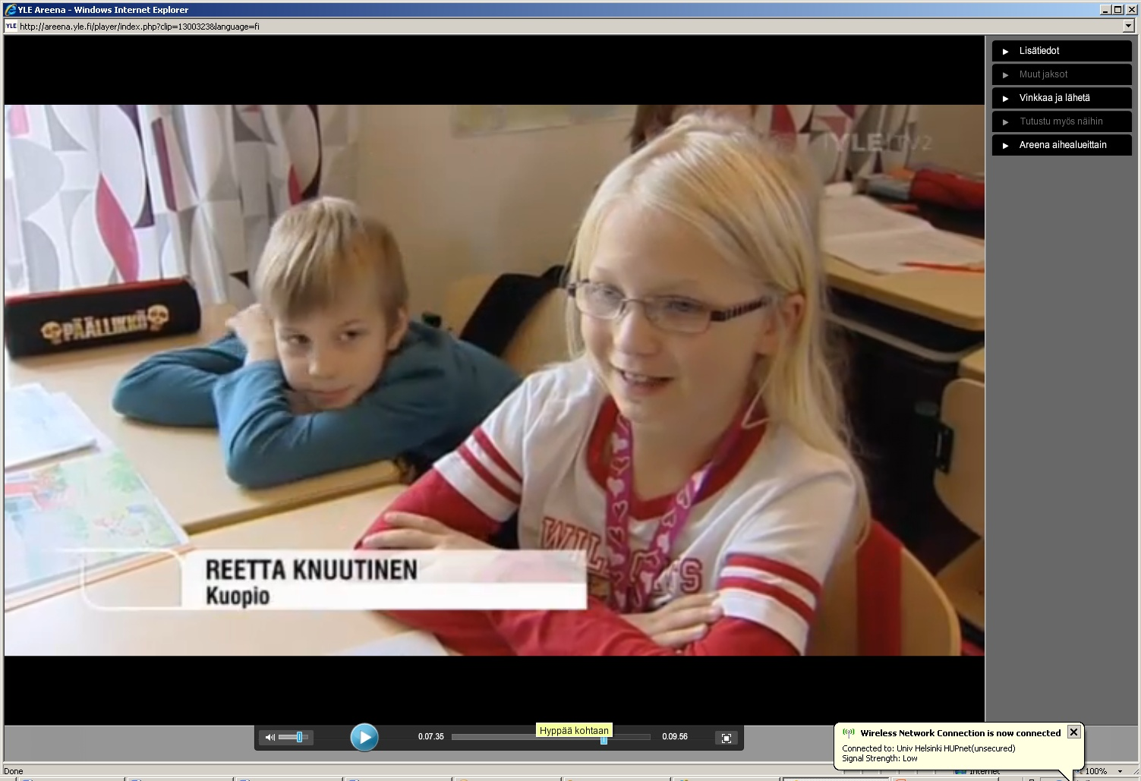
I like this type of learning. It is really nice to engae in learning together.

Slide 11
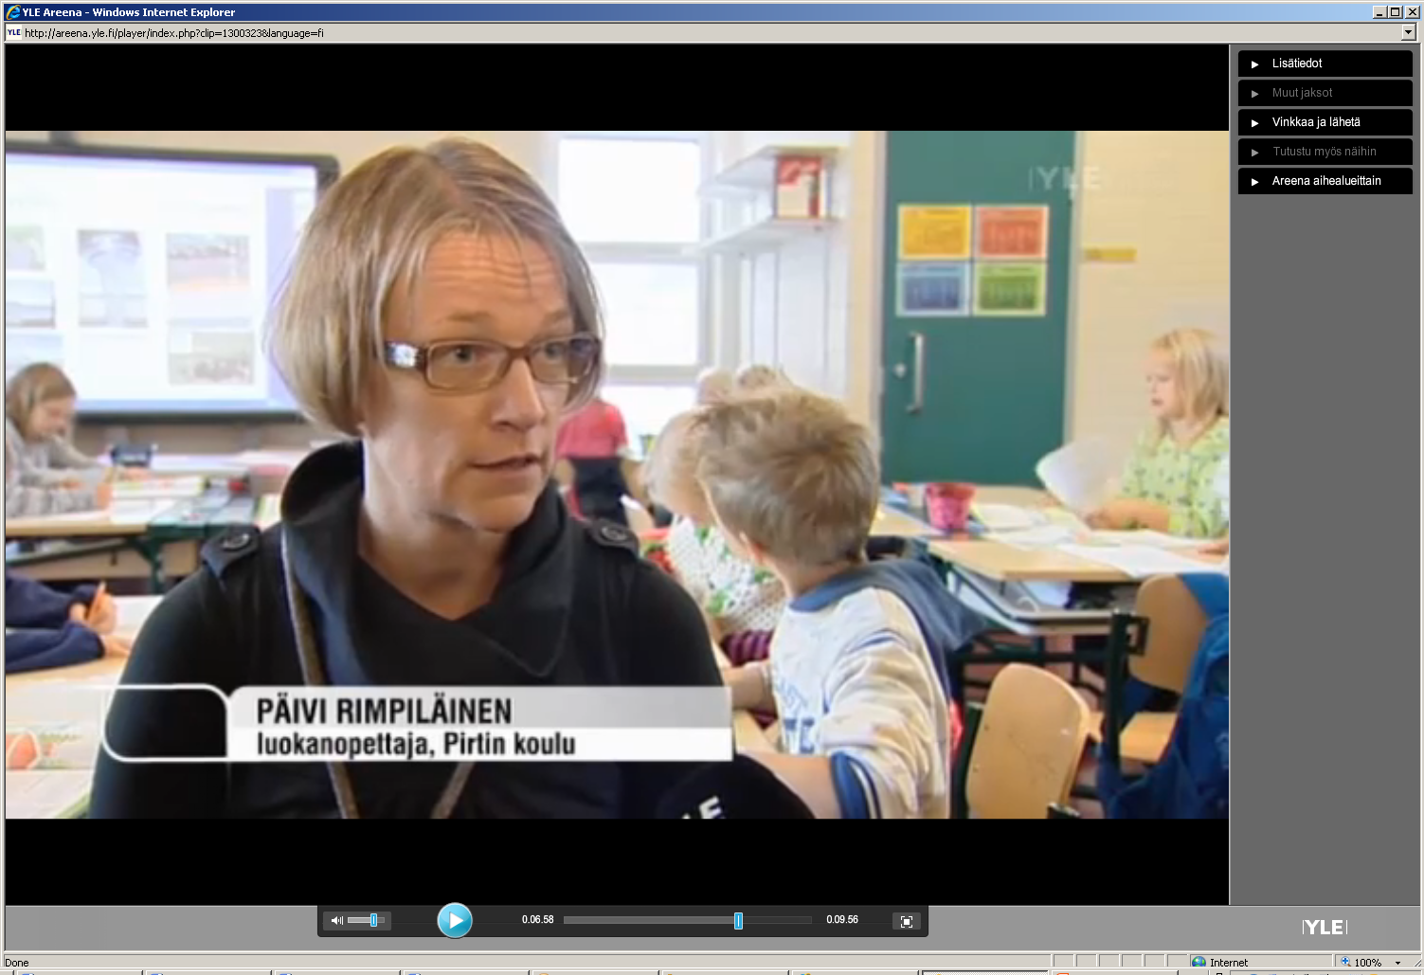
... It is not necessary, a pupil is ready for a school. Instead a school should be ready for a pupil!

Slide 12
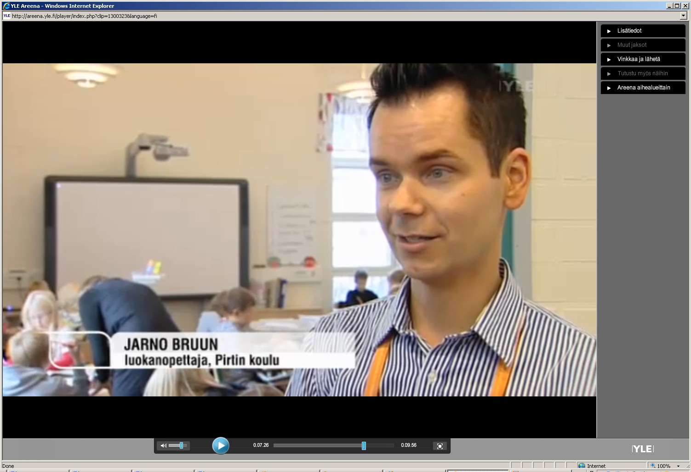
High-achieving pupils work as role models for lo-achieving pupils (support to the development of self efficacy; important in working life)
High-achieving pupils learn skills, like entrepreneurship skills, needed in further studies and in the working life.

Slide 13
School subjects in comprehensive school (total number of lessons hours, yearly)
Optional
subjects
13
Mother tongue
and literature
Other domestic
(Finnish/Swedish)
Physical
language 6 (Swedish or Fin)
42
education, music,
visual arts, craft
56
Foreign
languages
16
Voulntary
History , social
language
Mathematics
studies
10
Science subjects
12
32
Civics , religion or
ethics
11
31

Slide 14
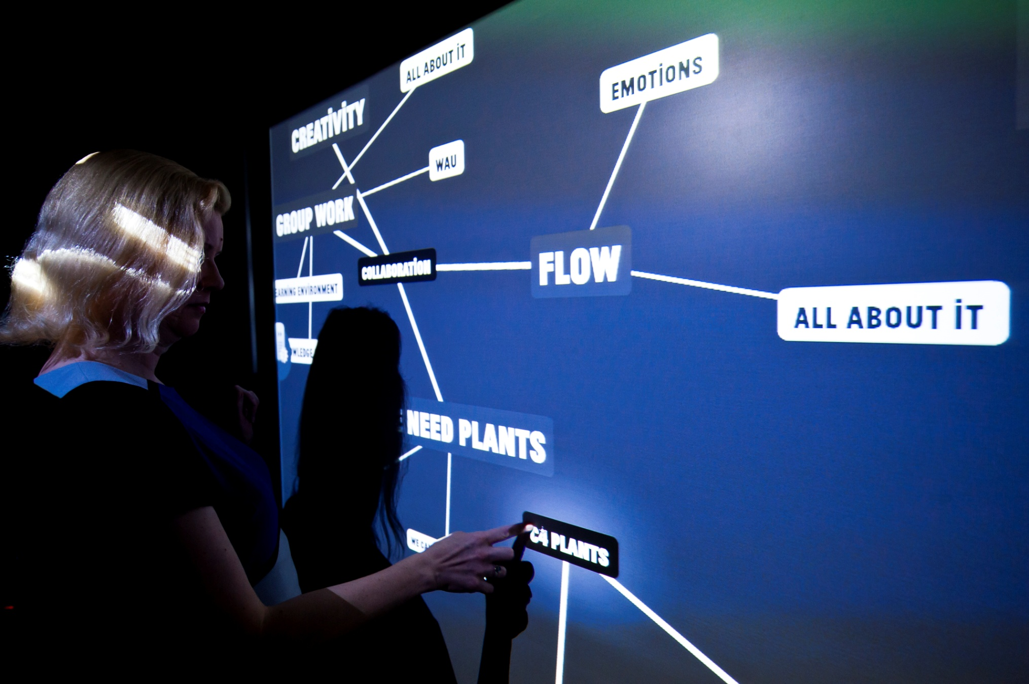
2. Education of professional Teacher at the University of Helsinki

Slide 15
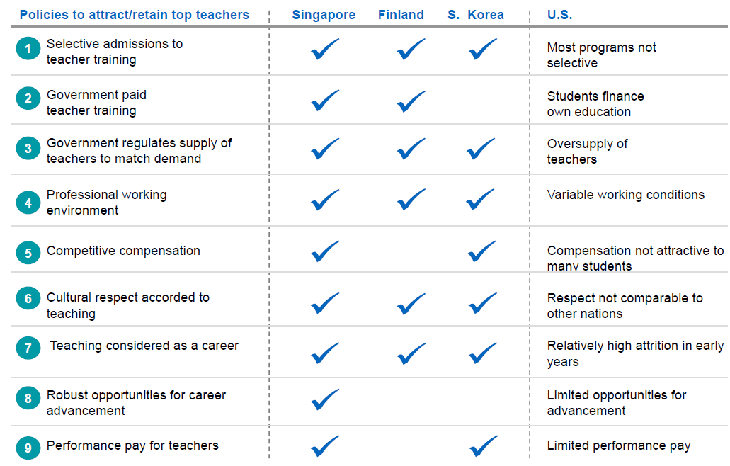
What is common in teacher education in high performing PISA countries?
McKinsey &Company Auguste, B., Kihn, P., & Miller, M. (2010) Closing the talent gap: Attracting and retaining top third graduates to a career in teaching: An International and market research-based perspective. McKinsley & Company

Slide 16
What is common in teacher education in high performing PISA countries?
According to McKinsey &Company Auguste, B., Kihn, P., & Miller, M. (2010) Closing the talent gap: Attracting and retaining top third graduates to a career in teaching: An International and market research-based perspective. McKinsley & Company

Slide 17
National Teacher Education Strategy: The teacher education programmes should help students to acquire:
high-level subject knowledge, pedagogical content knowledge, contextual knowledge, knowledge about nature of knowledge, …
social skills, like communication skills, skills to use ICT,
moral knowledge and skills, …
knowledge about school as an institute and its connections to the society (local contexts and stakeholders),
skill to co-operate with other teachers, parents, …
skills needed in developing one’s own teaching, the teaching profession and the local curriculum,
academic skills, like research skills, ...
high quality knowledge
base
networks & partnerships
life-long- learning

Slide 18
Individual characteristics of a professional teacher (Hargreaves & Goodson, 1996; Evans, 2008; Freidson, 2001; Urban & Dalli, 2011; Evetts, 2012)
Conceptual knowledge base ,
Specific professional ideology, incl. shared understanding of professional values and ethics code .
Include social and individual elements
Strong institutionalization of an occupational group.
Self-regulation of and -control over the work (self-assessment)
Autonomous role in planning and implementation (academic expertise).
Work (activities) is complex and not easy to standardize.
high quality knowledge
base
networks & partnerships
Not only the content of teacher education courses is important but how studies are organised in teacher education…
life-long- learning

Slide 19
Research on teacher professionalism refers to status of teachers and depends on … (Müller et al, 2010; TALIS 2008 survey)
individual characteristics (teacher knowledge, teaching philosophy, interaction skills, …)
school level factors (shared leadership, collaboration, school-society-family partnership …)
cultural and education policy factors at state level or context (trust culture, …)
^{All important}

Slide 20
A secondary (middle and high school) teacher
typically teaches at grades 7 to 12 (ages 13 to 19)
teaches typically one major and one minor subjects (e.g. math and physics)
A primary (elementary) school teacher (a class teacher)
teaches at grades 1 to 6 (ages 7 to 13)
teaches typically all 13 subjects

Slide 21
Teacher education at the University of Helsinki
University of Helsinki (11 faculties, 38 000 students, 7 400 staff members)
Faculty of Behavioural Sciences
Faculty of Arts
Faculty of Science
Faculty of Biosciences
Faculty of Theology
Faculty of Social Sciences
Dept. of Teacher Education
Teacher Training Schools
Secondary teacher education: pedagogical studies + subject studies
Primary teacher education

Slide 22
Structure of the Master’s degree of a secondary teacher: 3 + 2 years, 300 cr
Teachers
benefit of the research orientation
while they make the school curriculum,
plan, implement
and evaluate
teaching and learning
Bachelor’s level (180 cr)
Master’s level (120 cr)
180
160
140
Master- thesis
120
Subject matter knowledge, knowledge about teaching and learning, and school practise are integrated into the students’ own personal pedagogical view
cr = 27 hours of work
Study credits
100
80
BSc thesis
60
Ped. thesis
40
Teaching practice
20
0
Major Subject
Minor Subject
Pedagogical
Communication
studies
and language
studies

Slide 23
Structure of the master degree of a primary teacher: 3 + 2 years
Finnish language, PCK
Mathematics, PCK
Bachelor
Bachelor
’
’
s level (180
s level (180 cr)
Master
’
s level (120 cr)
Physics, PCK
180
Chemistry, PCK
160
Biology, PCK
Master
Geography, PCK
Master
-
140
-
thesis
thesis
History, PCK
120
cr = 27 hours of work
Religion/ethics PCK
Study credits
100
Pedagogical studies
Sports
80
Teaching practice
Arts
60
BSc thesis
Music
40
Crafts
20
0
Major
Multi- disciplinary studies
Minor
Communication
Education or
Ed. Psych.
Subject
and language
studies

Slide 24
The pedagogical studies helps the students …
to integrate subject matter knowledge, knowledge about teaching and learning and school practice into their own personal pedagogical view;
to become aware of the different dimensions of the teacher profession: social, philosophical, psychological, sociological, and historical basis of education;
to be able to collaborate in different networks and partnerships;
to be able to reflect on their own personal pedagogical “theory/view” (reflection for, in and on action);
to act as autonomous professional in planning, implementing and assessing teaching and learning;
to develop potentials for lifelong professional development through research orientation.

Slide 25
Teaching Practice - Reflection in Action http://www.youtube.com/watch?v=SDCm1fIPKH8&playnext=1&list=PLEE385BC5A0125995&feature=results_main

Slide 26
Finnish educational context
Helsinki, February 2011, 12:00
3. Examples of continuous improvement of education by the professional teachers at the school site

Slide 27
World around the school is changing …
Technology
Working life
Diversities inside the communities
Amount of knowledge and skills and nature of knowledge
Free time
Population
Climate change Natural environment
Economy
Living environment;
Youth culture
Diverse learners

Slide 28
21st century competences Binkley, M., Erstad, O., Herman, J., Raizen, S., Ripley, M., Miller-Ricci, M. & Rumble, M. (2012). Defining twenty-first century skills. In P. Griffin, B. McGaw & E. Care (Eds.) Assessment and teaching of 21st century skills (pp. 17–66). Dordrecht: Springer
Ways of thinking | - Creative and critical thinking - Learning to learn, use of metacognition
Ways of working | Communication, collaboration and networking - Inquiry (questioning, concluding), explaining - Generating ideas
Tools for working | - Broad literacy (network of concepts, skills) - Educational technology
Context for working | - Personal, social, local, global - Working life
Attitude needed for working | - Willingness to use knowledge, engagement - Self-efficacy

Slide 29
An educational innovation is as an idea or practice …
that is new to one (or a group) who create it
that one meets first time
that one knows but has not adopted or rejected it (Rogers, 2003)

Slide 30
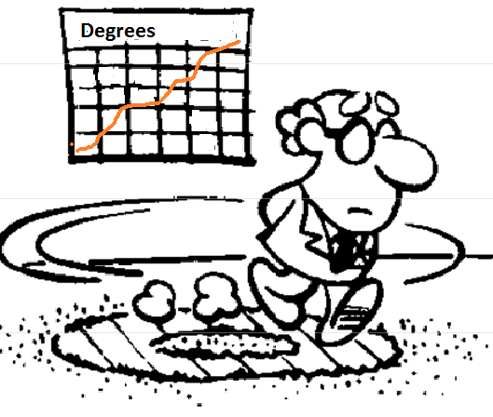
Creative process and problem-solving

Slide 31
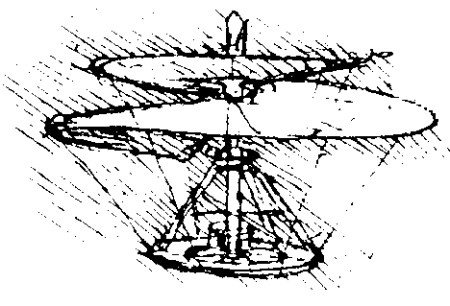
Innovations are created a through a creative process
In a creative process one is combining ideas and facts he/she already knows in order to create something new (at least for him (Fisher, 1990, 29-31).
You should be ready to ask: ”Could this be organised in a different way?”

Slide 32
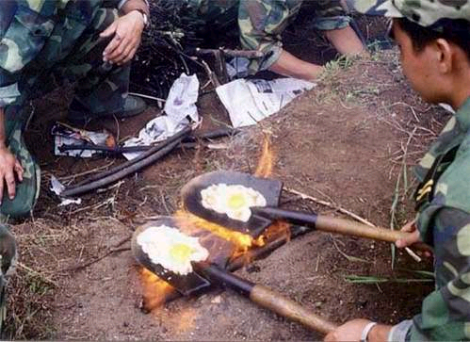

Slide 33
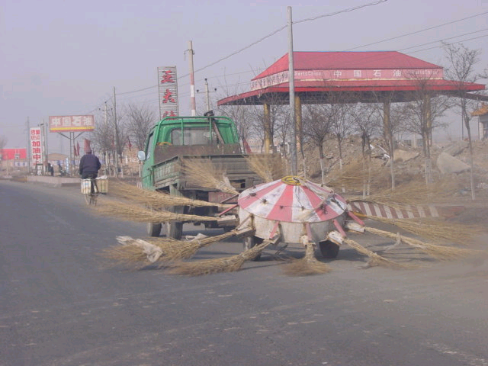

Slide 34
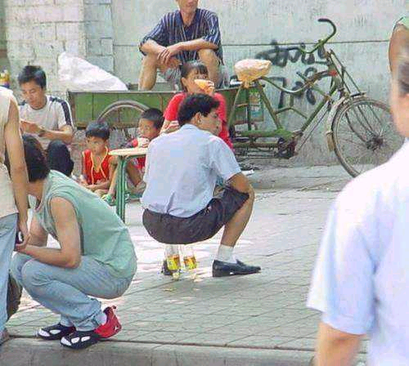

Slide 35
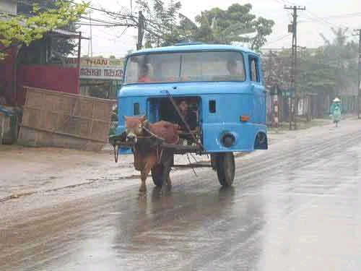

Slide 38
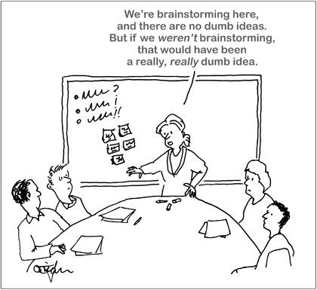
We are brainstorming here, and there are no dumb ideas.

Slide 39
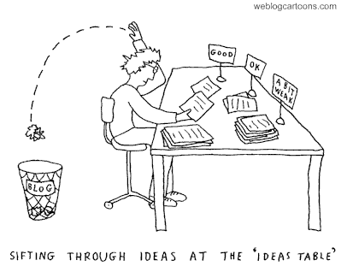
I am happy to have almost 100 ideas. Now it is time for evaluating the ideas

Slide 40
A creative problem-solving process
An open problem
Facts Opinions Aims
Visions
Ideas
Evaluation of
ideas
Accepting the outcome of the creative process
Implementation

Slide 41
Ideointimenetelmiä
Generating of ideas is the hearth of the problem-solving process

Slide 42
8x8 method for generating ideas for the smartphone use
Making notes - text - graph
Looking for info: Google, Bing
Sharing
SkyDrive
Messenger
Vimeo
- Skype
Applications
Office programs
Sääkaveri (weather app)
Map software / navigator
Calculator
Water level app
Helsingin sanomat app
Vimeo
Skype-...
Recording notes - picture - video - audio
How I use smartphone in learning
E-mail
Looking notes - listening - surffing
Wiki YouTube Newspapers
Applications

Slide 43
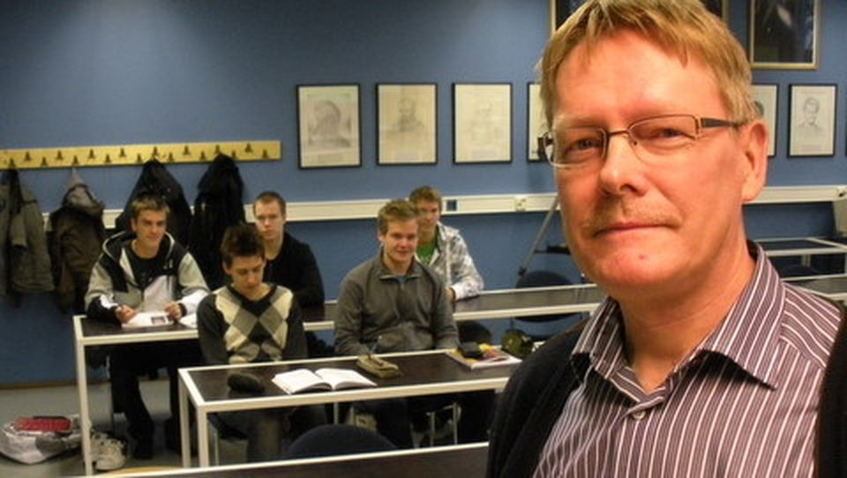
We have designed in a grade level team the use of smartphones in science learning in order to personalise pupils’ learning

Slide 44
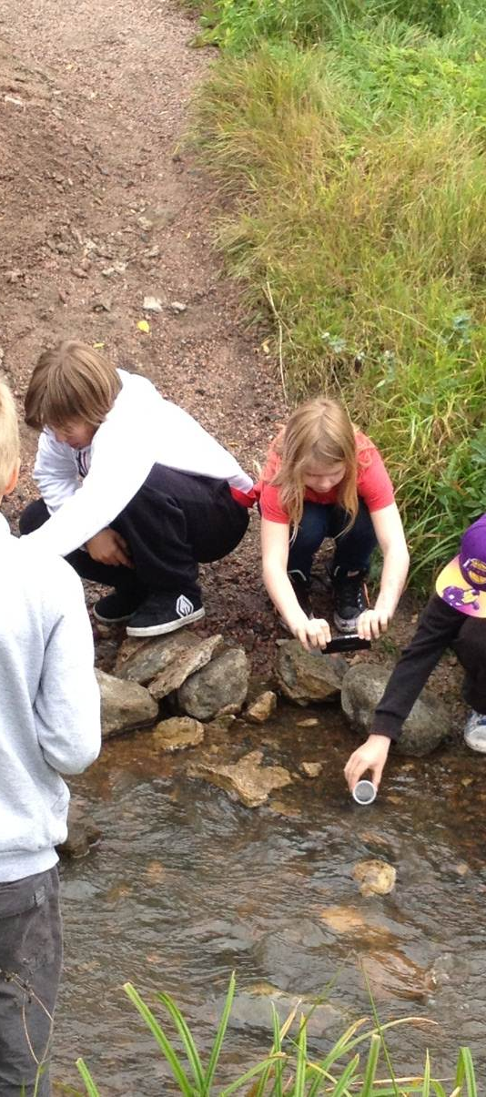
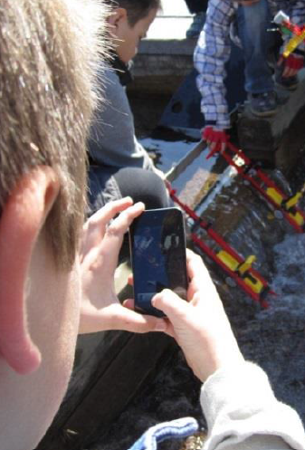
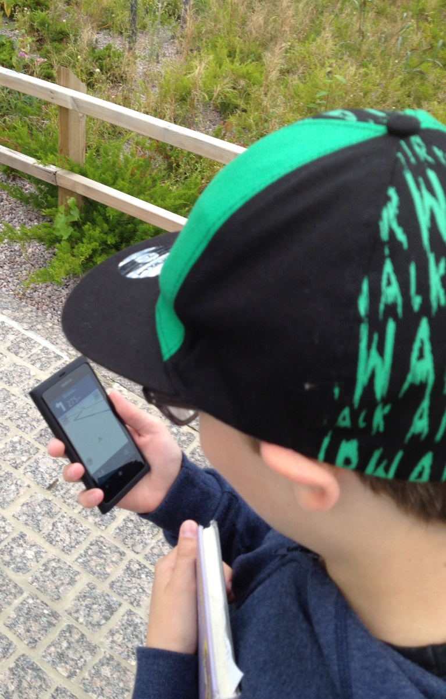

Slide 45
Smartphones in Education: Electricity Project (kutoset) https://www.youtube.com/watch?v=YpBU7ZOuyR0 Smartphones in education: Exploring sky (vitoset) https://www.youtube.com/watch?v=GuRw5Em8zS0

Slide 46
Personalisation of learning through the use of mobile devices
Personalizing of learning through choosing …
Is guided by general differentiation principles, like - respectful tasks - flexible grouping - continuous formative assessment
Content
Process
Product
Learning profile
Readiness
Interest
Use of mobile phone personalise
Use of mobile phone personalises
Use of mobile phone could increase interest: - content - context - task - knowledge
A mobile phone is a tool for rich learning resources
According to student’s
Tomlinson, 1999

Slide 47
Participants and data
49 pupils (27 male, 22 female, 10 special needs pupil, age 11)
3 teachers and 3 researcher
Pupils develop and use smartphones (Lumia 800) with data package
Data gathering through
Documents created during the project
Socrative questionnaire (ESM)

Slide 48
Smartphone use in science project - all respondents
teacher’s influence on pupils use of smartphones in primary science learning
Day

Slide 49
21st century competences Binkley, M., Erstad, O., Herman, J., Raizen, S., Ripley, M., Miller-Ricci, M. & Rumble, M. (2012). Defining twenty-first century skills. In P. Griffin, B. McGaw & E. Care (Eds.) Assessment and teaching of 21st century skills (pp. 17–66). Dordrecht: Springer
Ways of thinking | - Creative and critical thinking - Learning to learn, use of metacognition
Ways of working | Communication, collaboration and networking - Inquiry (questioning, concluding), explaining - Generating ideas
Tools for working | - Broad literacy (network of concepts, skills) - Educational technology
Context for working | - Personal, social, local, global - Working life
Attitude needed for working | - Willingness to use knowledge, engagement - Self-efficacy

Slide 50
I have designed with other teachers, pupils and out-of-school collaborators a new model for School-Community Collaboration (SCC) that engage primary pupils in SCC.
SSC creates learning environments for creative use of ICT.

Slide 51
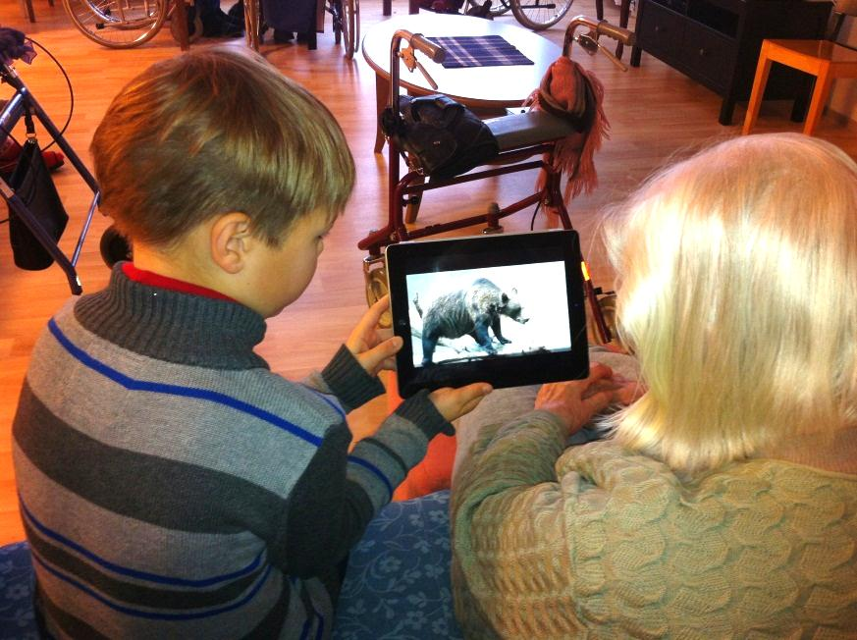
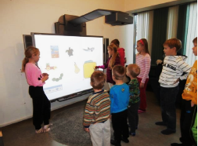

Slide 52
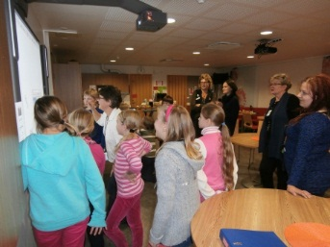
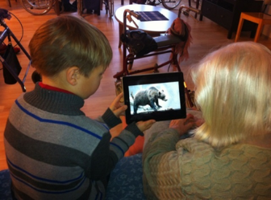
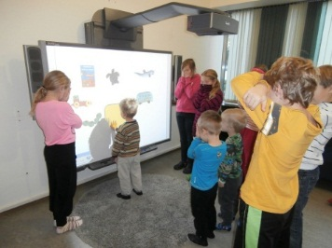
School, Kindergarten, Senior Home and Library Partnerships through the Use of ICT
Crossing of boundaries creates learning environments for engaging pupils in learning
Versatile use of ICT as an Innovation
Tutor-students as innovators, innovation adaptors and experts
Active, responsible, participation

Slide 53
An action team in partnerships is based on Epstein’s (2011) model.
Action Team
Adults
City Library
Senior Home
Tutor-Students
Ten Fourth graders
Kindergarten
School
One Teacher
Headmaster
Researcher
Manager
One Kindergarten teacher
One kindergarten nurse
Manager
Two library workers
Manager
One senior home worker
Five girls and
five boys

Slide 54
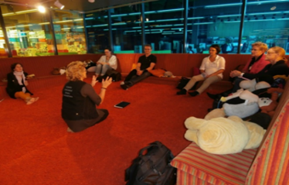
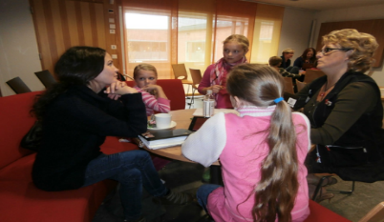
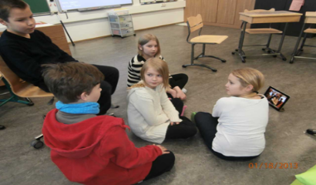
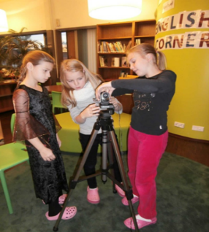
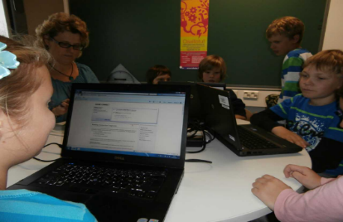
Collaboration in practice
Getting familiar to each other
Planning the action together
Training
Implementing to practice
Dat collection trough questionnaires and interviews and analysis
Sharing best practices

Slide 55
Smartphones in education - Finnish Forest Fair (vitoset) https://www.youtube.com/watch?v=yvjIsfZhKfA

Slide 56
21st century competences Binkley, M., Erstad, O., Herman, J., Raizen, S., Ripley, M., Miller-Ricci, M. & Rumble, M. (2012). Defining twenty-first century skills. In P. Griffin, B. McGaw & E. Care (Eds.) Assessment and teaching of 21st century skills (pp. 17–66). Dordrecht: Springer
Ways of thinking | - Creative and critical thinking - Learning to learn, use of metacognition
Ways of working | Communication, collaboration and networking - Inquiry (questioning, concluding), explaining - Generating ideas
Tools for working | - Broad literacy (network of concepts, skills) - Educational technology
Context for working | - Personal, social, local, global - Working life
Attitude needed for working | - Willingness to use knowledge, engagement - Self-efficacy

Slide 57
National core curriculum
4. How do school site supports the professionalism of teachers

Slide 58
What is adoption and what influences it?

Slide 59
Factors influencing the adoption of educational innovations (Fullan, 2007)
Properties of the innovations: usability aspects (learnability, newness, …), influence to learning and engagement, …
Local characteristics: curriculum and assessment, teachers’ beliefs, leadership, how teachers and pupils collaborate, networks and partnerships (inside – external),
External factors: education context, policy, 21st century skills movement, reforms in education, teacher education, level of decentralization, …
Communication channels
Could be supportive to the professionalism of teachers

Slide 60
Values and Aims of a Finnish School Values: human rights, equality, democracy, natural diversity, sustainable development, endorsement of multiculturalism, individualism (responsibility, a sense of community), respect for the rights …
Professional teachers
Knowledge base
Collaboration
Life-long learning
Local curriculum
and environments
Broad aims
Learning environments
Leadership and
quality culture
Goal orientation and interaction
Quality culture
Networks & partnerships
Learning of 21st century competences
Global
Stakeholders
Parents
Finnish society
Partners
Diverse learners
Finnish school

Slide 61
Direct quotations in the presentation
Three experienced teachers were interviewed: How do you experience the support of the school to the design and adoption of educational innovations from the point of view of - leadership, - teachers’ competence, - learning environments - networks and partnerships of the school
The answers were analysed using a deductive content analysis

Slide 62
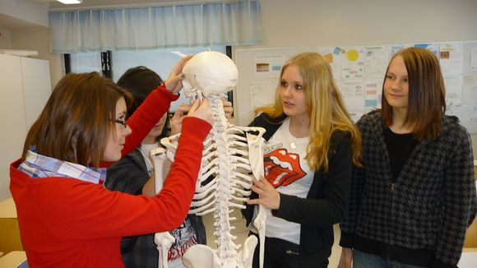
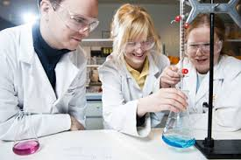
Teacher professionalism/ effectiveness

Slide 63
How teachers experience their professionalism?
In our school, teachers have versatile subject and pedagogical knowledge.
We share experiences and know-how in pedagogical coffee meetings.
.
It is important to learn to use new technology continuously together with other teachers and students.

Slide 64
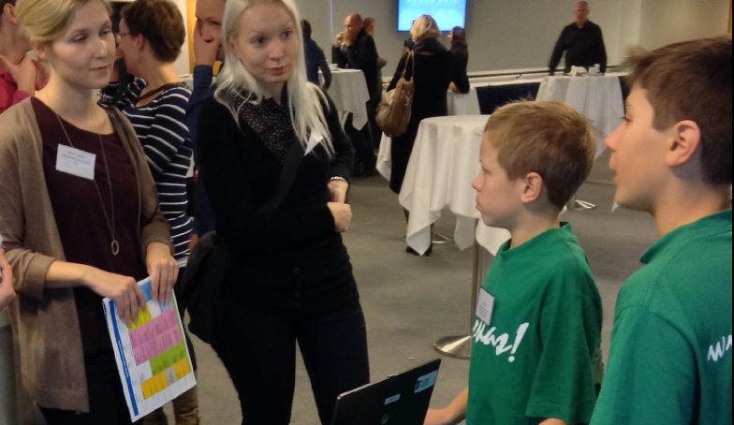
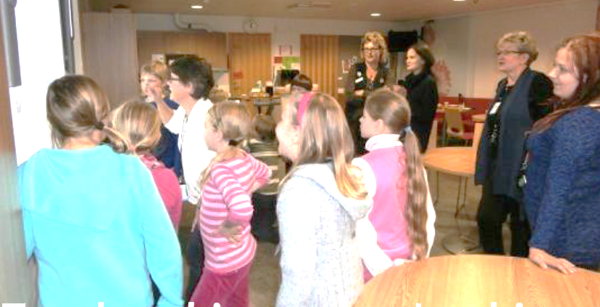
Pupils can teach teachers to use technology

Slide 65
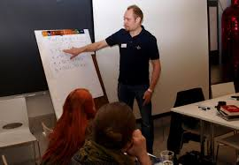
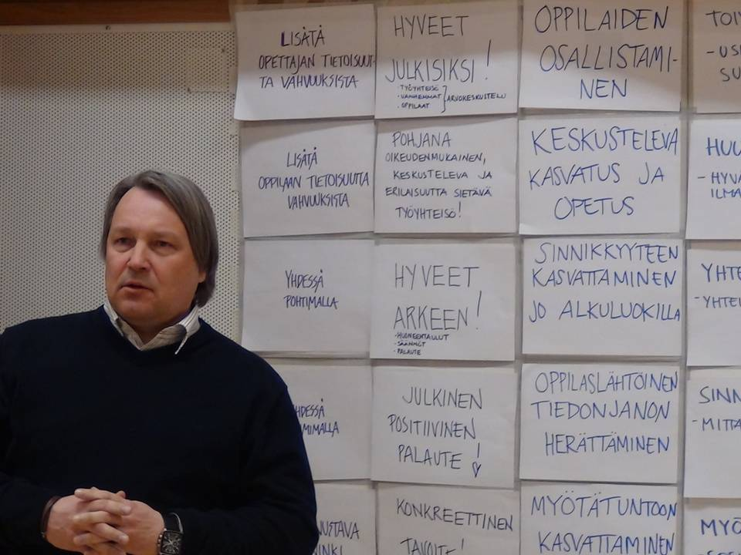
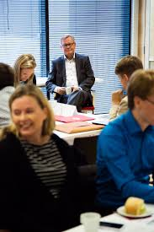
Leadership
Combination of instructional and transformational leadership (Marks & Printy, 2003; Huber & Muijs, 2010):
planning and implementation of the local curriculum, allocation of the school budget and quality assurance
goal orientation - including a common vision; collaboration and interaction; and sharing of responsibilities.
Combination of instructional and transformational leadership (Marks & Printy, 2003; Huber & Muijs, 2010)

Slide 66
How teachers experience leadership?
You can recognise goal orientation in the operations of the school.
Interaction is organised through …
Openness and informing of forthcoming issues is important. … The strength in leadership is shared leadership.
The teachers and the principals should share a common vision … versatile collaboration support the adoption ….
Close to transformational leadership (Marks & Printy, 2003; Huber & Muijs, 2010)

Slide 67
A teacher leader (Lieberman, 1992, Harris, 2003)
is goal oriented
can plan, implement and assess his/her own practices and students’ learning
has deep understanding on teaching and learning
is able to work collaboratively with other teachers
is a facilitator, coach, mentor or a trainer of other teachers
is able to consume research based knowledge
Is a curriculum specialist and innovator for new approaches
is able to use assessment outcomes for school development.
…
knowledge base
networks & partnerships
life-long- learning

Slide 68
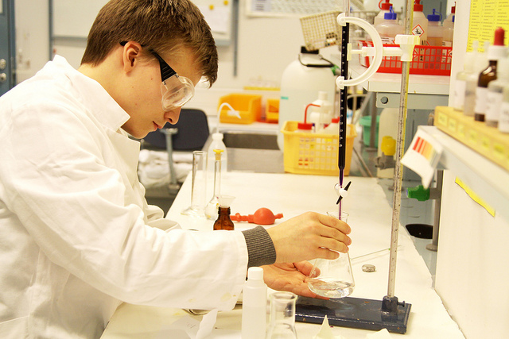
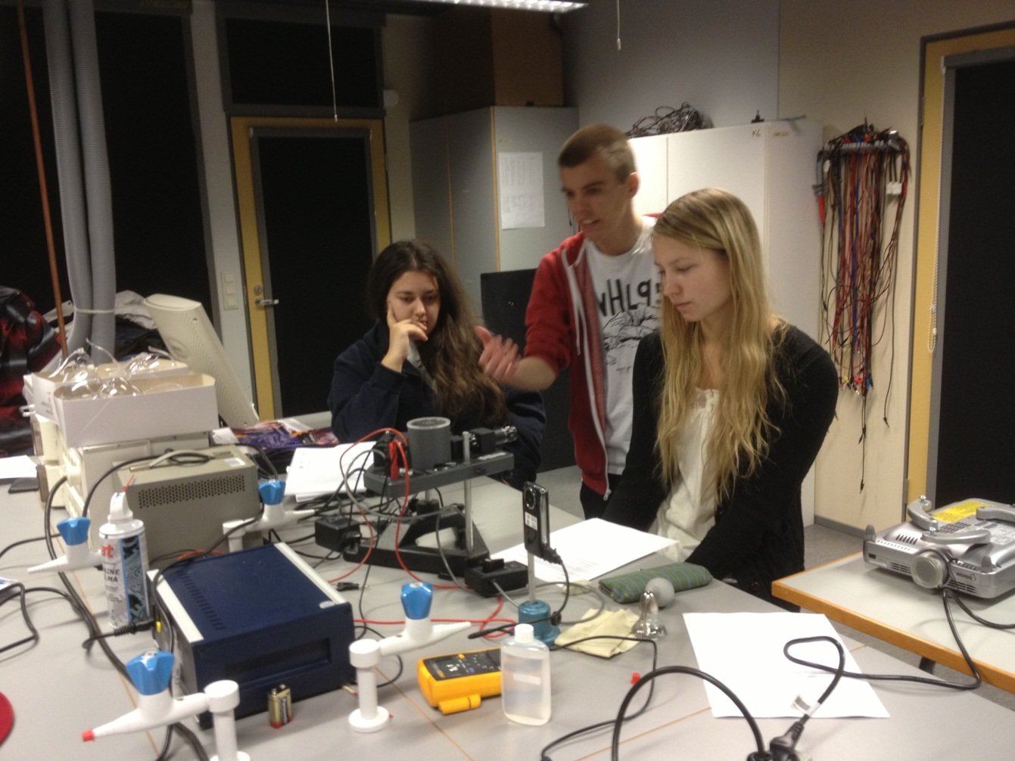
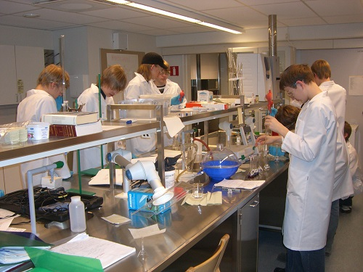
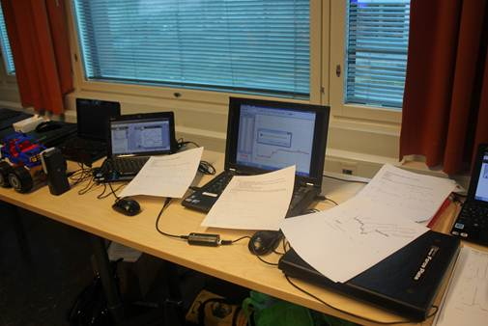
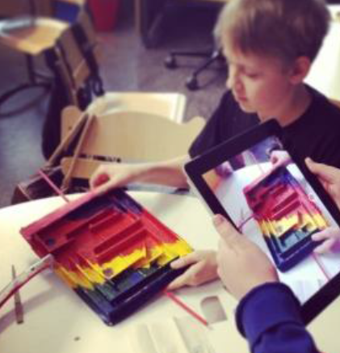
Learning environments

Slide 69
How teachers experience learning environments?
More we have technology and resources, more we need co-planning, organising and support
It is important there are versatile learning spaces where students are able to engage in learning alone or in a small group. We need to design new environments.
It is important the teachers share a common goal [e.g., on the use of technology in teaching and learning] and support each other to approach these goals

Slide 70
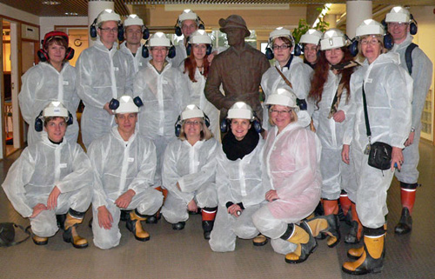
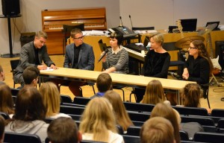
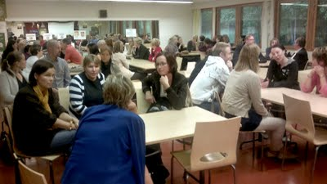
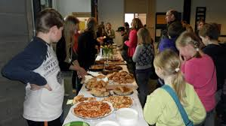
Networks and partnerships
Networks are for sharing (communicating) ideas, opinions and experiences Networks support adoption of educational innovations: The information flows through networks (Rogers, 2003).
In a partnership parties collaborate and share common aims, information and services: School-family-partnership facilitates the sharing of educational aims and responsibilities in order to support the development and learning of a student (Epstein, 2009).

Slide 71
How teachers experience networks and partnerships?
Networks and partnerships support communication in levels: - school level (grade level and leadership teams); - city level (thematic networks, principal networks); - school-family-society partnerships; - national level networks.
The use of technology supports networking
The networking should start from our needs – not coming as orders from the city level. In order to support adoption …
School-family collaboration is organised through parents’ clubs & classroom committees.

Slide 72
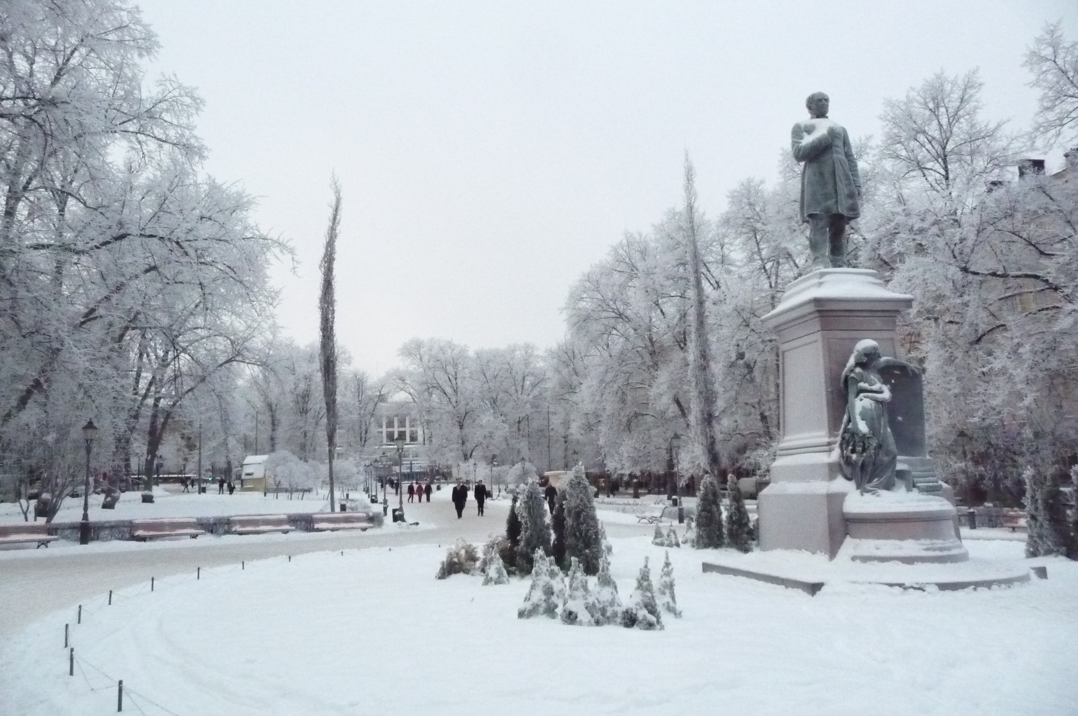
4. Discussion

Slide 73
Which school level factors support the design and adoption of educational innovations?
Finnish school is supportive for communication: - characteristic of leadership and professionalism, - networks and partnerships.
Teacher professionalism depends on: - teacher competence: - teacher knowledge base
- networks & partnerships (collaboration, facilitator)
- life-long-learning (consume research based knowledge; reflection)
- school level factors - cultural and education policy factors
Factors influencing the design and adoption of educational innovations:
- properties of the innovation - local characteristics (environments, leadership,…)
- external factors (policy, culture, …)
73

Slide 74
In an innovative school we need …
more ... |  | less ...
professionalism | – | bureaucracy
long term policy and a vision | – | ad hoc ideas coming from the politicians
decentralization, decision making and assessment at local level | – | standardization, inspection and national testing
trust based responsibility (self-evaluations, listening of pupils and municipality people/ parents voice) | – | test based accountability
collaboration, networking and partnerships | – | competition and rankings

Slide 75
Thank you!

