Slide 1
Innovative School is
Supportive for the Design and Adoption of Educational Innovations
GLA, Newyork, Wednesday, April 9, 2014
Jari Lavonen, Department of Teacher Education, University of Helsinki, Finland
Jari.Lavonen@Helsinki.Fi

Slide 2
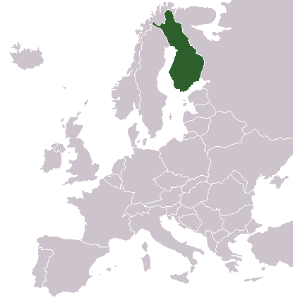
Republic Finland
In northern Europe,
area of 340 000 km²
(12 times Massachusetts)
5,4 million people
(about Massachusetts)
Success in
- welfare
- education

Slide 3
World around the school is changing …
Technology
Working
life
Diversities inside communities
Amount of knowledge and nature of knowledge
Free time
Population
Climate change
Natural environment
Economy
Living environment
Youth culture
Diverse learners
Finnish school

Slide 4
Presentation is based on a research project
Innovative School (part of the Finnable 2020 consortium),
funded by the Finnish Funding Agency for Technology and Innovation (Tekes),
There are senior researchers Jari Lavonen & Kalle Juuti and PhD students Tiina Korhonen, Minna Kukkonen
& Kati Sormunen in the project.
Content of the presentation:
  Theoretical frame
  Finnish education context
  An innovative school which is supporting design and adoption of innovations
  Finnish teacher education
  Discussion

Slide 5
Question to be answered
Which school level factors support the adoption of educational innovations in Finnish education context and how?
An educational innovation is as an object, idea or practice
  that is new to one (or a group) who create it
  that one meets first time
  that one knows but has not adopted or rejected it
  (Rogers, 2003)

Slide 6

I have designed with other teachers, students and out-of-school collaborators a new model for School-Community Collaboration (SCC) that emphasises the use of ICT and inquiry oriented learning.
SSC creates learning environments and possibilities for creative and collaborative problem-solving and inquiry.
We have adopted it to our monthly use

Slide 7

We have designed in a grade team the use of smartphones in science learning in order to personalise learning in situations where students collect data during science inquiry activities.
Versatile use of smartphones in inquiry was adopted by other grade teams.

Slide 8



1. Theoretical frame

Slide 9
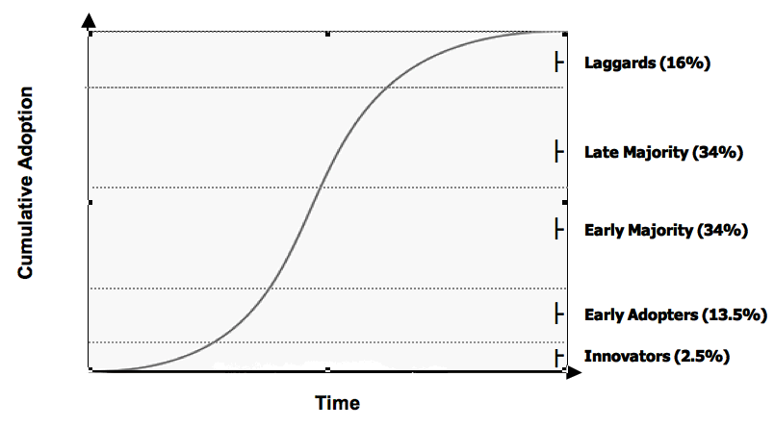
Diffusion and adoption of (educational)innovations (Rogers, 2006)
S-shape diffusion process by science teachers
Adopter categories of science teachers:
Cumulative Adoption
By Science Teachers
through communication

Slide 10
Adoption of educational innovations for science teaching and learning (Fullan, 2007)
How to support the adoption of educational innovations?
Topics to be taken into account
  Properties of the innovations: usability aspects (learnability, newness, …), influence to learning and motivation, …
  Local characteristics: curriculum and assessment, quality assurance, professionalism of teachers, leadership, networks and partnerships (inside – external), …
  External topics: education context, policy, 21st century skills movement, reforms, teacher education, level of decentralization: autonomy - accountability, …
Could be supportive
to professionalism of
teachers

Slide 11
Characteristics of a professional development program, supporting the adoption of educational innovations
(Van Driel, Beijaard & Verloop, 2001; Lavonen, Juuti, Aksela, & Meisalo, 2006)
a series of face-to-face meetings and distance supported working at school level,
a group of teachers from different schools;
cumulative development of teachers’ competencies starting where they are;
co-planning, implementation and assessment of a teaching modules;
collaboration and reflection in small groups;
versatile contexts including ICT use and integration of it to science activities, like inquiry activities;
continuous follow up and assessment of the program
a follow-up (short) meeting some months later for sharing the results of the efforts
Structure
Training
Assessment

Slide 12
Finnish educational context
Helsinki, February 2011, 12:00
Direct quotations in the presentation

Slide 13
Direct quotations in the presentation
Three experienced teachers were interviewed:
How do you experience the support of the school to the design and adoption of educational innovations from the point of view of
- leadership,
- teachers’ competence,
- learning environments
- networks and partnerships of the school
The answers were analysed using a deductive content analysis

Slide 14
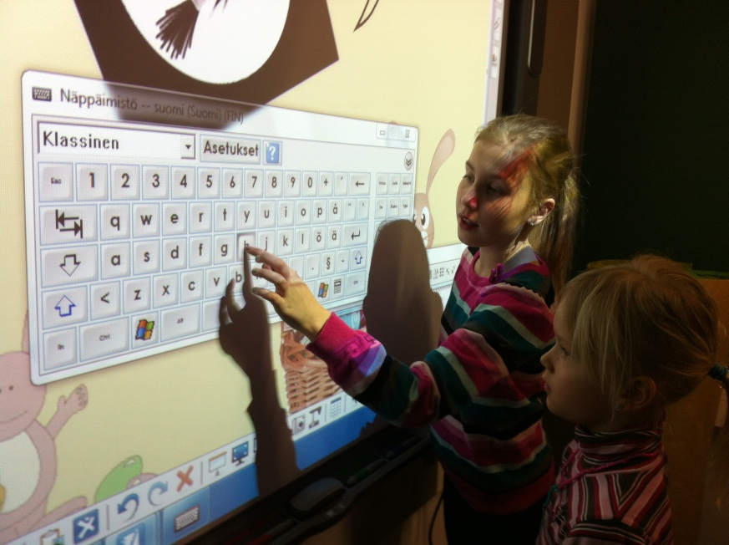
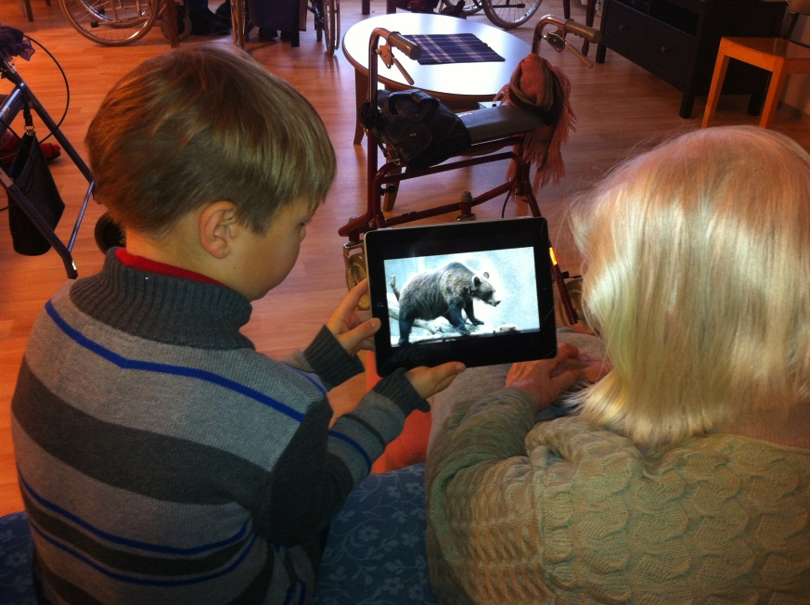
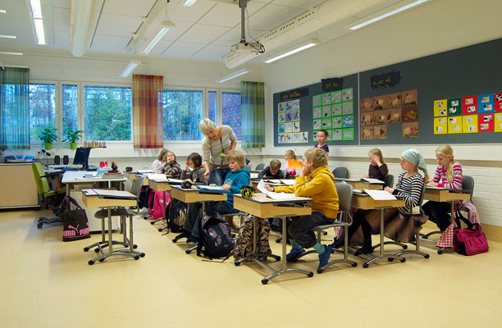
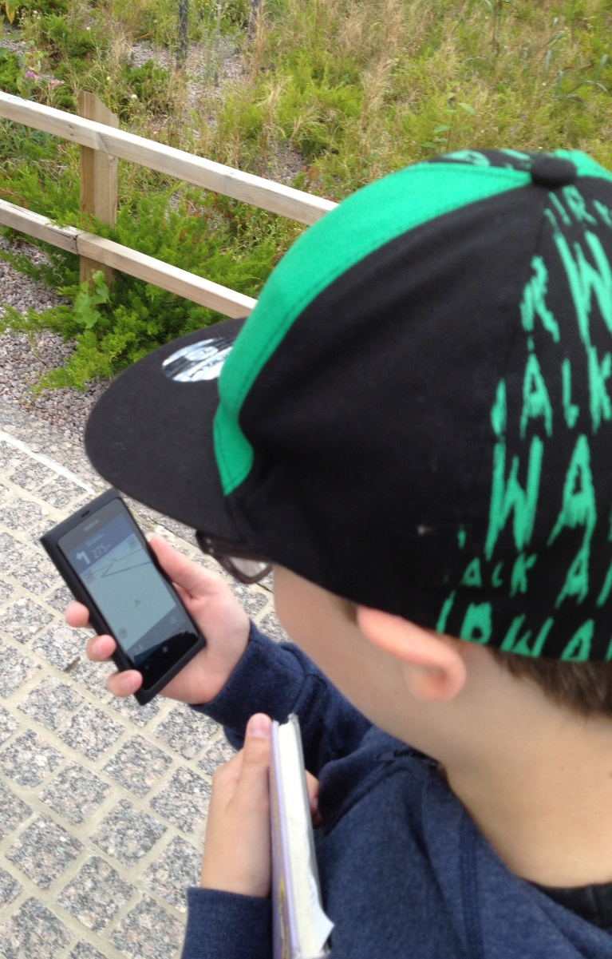
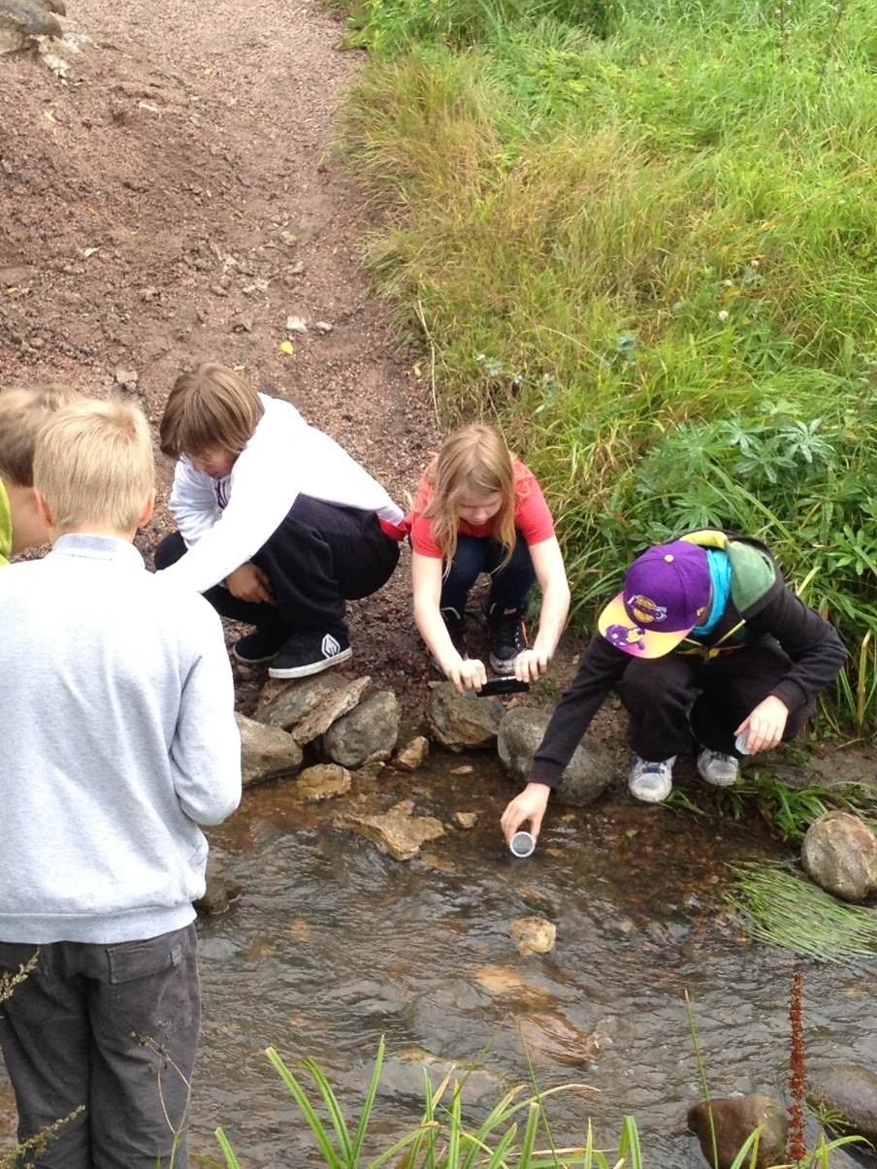
2. Finnish education context

Slide 15
Characteristics of Finnish Education
Laukkanen (2008), Niemi et al. (2012), Sahlberg (2011)
Common, consistent and long-term policy
- models for teacher & comprehensive education are 40 years old
Educational equality
- need to mitigate socio/economic backgrounds
- education is free (books, meals, health care, …)
- well-organised special education (inclusion) and counselling
Devolution of decision power to the local level
- leadership and management at school level (headmaster)
- teachers are responsible for local curriculum and assessment
The culture of trust and co-operation are based on professionalism (academic expertise):
national level – district – school – families
- no inspectors, no national exams (testing) …
- no private tutoring or evening schools

Slide 16
 | Outcome based –model | Finnish ‘input’ –model
Aims as | Learning outcomes | Broad aims for teaching/ learning
Important level | National/district level assessment | Assessment at the level of school and classroom (teacher)
Focus … | Too often on product | on process and product
 | +a learner knows what he/she should learn and is active in the learning process - competitive school culture: ranking of students and schools - “teaching to the test” | +co-planning +a teacher conducts assessment for enhancing learning processes - problematic to compare the quality of learning outcomes and select students to next level
Notes:
*Spelling correction for district
*removed “Too” from the focus for outcome based-model
*The format on here might be too large for the slide?

Slide 17
Levels and interactions in Finnish Education … + Leadership
According to PISA 2012 School Questionnaire ….
70% of the principals in U.S. and 30% in Finland were encouraging teachers at least once a month to make sure that the professional development activities are in accordance with the curriculum aims.
Partners:
- union of
municipalities
- universities
- industry
Interest
groups
- labour
unions
- families
- ...
Level 1
national
Level 2
district
school
Level 3
classroom
General National Objectives and Education policy
National level curriculum and assessment
62% of Finnish and 44% of U.S. teachers feel that they are responsible for the preparation of a “local curriculum”
Municipalities: Local curriculum
Schools: principals & teachers
Teacher education
Learning materials
Teaching
Learning
Parents
Leadership & management
70% of Finnish and 40% of U.S. teachers feel that they are really responsible of student assessment
4 % of the Finnish schools and 35% of the U.S. school reported constant pressure from many parents side.

Slide 18
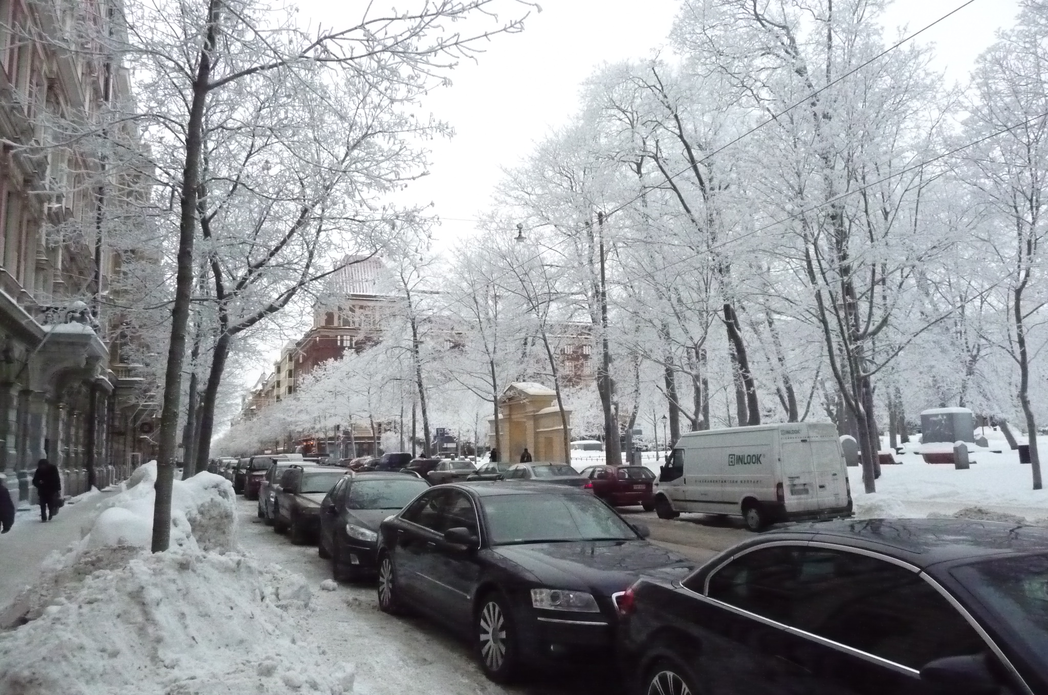
National core curriculum
3. An innovative school model which is supporting design and adoption of innovations

Slide 19
Values and Aims of Innovative Finnish Schools
Professional teachers
Subject matter and pedagogical
knowledge
Collaboration skills
Partnership skills
Competence for lifelong learning
Local curriculum
And versatile
environments
Broad aims
Future learning
environments and
tools
Teaching and
assessment methods
Leadership and
quality culture
Distributed
leadership and
management
Goal orientation and interaction
Quality assurance
Teams and teamwork
Family-school,
society-school
partnership
Collaboration
Informing /
interaction
Support for adoption of educational innovations
Finnish
society
Partners
Global
Stakeholders
Parents
Diverse learners
Finnish school

Slide 20
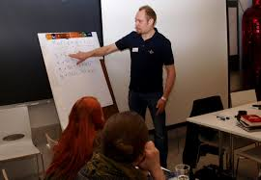
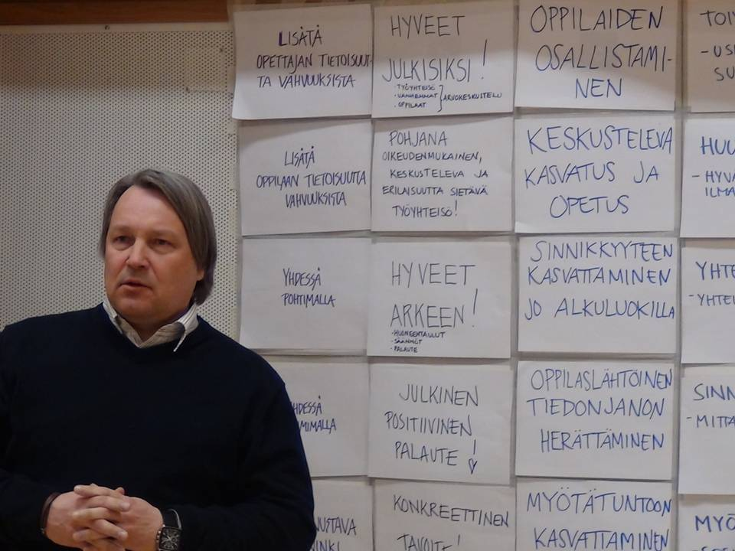
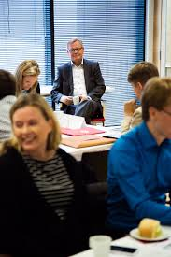
Leadership

Slide 21
The characteristics of leadership in an innovative school in the Finnish context
Combination of instructional and transformational leadership (Marks & Printy, 2003; Huber & Muijs, 2010):
goal orientation, including a common vision; collaboration and interaction; and sharing of responsibilities.
planning and implementation of the local curriculum, allocation of the school budget and quality assurance
Leadership to be demonstrated by employees are
participation, empowerment, and commitment.

Slide 22
Teacher leadership (Katzenmeyer and Moller, 2001)
Broad meaning of teacher leadership fits well with the Finnish teachers
A teacher leader (Lieberman, 1992, Harris, 2003)
has a clear vision and is goal oriented
can plan, implement and assess his/her own practice and students learning
has deep understanding on teaching and learning
is able to work collaboratively with other teachers
is a facilitator, coach, mentor or a trainer of teachers
is able to consume research based knowledge
Is a curriculum specialist and innovator for new approaches
is able to uses assessment outcomes for whole school development.
…
high quality
profesionalism
networks &
partnership
life-long-
learning

Slide 23



How teachers experience leadership?
You can recognise goal orientation in the operations of the school.
Interaction is organised through monthly meetings and weekly info breaks
Openness and informing of forthcoming issues is important. … The strength in leadership is shared leadership.
ICT is used in school-home collaboration
The teachers and the principals should share a common vision … versatile collaboration support the adoption … The role of the school principal is important.

Slide 24
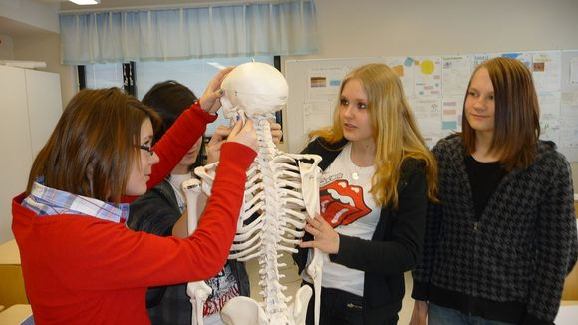
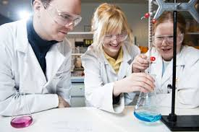
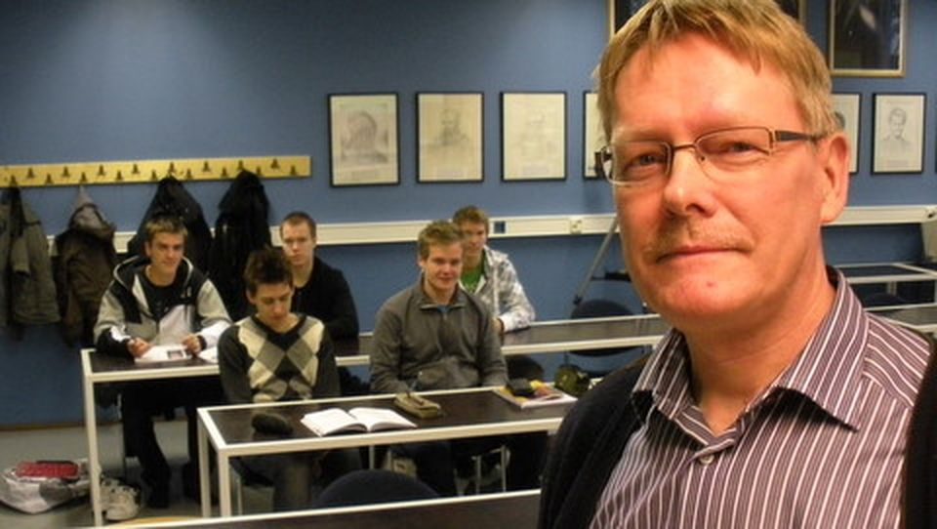
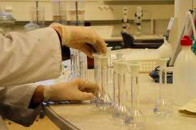
Teacher professionalism/ effectiveness

Slide 25
Teacher professionalism (and professionality)
(Müller et al, 2010; TALIS 2008 survey)
Teacher professionalism refers to status of teachers and depends on
  cultural and education policy factors at state level or context (accountability policy ⬄ trust culture, …)
  school level factors (shared leadership, collaboration, school-society-family partnership …)
  individual characteristics (teacher knowledge, teaching philosophy, interaction skills, …)
(Teacher professionality is built on knowledge, skills and procedures used at work. )
^{All important}
Are supportive for
design and adoption
of innovations

Slide 26
Diverse definitions to professionalism
(Hargreaves & Goodson, 1996; Evans, 2008; Freidson, 2001; Urban & Dalli, 2011; Evetts, 2012)
Characteristics of professionality:
The professional (conceptual) knowledge base
Self-regulation of and -control over the work (self-assessment).
Specific professional ideology, incl. shared understanding of professional values and ethics code .
Include social and individual elements
Strong institutionalization of an occupational group.
Autonomous role in planning and implementation.
Work (activities) is complex and not easy to standardize.
high quality
profesionalism
networks &
partnership
life-long-
learning

Slide 27
How teachers experience teacher professionalism?
Teachers named three main areas which are crucial in their professionalism from the point of view of design, implement and adopt of educational innovations:
- pedagogical competence,
- their skills in partnership and networking
- willingness to life-long-learning, design and adoption of
innovations
In our school teachers has versatile subject and pedagogical knowledge.
We share experiences and know-how in pedagogical coffee meetings.
Teachers are eager to develop their own work and interested about new innovations.
It is important to learn to use new technology continuously.

Slide 28
Networks and School-society-family-partnerships are supportive for …
sharing, generating and adoption of educational innovations (Rogers, 2003),
creation of environments or cultures supportive for learning and for use of new knowledge and skills in different contexts (Bransford & Donovan, 2005; Epstein, 2009),
the development of interest and motivation through rich contexts (Bennett, Hogarth & Lubben, 2003).

Slide 29
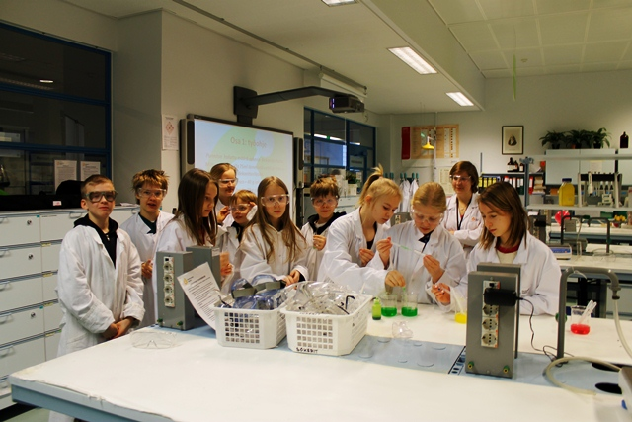
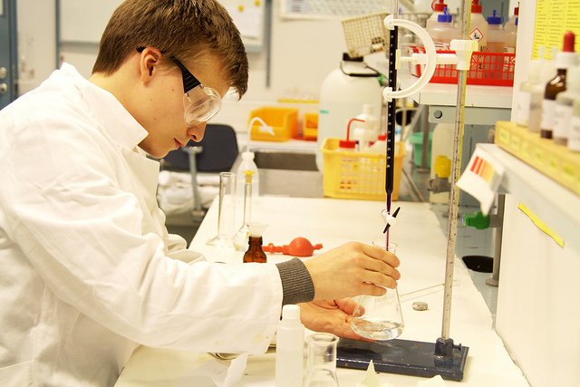
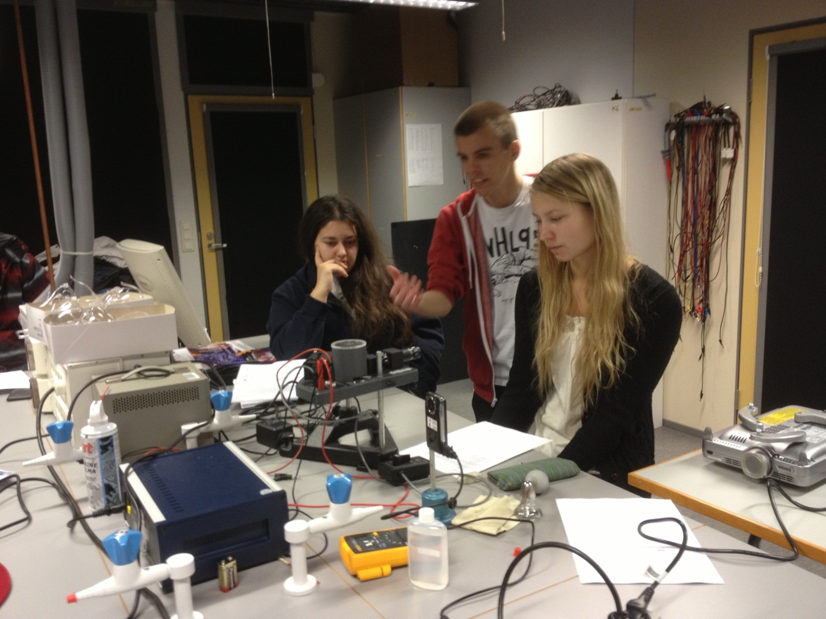
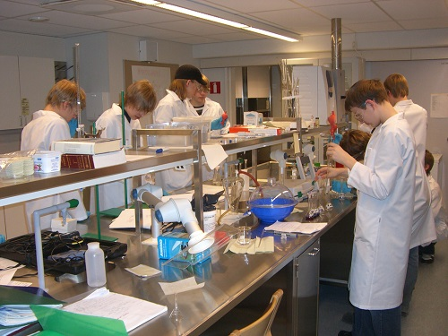
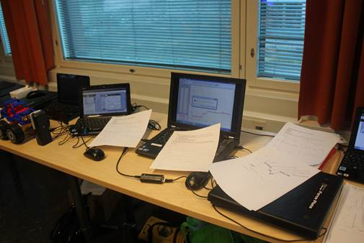
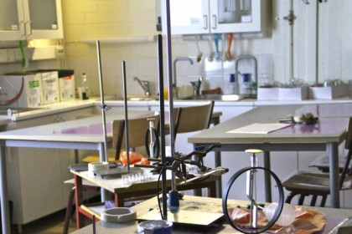
Learning environments

Slide 30
Learning 21st century competencies in versatile
learning environments
PISA, New Millennium learners, DeSeCo, …
Ways of thinking | - Creative and critical thinking - Learning to learn, use of metacognition
Ways of working | Communication, collaboration and networking - Inquiry (questioning, concluding), explaining - Generating ideas
Tools for working | - Broad literacy (network of concepts, skills) - Educational technology
Context for working | - Personal, social, local, global - Working life
Attitude needed for working | - Willingness to use knowledge, engagement - Self-efficacy

Slide 31
How teachers experience learning environments?
More we have ICT tools and resources, more we need co-planning, organising and support
It is important there are versatile learning spaces where students are able to engage in learning alone or in a small group
It is important the teachers share a common goal on the use of ICT in teaching and learning and support each other to approach these goals

Slide 32

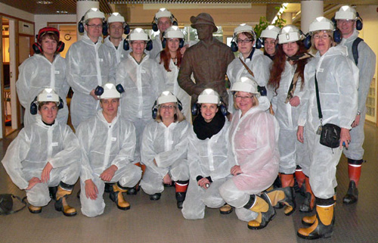
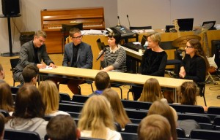
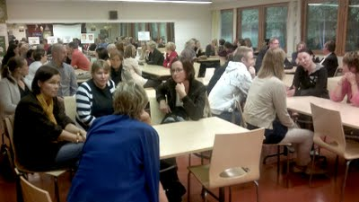
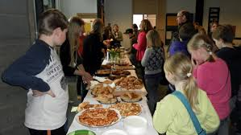
Networks and partnerships

Slide 33
Networks and partnerships
Networks are for sharing (communicating) ideas, opinions and experiences and, moreover, are important in diffusion and adoption of educational innovations:
The information flows through networks (Rogers, 2003).
In a partnership parties collaborate and share common aims, information and services:
School-family-partnership facilitates the sharing of educational aims and responsibilities in order to support the development and learning of a student (Epstein, 2009).

Slide 34
How teachers experience networks and partnerships?
Networks and partnerships in four levels:
- school level (grade level, multiprofessional, leadership teams); - city level (thematic networks, principal networks);
- school-family-society partnerships;
- national level networks.
In all levels ICT is supporting networking and
collaboration
“The use of ICT, supporting networking, has been developed for a long time.
The networking should start from our needs – not coming as orders from the city level.
School-family collaboration is organised through parents’ club & classroom committees..

Slide 35
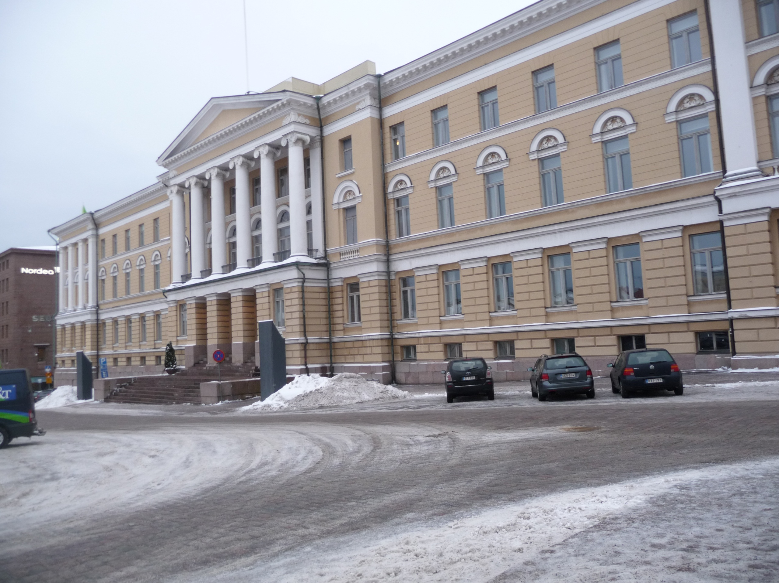
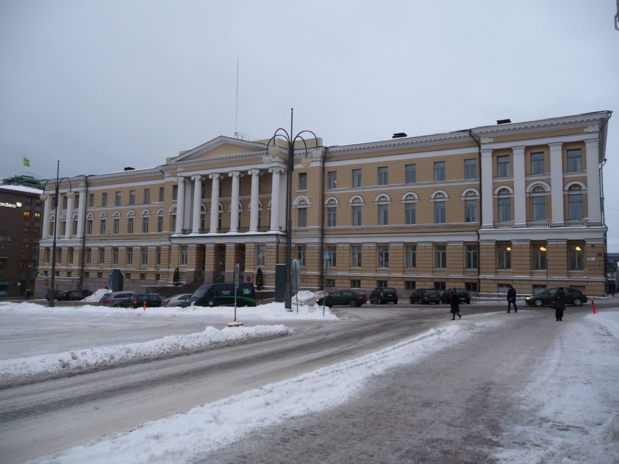
4. Finnish Teacher Education
Teachers are academic experts who are able to
- autonomous decision making,
- plan and implement learning activities
- evaluate their own teaching and student s’ performance
- lifelong learning (professional development)
Helsinki university main building
4. Finnish Teacher Education

Slide 36
A secondary (subject) teacher
typically teaches at grades 7 to 12 (ages 13 to 19)
teaches typically one major and one minor subjects (e.g. math and physics)
An elementary (primary) school teacher
(a class teacher)
teaches at grades 1 to 6 (ages 7 to 13)
teaches typically all 13 subjects

Slide 37
Structure of the master degree of a primary teacher: 3 + 2 years
Finnish language, PCK
Mathematics, PCK
Bachelor
Bachelor
’
’
s level (180
s level (180 cr)
Master
’
s level (120 cr)
Physics, PCK
180
Chemistry, PCK
160
Biology, PCK
Master
Geography, PCK
Master
-
140
-
thesis
thesis
History, PCK
120
cr = 26 hours of work
Religion/ethics PCK
Study credits
100
Pedagogical
studies
Sports
80
Teaching
practice
Arts
60
BSc thesis
Music
40
Crafts
20
0
Major
Multi-
disciplinary
studies
Minor
Communication
Education or
Ed. Psych.
Subject
and language
studies

Slide 38
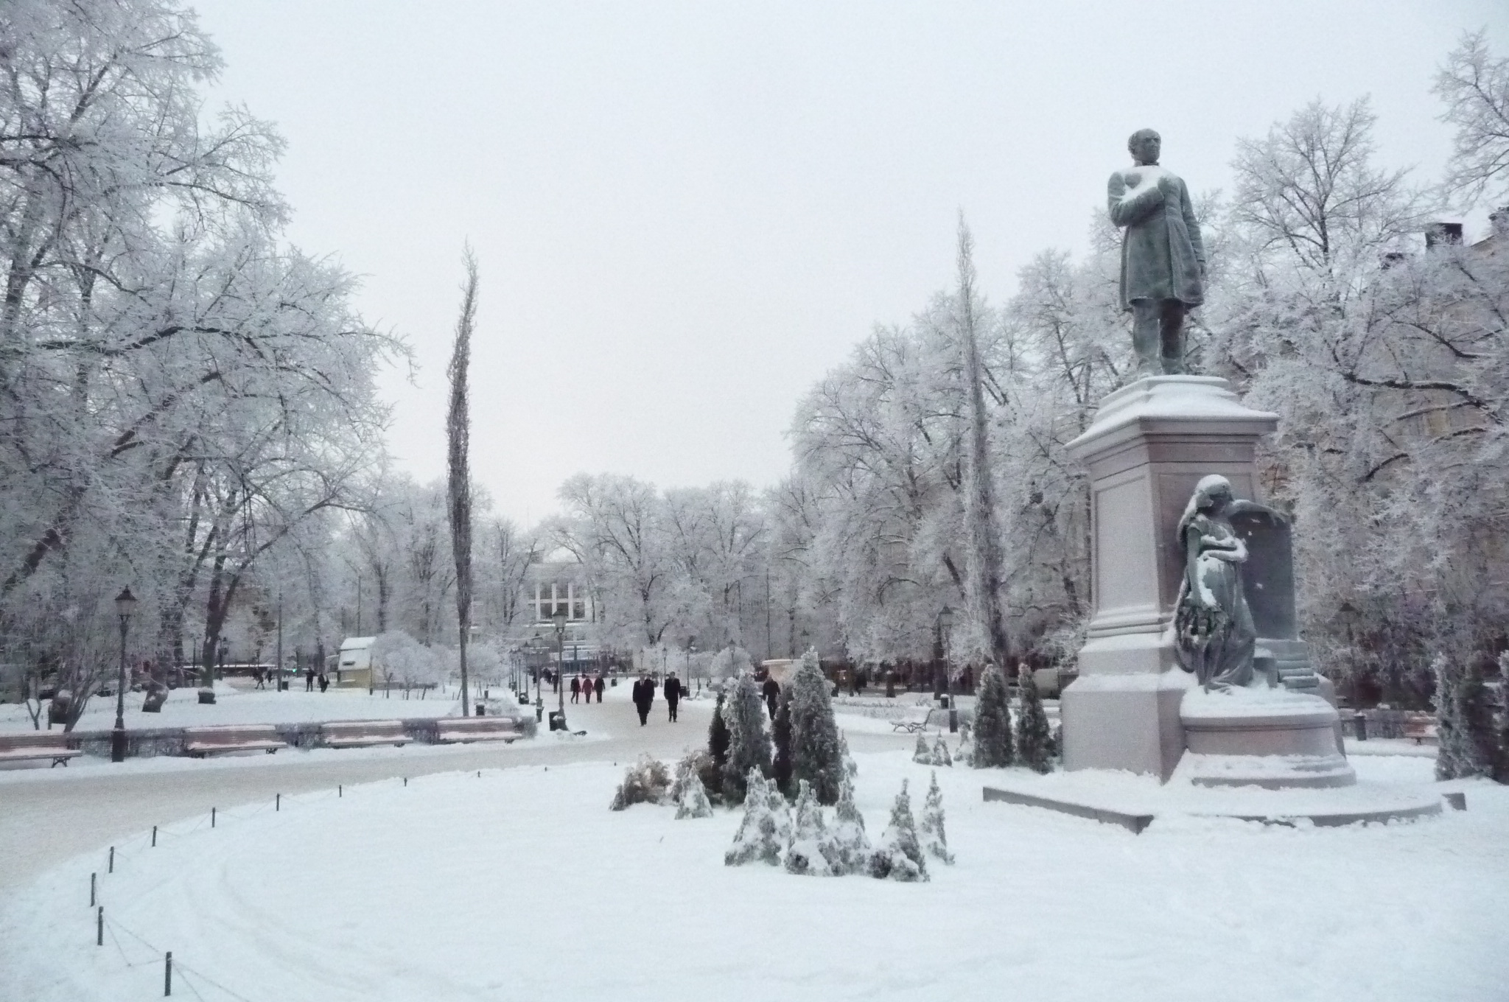
5. Discussion

Slide 39
What kind of teachers could support the adoption of educational innovations at school site

Slide 40
1. A versatile knowledge base in order to act as an autonomous academic professional
Subject matter knowledge.
PCK and GPK, which are needed for (broad) planning, implementation and assessment of teaching and learning.
Moral and ethical knowledge in order to work ethically correctly with students and parents
Teacher leadership attitude
Skills needed in producing and consuming research based knowledge.
The planning and assessment of
teaching and learning are based on
1) the local curriculum and
2) the different needs of the students.
3) research based knowledge on teaching and learning (consuming of educational research)

Slide 41
2. Readiness for collaboration and partnership
Understanding the different dimensions of teacher profession
Readiness for collaboration inside the school : in grade teams, in multiprofessional teams; in school welfare group, ..
Readiness for collaboration at municipality level in :development and professional development activities
Readiness for school-family partnership.
Readiness for school society/industry/… partnership.
Schools are not isolated institutes in a society.

Slide 42
3. Life-long-learning
Skills needed in evaluation and design of teaching activities and learning environments.
Skills needed in generation and adoption of educational innovations in collaboration with other teachers and
in networks and in partnerships
A creative teacher recognises problems around him/her, is able to generate alternatives for solving the problems and able to select the most appropriate solution among the alternatives.

Slide 43
Thank you!

