Slide 1
Finnish Experiences in STEM Education
(30 min)
Foro Nacional STEM
Tuesday, October 17th at 11:00 am, 2015 Lima, Peru
Jari Lavonen, Department of Teacher Education, University of Helsinki, Finland
Jari.Lavonen@Helsinki.Fi

Slide 2
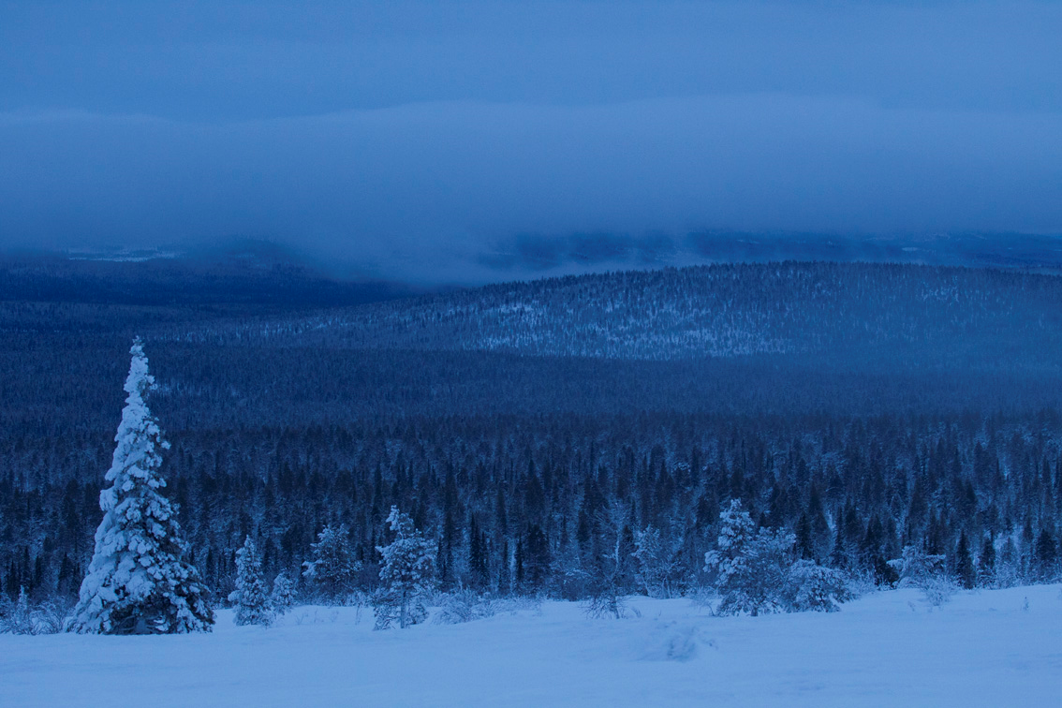
Content of the presentation
1. STEM in the curriculum
2. STEM learning practices
3. STEM learning materials
4. Assessment in STEM education

Slide 3
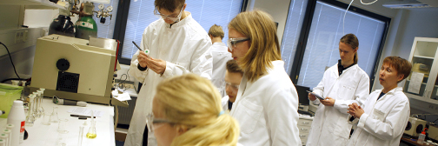

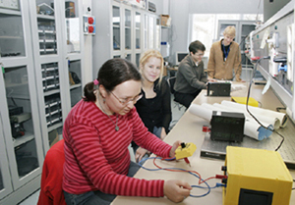
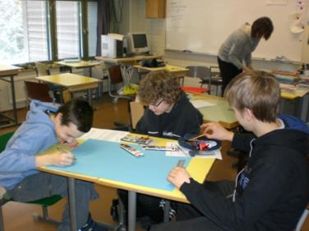
1. STEM in the curriculum
3

Slide 4
 | Outcome based –model | Finnish –model
Aims as | Learning outcomes | Broad aims for teaching/ learning
Important level | National/district level planning and assessment | Assessment and planning at the level of a school and classrooms
 | +a learner knows what he/she should learn - competitive school culture: ranking of students and schools - “teaching to the test” | +co-planning +a teacher conducts assessment for enhancing learning processes - problematic to compare the quality of learning outcomes and select students to next level
Notes:
*Spelling correction for district
*removed “Too” from the focus for outcome based-model
*The format on here might be too large for the slide?

Slide 5
Allocation of science subjects to grades in comprehensive school
Grade
1
2
3
4
5
6
7
8
9
10
11
12
Student
s’
7
8
9
10
11
12
13
14
15
16
17
18
age
Level
primary school
lower secondary
upper secondary
school
school, high school
Comprehensive school, Basic education
S
cience
Integrated
environmental
Integrated
Separate
:
Separate
:
subjects
and natural studies
+ technology education
environmental
Biology
1.2 hours
Biology
2+3 course
s
and natural
studies
+ technology
education
Geography
1.2 hours
Geography
2+2
Physics
1.2 hours
course
s
Chemistry
1.2 hours
Physics
1+7 course
s
/week/year
Chemistry
1+4 course
s
Health education
Health education
3 hours/week/year
1 hours
Techology education
1-2 hours/week/year
4 hours/
week/year
/week/year
Compulsory/
C
C+O
O
Optional
Primary
teachers
Secondary
teachers
Korea
Integrated physics, chemistry, biology,
& earth science
2 hours/week
Integrated physics, chemistry, biology, &
earth-science
3 hours/week

Slide 6
Comparison of 21st century competences and Finnish border-crossing wide-ranging areas of competences
21st century competences | Finnish border-crossing wide-ranging areas of competences
Ways of thinking - Critical and creative thinking - Learning to learn Ways of working - Inquiring and problem-solving - Communication and collaboration Tools for working - Broad literacy - Technological skills Acting in the world - Global and local citizenship - Cultural awareness and social responsibility | - Thinking and learning to learn - Inquiry orientation, - Interaction and communication - Multi-literacy - ICT competence - Taking care of your-self, everyday life skills, safety - Working life skills and entrepreneurship - Participation and influence, responsibility for sustainable future

Slide 7
Learning 21st century competencies in versatile
learning environments
PISA, New Millennium learners, DeSeCo, …
Ways of thinking | - Creative and critical thinking - Learning to learn, use of metacognition
Ways of working | Communication, collaboration and networking - Inquiry (questioning, concluding), explaining - Generating ideas
Tools for working | - Broad literacy (network of concepts, skills) - Educational technology
Context for working | - Personal, social, local, global - Working life
Attitude needed for working | - Willingness to use knowledge, engagement - Self-efficacy

Slide 8
Examples of goals for learning scientific method:
The pupils will learn in physics and chemistry:
- scientific skills, such as the formulation of questions … ,
- to process, present and interpret results,
- to carry out simple scientific experiments ….
Examples of goals for learning engineering method:
The pupils will learn in technological contexts:
- generating ideas, evaluate ideas, design, implement, …
Examples of contents of “physical systems”:
- natural structures and proportions (grades 7 – 9),
- motion and forces, models of uniform and uniformly accelerating motion (grades 7 – 9) , …
The OECD definition of scientific literacy fits well with
the goals and contents for science education in Finland, see http://www.minedu.fi/OPM/Julkaisut/2008/PISA06._Analyses_Reflections_and_Explanations?lang=en

Slide 9
STEM learning practices
Local authorities are responsible for
development of teaching and learning
– no national inspectors

Slide 10

We have designed in a grade level team the use of smartphones in STEM learning in order to personalise pupils’ learning
…

Slide 11
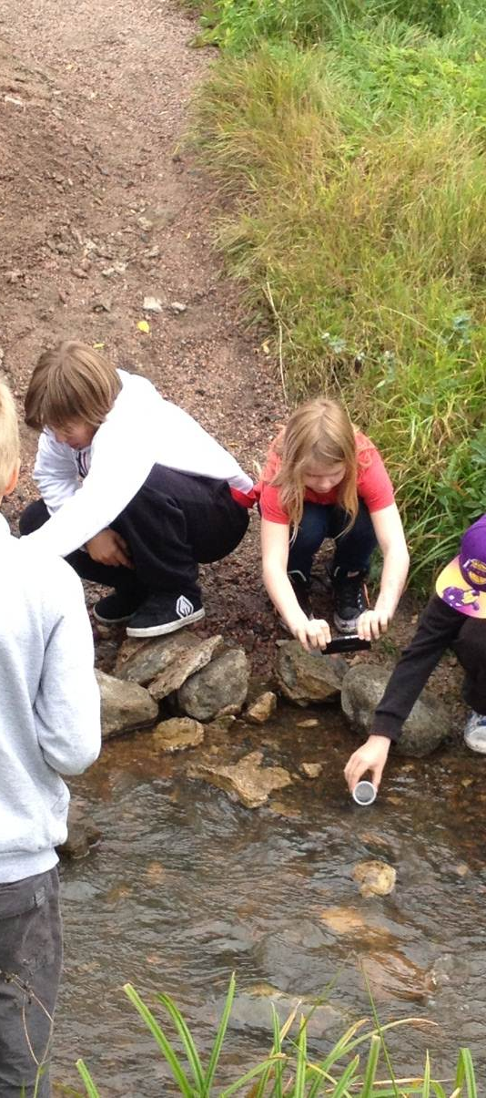
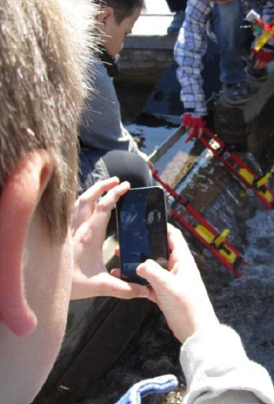
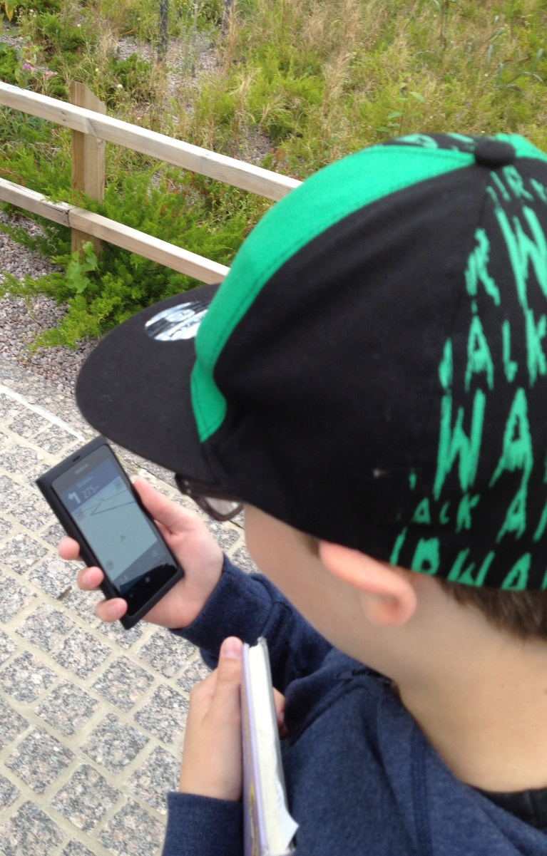

Slide 12
Smartphones in Education: Electricity Project (kutoset) https://www.youtube.com/watch?v=YpBU7ZOuyR0
Smartphones in education: Exploring sky (vitoset) https://www.youtube.com/watch?v=GuRw5Em8zS0

Slide 13

I have designed with other teachers, pupils and out-of-school collaborators a new model for School-Community Collaboration (SCC) that engage primary pupils in SCC.
SSC creates learning environments for creative use of ICT.

Slide 14
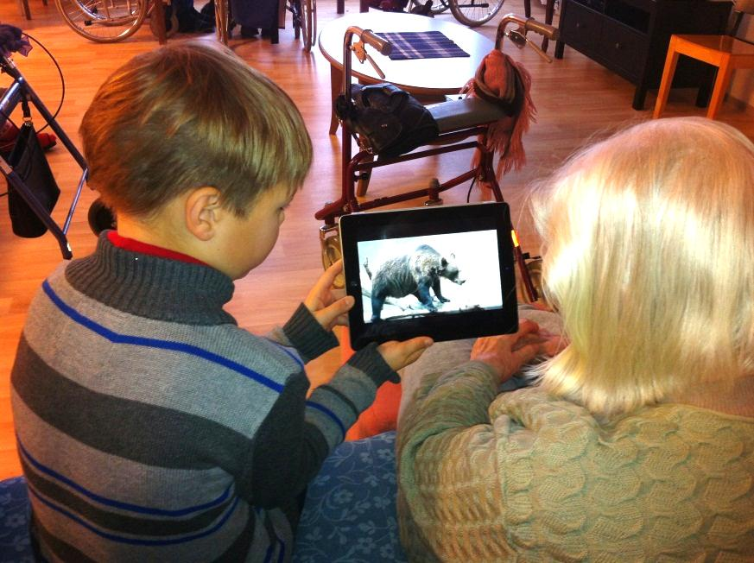

Slide 15
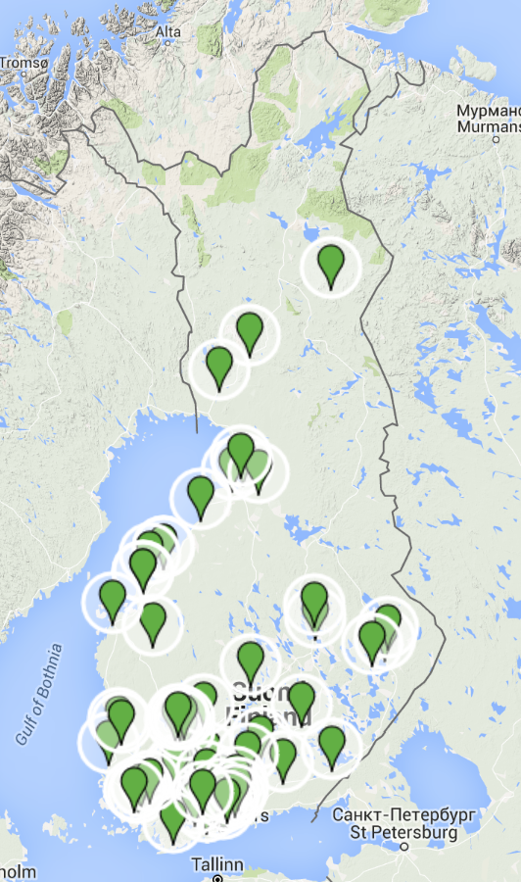
“We” have developed in a national Innokas Network STEAM-practices in order to teach and learn 21st century competences.
As a part of Innokas Network activities we organize every year Robocup Junior Finland.
The event include action-based presentations and workshops focusing on coding and robotics
The event is open to the public.
http://www.innokas.fi/en/

Slide 16
Robocup Junior Finland
https://vimeo.com/145918925

Slide 17
National framework curriculum for basic education 2016 will support schools to look solutions to the questions …
What types of competences will be needed in everyday and working-life situations? What will education mean in the future?
How will change be realised in municipal and school level, and even in every lesson?
What kind of competences will teachers and other school staff need in order to be able to collaborate and promote learning for the future?
How do the national core curricula guide the preparation of local curricula and support the work of teachers and the whole school community?

Slide 18
Teaching Methods in Science Education in Finland
“Teaching method” is used here as a synonym for a
- learning or instructional method/model/strategy,
- student activity or classroom practice.
Teaching methods are
- goal-oriented and
- emphasise social interaction among students and
between students and the teacher.

Slide 19
PISA 2006 Student questionnaire data:
Nature of science teaching and learning
In the PISA 2006 Student Questionnaire
students were asked about their
opinions concerning
the frequency of different kinds of
- communication styles and
- science activities

Slide 20
An example
According to PISA 2006 Student questionnaire: Activities dealing with practical work
Finland
OECD Average
Students are asked to draw conclusions
from their experiments
Students do experiments by following
the instructions of the teacher
Students spend time in the
laboratory doing experiments
Students are allowed to
design their own experiments
never or hardly never (1) in most lessons (3)
in some lessons (2)
in all lessons (4)

Slide 21
How Finnish students learn PISA competences? A summary
Role of a teacher is important in a science classroom (like a teacher guided practical work)
Students were not interested how scientists design experiments and what is required for scientific explanations.
There were low frequencies in science inquiry and debate activities.
  However, students performed well in PISA
Finnish teachers help students to acquire competences through guided practical work activities: a student has possibility to make conclusions.

Slide 22
STEM learning materials
Independent publishing houses are
producing learning materials
Teachers are responsible for selection
and use of the materials

Slide 23
Finnish textbooks connect phenomena and applications: rich contexts

Slide 24
Finnish textbooks introduce several everyday and technical applications: rich contexts

Slide 26
Guided inquiry:
Students are guided to plan investigations
predictions

Slide 27
Guided inquiry:
Students are guided to predict

Slide 28
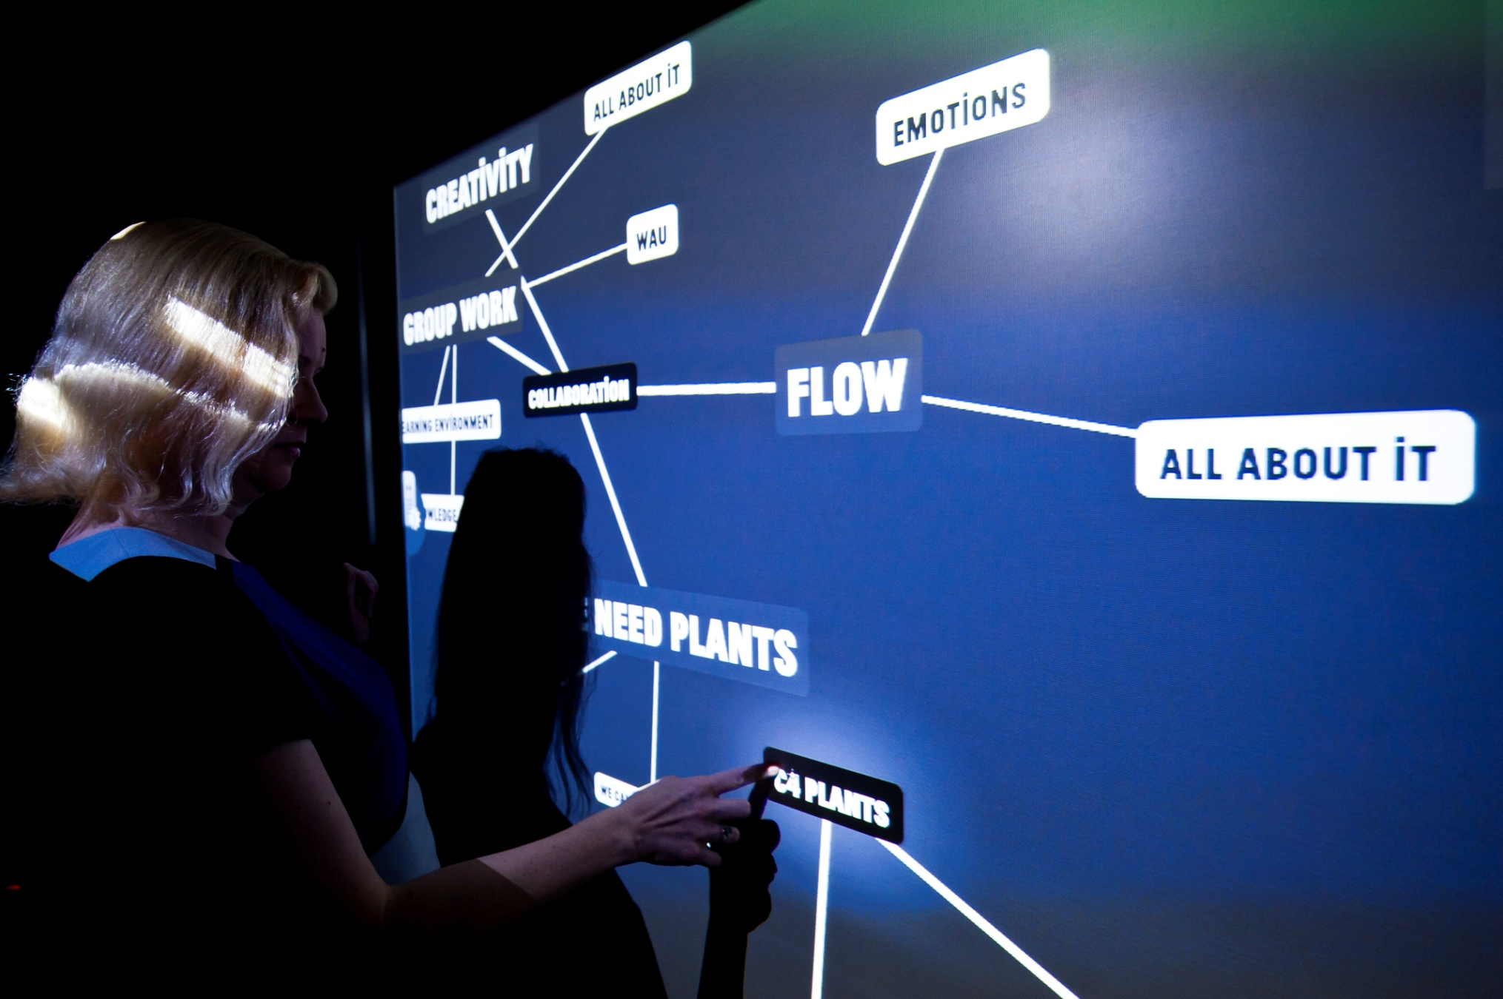



3. Assessment in STEM subjects

Slide 29
Teacher-conducted assessment has a central role in Finnish classrooms
Teachers are autonomous academic professionals, who are able to plan, implement, and assess teaching and learning
Assessment data is used in for improving teaching and learning

Slide 30
A case study on school assessment: how?, why? , Needs? -> Development of assessment tools and practices
  22 teachers → different backgrounds, from different schools, different experience with educational technology
 | 14 subject teachers (math, physics, English, biology) | 4 primary school teachers | 4 preschool teachers
Teaching experience | 2,5-30 years | 8-11 years | 2-15 years
Gender | 7 females 7 males | 4 females | 4 females
Notes:
-not a sample, deliberately selected since the point was to get a versatile view of assessment...handpicked...different schools, different subjects
-erilaiset näkökulmat arviointiin, ei tietty case, no generalization, we are conceptualizing assessment and discussing Finnish teachers
-the cases are seen as partners, not just objects of study (especially not measurement)

Slide 31
Outcomes
Five themes emerged from the data
Assessment as part of professional development
Technical properties of available resources
Pedagogical usability of assessment resources
Different forms of assessment
Special features of teaching and learning science

Slide 32
Theme 1: Assessment as part of professional development
Teachers’ autonomous role as a conductor of assessment: teachers know best how to organize assessment
Student assessment provides teachers a starting-point for reflecting on the quality of teaching science
…there has to be knowledge of the students when implementing assessment, we can’t have outsiders come in and use the same scales for everybody, we have to understand the reasons behind the results.
(Teacher 3, 121)

Slide 33
Theme 2: Technical properties ´(usability) of available resources
teachers value technology which is convenient and easy to use
  learnability
  easy to use
  added value for assessment practice: diverse, quality, context, terminology, difficulty scale
Aid for carrying out assessment and documenting as well as processing the assessment data
The system should be user-friendly, where teachers can easily find the content that they are currently teaching. (Teacher 4, 152)

Slide 34
About assessment materials or resources...
→both technical and pedagogical aspects
→alignment with teaching
→possibility to adapt materials
or e.g. use self-made materials
Requirements for materials and resources
high in learnability
easy to use
tasks: diverse, good quality, context, terminology, content and difficulty level
Notes:
-this perspective relevant because of the overall project
-both aspects were discussed
-easy to use example: teacher said it needs to be ”idiot-proof”

Slide 35
Theme 3: Pedagogical usability of available resources
Possibility to adapt resources to one’s needs flexibly:
the forms and purpose of assessment activities vary
resources should be in accordance with implemented instruction
  types of items
  contexts of the items
  aligning approaches used in teaching
partly I make them [tests] myself, partly I choose from ready materials, from these teachers’ materials I see if there are suitable tasks...It’s a pretty big job to make each one by myself and sometimes I look at some other material... (Teacher 5, 30)

Slide 36
Theme 4: Different forms of assessment
Assessment is an element of everyday classroom activities: different forms are combined flexibly and there is no need to classify the forms of assessment
  teachers conduct assessment
  continuous part of teaching
  consists of multiple elements and a variety of approaches (e.g. not just tests)
  feedback to both students and a teacher
  self-assessment (!)
  how s/he works in science class and you can see it from their classroom activities, for example, if they have understood something and…so I would argue that it is quite innate that a teacher assesses all the time…(Teacher 7, 168)

Slide 37
Theme 5: Special features of teaching and learning science
A special attention paid on inquiry as an approach as well as experiments in science education
  paper-and-pencil tests do not cover all aspects of learning science
Potential in using technology (e.g., simulations)
.. I document quite in detail how well students have managed to reach the aims... The paper-and-pencil tests are a starting-point and then I check the notebooks, how well students have taken part in classroom discussion and how well they carry out and understand experiments... (Teacher 1, 167)

Slide 38
Discussion:
Teachers emphasise differently pedagogical aims in (science classrooms) → various needs
  assessment materials should be adaptable, easy to use and still serve specific demands of science education
  pedagogical issues should be considered
Teachers are aware of principles of assessment and self-regulated learning
→ willingness to try and use new innovations
→ a need for modifying the current practice
A challenge to teacher-adaptive assessment

Slide 39
The practice of assessment
Data example: “innate feeling”
well a teacher is left with this kind of image...let’s say that in time I have learnt to trust my own image for example of class activity and this kind of participation…and then you just have to trust your own professionalism too, that I do remember how this one like does…because I can’t write down somebody’s activity in every class… but there is that professionalism that you know the students and you can like straight away determine their level of participation which is assessed continuously… (B1, 145)
Notes:
-lue sitaatti ääneen
-can be problematic, against what criteria are the teachers assessing the student?

Slide 40
Shift in assessment
Shift towards internal, teacher-conducted procedures like alternative and formative forms of assessment (aiming to improving learning)
  Internal/external perspectives
  Formative/summative/diagnostic
  Purposes of doing assessment
  Using of assessment information for different purposes
  Changes in assessment practice
(Maier, 2009; Black & Wiliam, 2003; Parr & Timperley, 2008;
Inbar-Lourie & Donitsa-Schmidt, 2009;)
Notes:
-difference between assessment and e.g. grading
-assessment is here thought to be done for...
-versus quality assurance by centralized testing of learning outcomes, e.g. Black&Wiliam discuss formative assessment, and that it is infact improving classroom practice that can raise standards
-some perspectives that we have looked at in the theoretical discussion of this study
-form/summ/diag, teachers do not actually differentiate and recognize the concepts, these are more for theoretical use...→in general they use a combination of approaches...
-the context of the study has guided the formation of the theoretical background

Slide 41
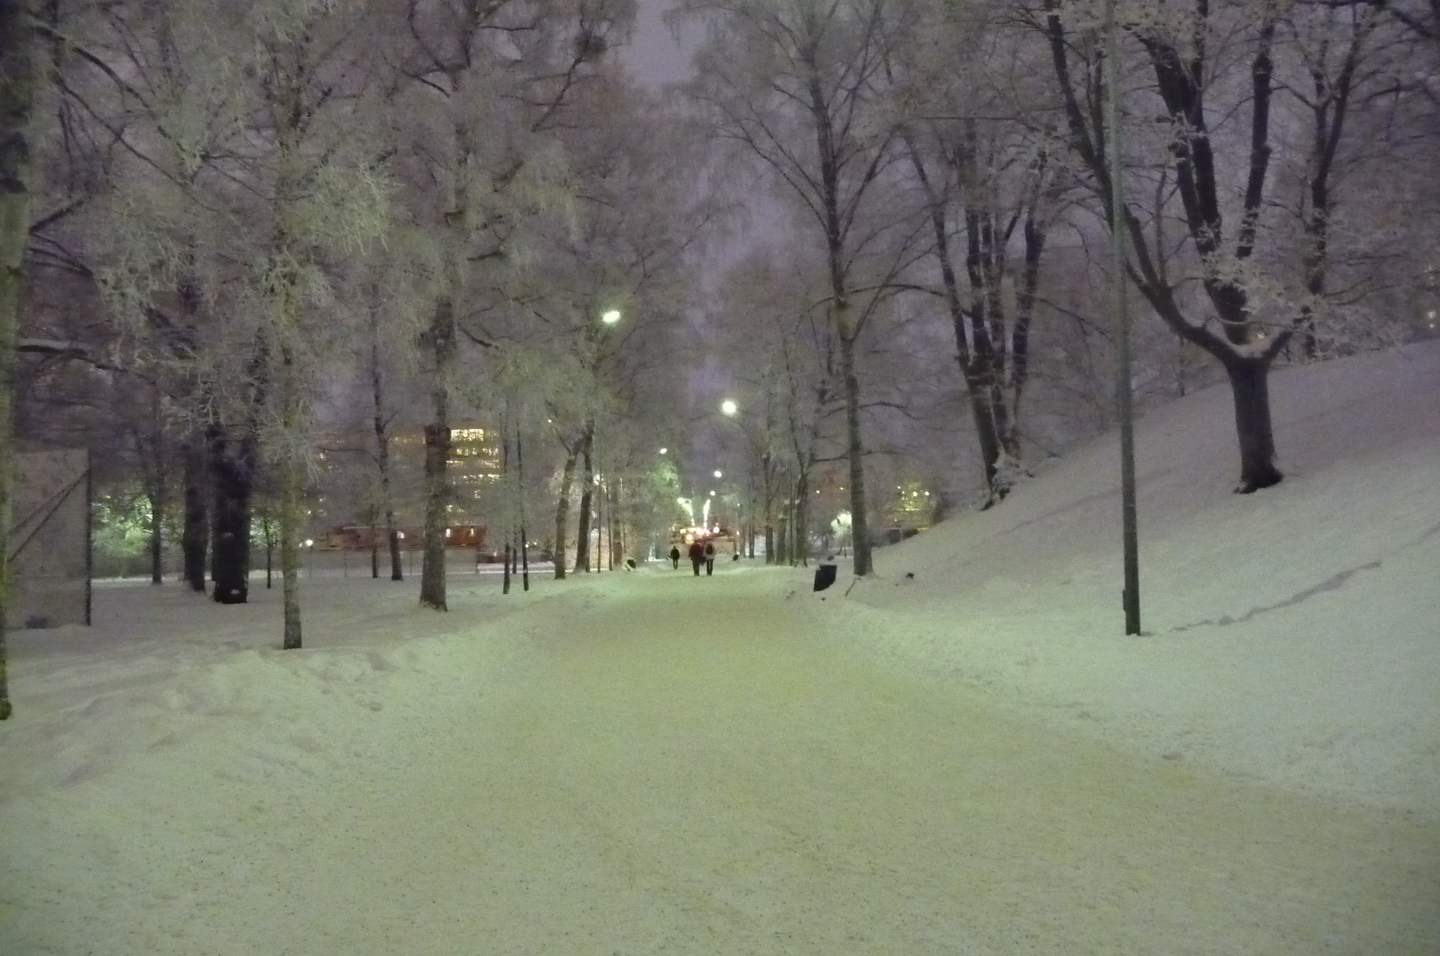
National Monitoring in Science

Slide 42
National level monitoring (assessment)
The aim was to monitor how well students had acquired the knowledge and skills in science subjects indicated in the National Core Curriculum for Basic Education (FNBE, 2004):
  Organized in the year 2011
  (previously in 2001).
  In the end of compulsory education
  A representative sample
  A paper-and -pencil-test
Information about instruction methods and attitudes were collected

Slide 43
A framework for monitoring
The taxonomy by Anderson & Krathwohl (revised Bloom's taxonomy) was used as a framework for designing items which
  could activate different cognitive processes
  measure different types of knowledge
(Anderson, Krathwohl et al. 2001)

Slide 44
Two-dimensional cross-classification
The use of the taxonomy is complicated and not necessarily reliable. Classification of the desired knowledge and skills seems to vary among individuals. Thus, the scaling of cognitive processes dimension was reduced from 6 points into 3 points.

Slide 45
Knowledge Dimension
Factual knowledge
Conceptual knowledge
  Knowledge of science
Procedural knowledge
  Procedural knowledge related to science process skills
  Procedural knowledge related to integrated science process skills
Epistemic knowledge
  Nature of science inquiry (research question, setting, using the data, …)
  Nature of scientific explanations (limitations, ..)
Metacognitive knowledge

Slide 46
Item types in a paper and pencil test
The item types:
  multiple choice,
  true/false,
  matching,
  short answer .
Information available in the items
  text and pictures,
  tables and graphs.

Slide 47
Classification:
Knowledge needed for solving the item: Conceptual knowledge
Cognitive processes: b) Remember, a) c) d) Understand
Item type: true/false
This question was interesting for me O O O O O
I am sure I am able to solve this question O O O O O
I will get benefit of this type of topic in my further studies O O O O O
I will get benefit of this type of topic in my everyday life O O O O O
Coding: 0 or 1 correct -> 0 p; 2 correct -> 1 p; 3 correct -> 2 p; 4 correct -> 3 p

Slide 48

Classification:
Knowledge needed for solving the item: Procedural knowledge
Cognitive processes: Understand
Item type: true/false
F_WORK_3_JL. In the laboratory a wooden block’ was drawn on the surface of the table along. In the test the force (F) and the distance (s) were measured. The results were presented in a table. The work (W) made by the force also was calculated to the table.
s (m) | F (N) | W (J)
0,10 | 2,0 | 0,20
0,20 | 2,0 | 0,40
0,30 | 2,0 | 0,60
0,30 | 2,0 | 0,80
0,50 | 2,0 | 1,0
Coding: 1 correct -> 0 p; 2 correct -> 1 p; 3 correct -> 2 p; 4 correct -> 3 p

Slide 49
Classification:
Knowledge needed for solving the item: Conceptual knowledge
Cognitive processes: Understand
Item type: true/false (computational question)
Coding: 1 correct -> 0 p; 2 correct -> 1 p; 3 correct -> 2 p; 4 correct -> 3 p

Slide 50
Classification:
Knowledge needed for solving the item: Procedural knowledge
Cognitive processes: Apply and create
Item type: long answer
Coding: 3 points

Slide 51
Outcomes of the monitoring (1)
A correlation between teacher grades and monitoring outcomes was 0.80!
Most of the students performed at least satisfactory: students solved in average 58% (57% physics) of the items:
  In physics conceptual knowledge 59% and in procedural knowledge 57%
  Items measuring memorizing 64% understanding 61% and applying 54%
Gender differences: boys were better in physics and girls in biology
Minor differences between areas in Finland
Finnish speaking students performed better than Swedish speaking students

Slide 52
Outcomes of the monitoring (2)
Environmental attitudes positive
Attitudes to biology and geography positive
Attitudes to physics and chemistry negative (gender difference)
Positive correlations with :
  science related self-efficacy and learning outcomes
  the number of practical work (and observations) and learning outcomes
  How often a teacher takes into account students’ ideas and attitude towards science and learning of science

Slide 53

Quality Culture

Slide 54
A new era in Quality Assurance (QA)
Wolff (2004): The focus in QA is turning more and more to
  mastering changes,
  allowing ownership for developers
Ehlers (2009) writes:
… “In education we need methods and practices that get deeper into organizations and closer to the teachers and learners.”

Slide 55
Levels of Quality Assurance in Finland
Quality Assurance (QA) has three main levels:
  National level QA
  - national framework curriculum
  - national monitoring
  Municipality level QA
  - meetings of school principals
  - municipality level monitoring,
  positive discrimination
  - feedback systems
  School level QA
  - student assessment , tutoring
  - student and parents feedback, assessment
  discussions
  - teachers self-assessment and development
  discussions
Interaction between the levels

Slide 56
Levels in Finnish QA
National level
  National Core Curriculum
  national assessment/monitoring based on samples
Municipality level
  municipalities are responsible for monitoring and allocating resources (positive discrimination)
School and teacher level
  School- and classroom-based assessment
  self-evaluations, cooperation with parents

Slide 57
Quality Culture:
  allows freedom for different actors
  is based on a certain level of trust
  is based on self-assessment and monitoring
  partners/levels take their responsibility seriously
  continuous interaction between different partners/levels
  students’ evaluations and staff members’ self evaluations is discussed collaboratively

Slide 58
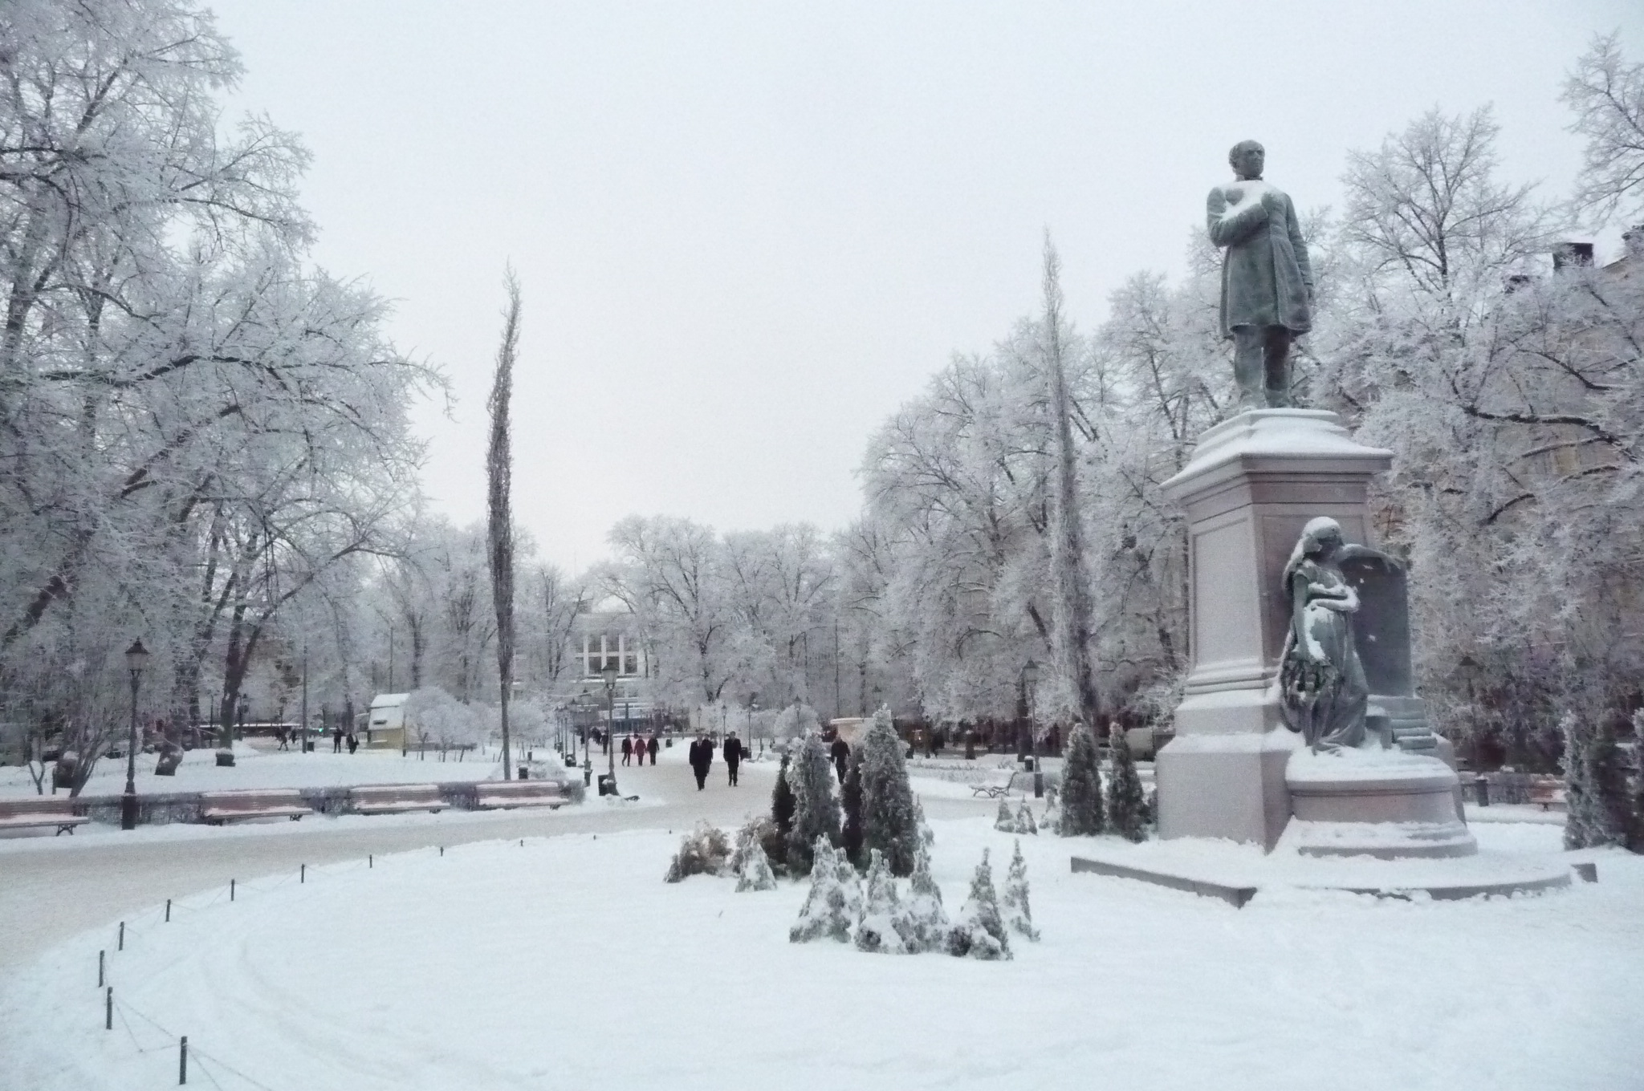
Discussion

Slide 59

Summing up the Finnish school assessment
Devolution of decision power and responsibility at the local level
No school inspections, national exams or pre-evaluation of learning materials
Teachers autonomous academic professionals
Assessment is organized mostly in the classroom by individual teachers
Assessment for learning
Notes:
-autonomous prof.: who are able to plan, implement, and assess teaching and learning
-data used: for improving teaching and learning
-there are some sample based assessments, e.g. In physics in 2011
-only standardized test is the matriculation exam at the end of upper secondary school, only 60% take it
-some national tests, but they are optional, and not sampled..certain subjects...not administered by a national body, only school or municipality level→findings do not have a big impact, no consequences

Slide 60
In general: What can be learned from Finnish education?
More ... |  | Less ...
collaboration and professionalism | – | competition
equal opportunities for all learners | – | private organizations taking care of education
decision making and assessment at local level |  | less standardization and national testing
trust based responsibility | – | test based accountability
formative and encouraging assessment | – | summative and punishment type assessment
Professionalism in assessment | – | Bureaucracy in assessment

Slide 61

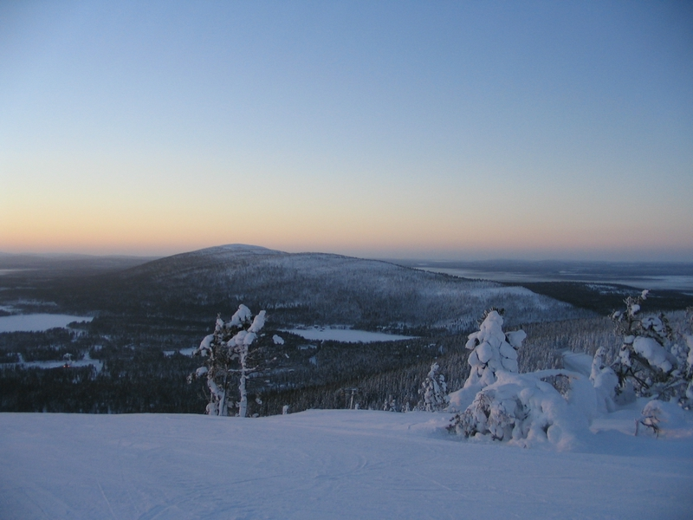
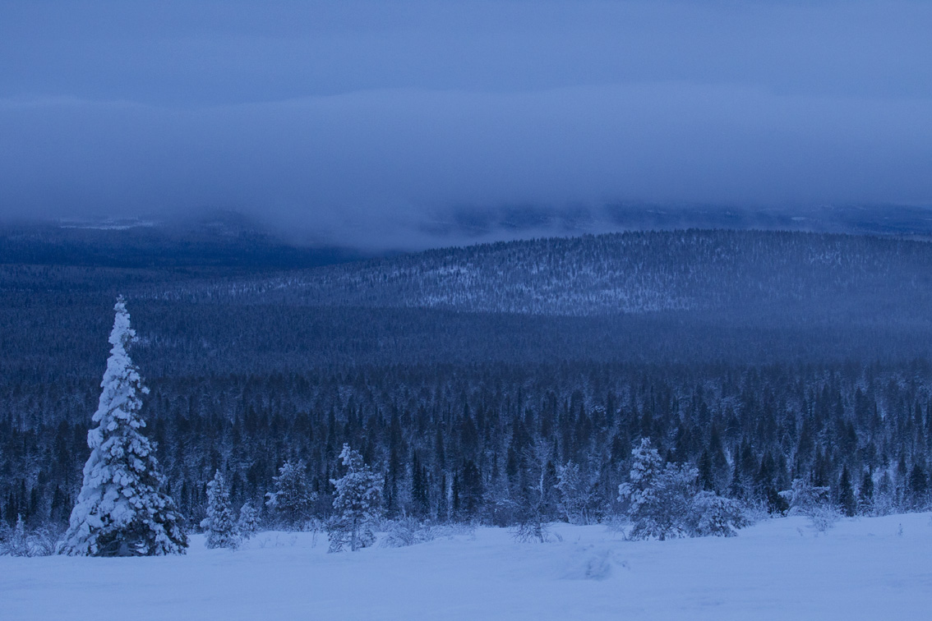
Thank you!

