Slide 1
How to build STEM teacher education?
Experiences of research and practice
Foro Nacional STEM
Monday October 16th at 9:30am, 2015 Lima, Peru
Jari Lavonen, Department of Teacher Education, University of Helsinki, Finland
Jari.Lavonen@Helsinki.Fi

Slide 2
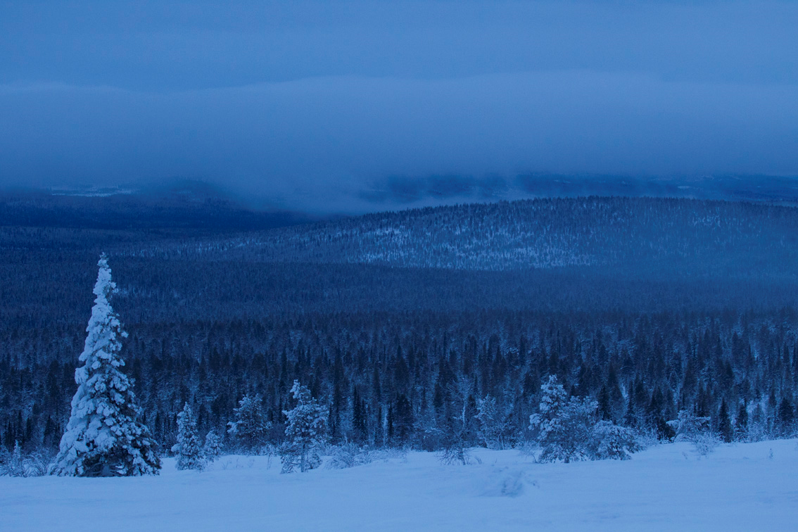
Content of the presentation
1. An “ideal” school context
2. Different approaches to characterize professional STEM teacher
3. Education of professional STEM Teacher at the University of Helsinki
4. Content Analysis of the Finnish (and
Korean) STEM Teacher Education
Programms
5. Discussion

Slide 3
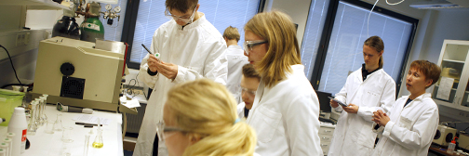
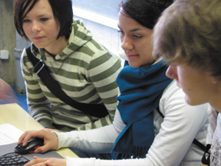
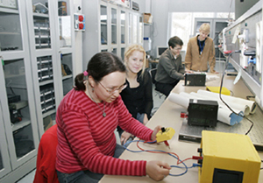
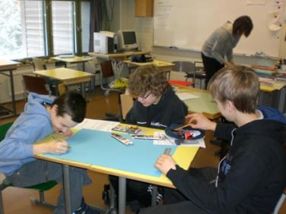
1. An ideal school context
3

Slide 4

Values and Aims of an Ideal School
Values: human rights, equality, democracy, natural diversity, sustainable development, endorsement of multiculturalism, individualism (responsibility, a sense of community), respect for the rights …
Leadership and
quality culture
Goal orientation and interaction
Quality culture
Professional teachers
Knowledge base
Collaboration
Life-long learning
Local curriculum
and
environments
Broad aims
Learning
environments
Networks &
partnerships
Learning of 21st century
competences
Global
Stakeholders
Parents
society
Partners
Diverse
learners
Finnish school

Slide 5
Characteristics of Finnish Education Context
Laukkanen (2008), Niemi et al. (2012), Sahlberg (2011)
Common, consistent and long-term policy
- models for teacher and compulsory education are 40 years old
- teachers are qualified and committed
- support to the development of broad literacy
Educational equality (especially in comprehensive school)
- education is free, including books, meals, health care, …
- schools do not select their students (school districts)
- well-organised special education (inclusion) and counselling
3. Devolution of decision power to the local level
- a headmaster is a pedagogical leader (leadership)
- local authorities (together with the teachers) plan local
curriculum, allocate resources, ...
- school based and encouraging assessment
The culture of trust and co-operation:
national level – district – school – families
- no inspectors, no national exams …
- no private tutoring or evening schools
Common, consistent and long-term policy
Educational equality
- education is free in first and second scyles
- well-organised special education (inclusive education/
personalised learning) and counselling
Decentralisation
- leadership and management at school level
- no inspectors and testing (comprehensive school)
- teachers are responsible to prepare a local curriculum
and classroom based assessment
The culture of trust and co-operation:

Slide 6
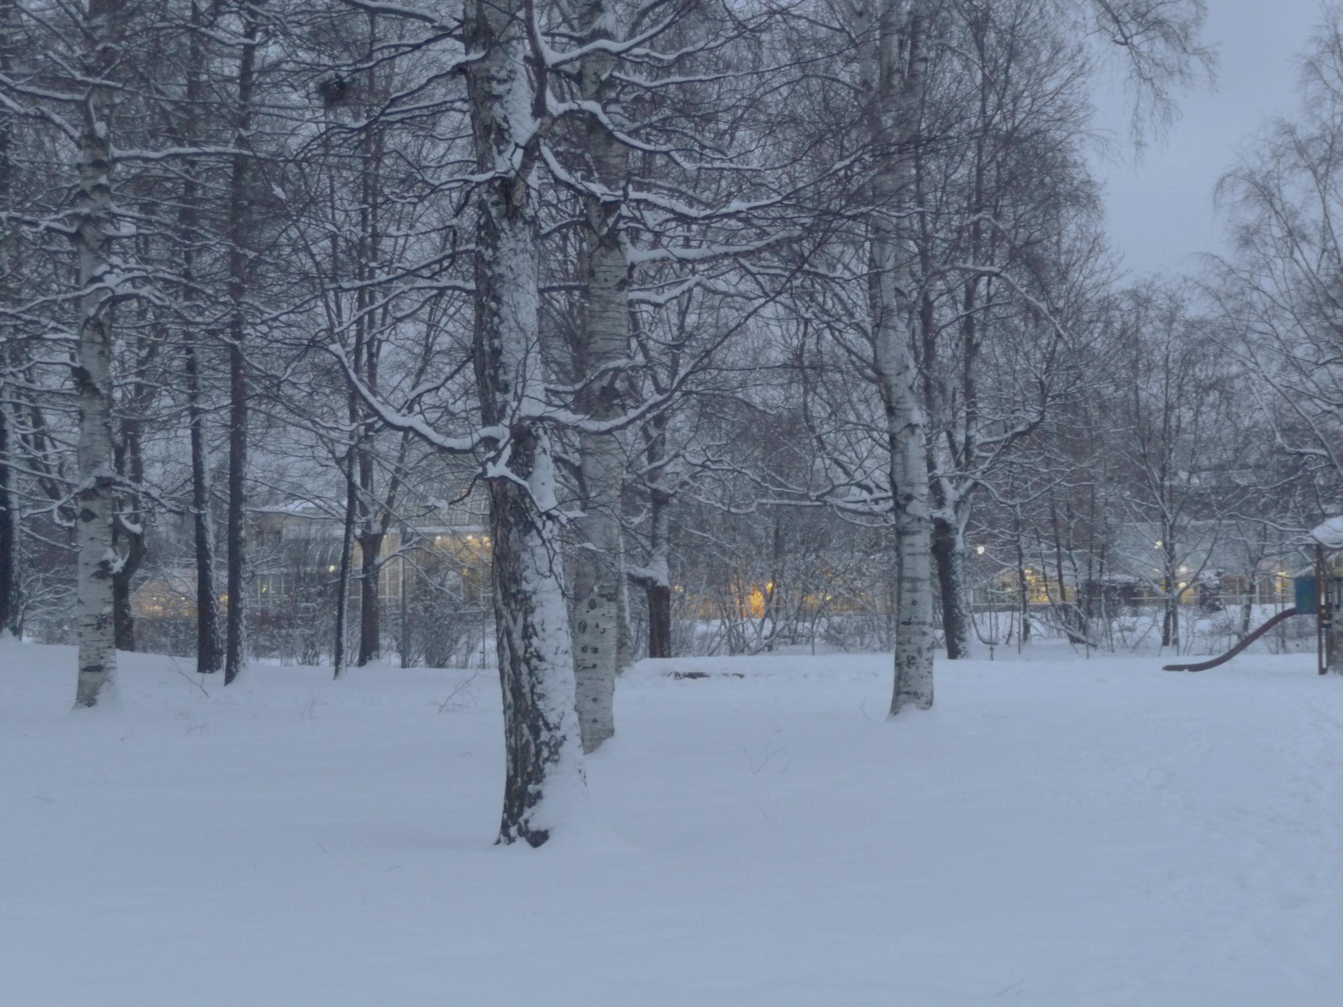
2. Different approaches
to characterize
professional STEM teacher

Slide 7
2. Different approaches to teacher effectiveness/ professionalism
A “professional teacher” is a complex and contradictory concept (Cruickshank & Haefele, 2001; Stronge & Hindman, 2003)
Instead of “professional” also “effective”, “competent”, “expert”, “quality”, “ideal” or “respective” are used
Teacher professionalism is approached through:
(Goe, Bell & Little, 2008):
(i) input approach: a versatile knowledge base of a
professional teacher,
(ii) process approach: processes that occurs in a
classroom between a teacher and students,
(iii) output approach: the effectiveness is seen in the
learning outcomes, measured e.g. by a national tests.

Slide 8
“Input approach”: Professionalism through learning of professional knowledge base during the initial teacher education
A professional teacher has a versatile knowledge base, allowing him or her to act as an autonomous (and academic) professional. Knowledge base:
- subject matter knowledge,
- pedagogical content knowledge and
- pedagogical knowledge
- contextual knowledge
- … (Shulman 1986, 1987; Gess-Newsome & Lederman, 1999;
Hashweh, 2005)
What is missing?

Slide 9
Students’ learning outcomes reveal the effectiveness of a teacher in the “output approach
An “effective teacher” is able to support students’ learning and influence students’ knowledge, skills or competences
-> Teacher effectiveness is seen in students’ learning outcomes.
The output approach has a close link to accountability “ideology”, where nationwide testing is organised in order to recognise effective and non-effective schools and teachers (Williamson & Walberg, 2004).
According to this “ideology” standards and accreditations are needed also for teacher education.
(Bullough Jr., Clark & Patterson, 2003).

Slide 10
Individual characteristics of a professional teacher
(Hargreaves & Goodson, 1996; Evans, 2008; Freidson, 2001; Urban & Dalli, 2011; Evetts, 2012)
Conceptual knowledge base ,
Specific professional ideology, incl. shared understanding of professional values and ethics code .
Include social and individual elements
Strong institutionalization of an occupational group.
Self-regulation of and -control over the work
(self-assessment)
Autonomous role in planning and implementation
(academic expertise).
Work (activities) is complex and not easy to standardize.
high quality
knowledge
base
networks &
partnerships
life-long-
learning

Slide 11
Research on teacher professionalism refers to status of teachers and depends on …
(Müller et al, 2010; TALIS 2008 survey)
individual characteristics (teacher knowledge, teaching philosophy, interaction skills, …)
school level factors (shared leadership, collaboration, school-society-family partnership …)
cultural and education policy factors at state level or context (trust culture, …)
^{All important}

Slide 12
A teacher leader
(Lieberman, 1992, Harris, 2003)
is goal oriented
can plan, implement and assess his/her own practices and students’ learning
has deep understanding on teaching and learning
is able to work collaboratively with other teachers
is a facilitator, coach, mentor or a trainer of other teachers
is able to consume research based knowledge
Is a curriculum specialist and innovator for new approaches
is able to use assessment outcomes for school development.
…
knowledge
base
networks &
partnerships
life-long-
learning

Slide 13
Origins of Knowledge (Where the knowledge of an expert is coming from?)
From the point of view of origins of knowledge, the knowledge could come from (Hiebert et al., 2002):
  practice
    experience (Dewey, 1938)
    practice with feedback (Gagne, 1985)
    failure (Schank, 1989)
    reflective practice (Ericsson, 2001)
  professional (theoretical) sources of information
    academic books
    lectures
    workshops
    own research
  Combination

Slide 14
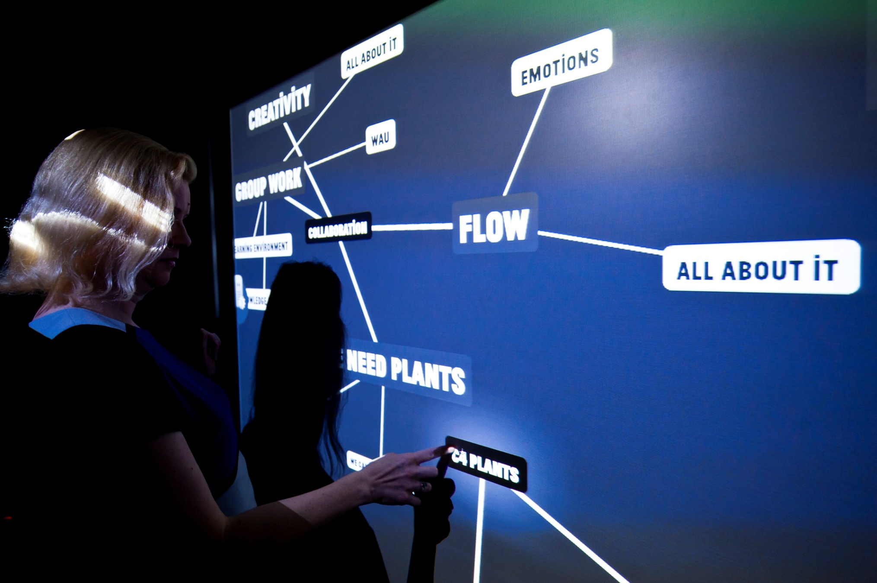



3. Education of Professional STEM Teachers at the
University of Helsinki

Slide 15
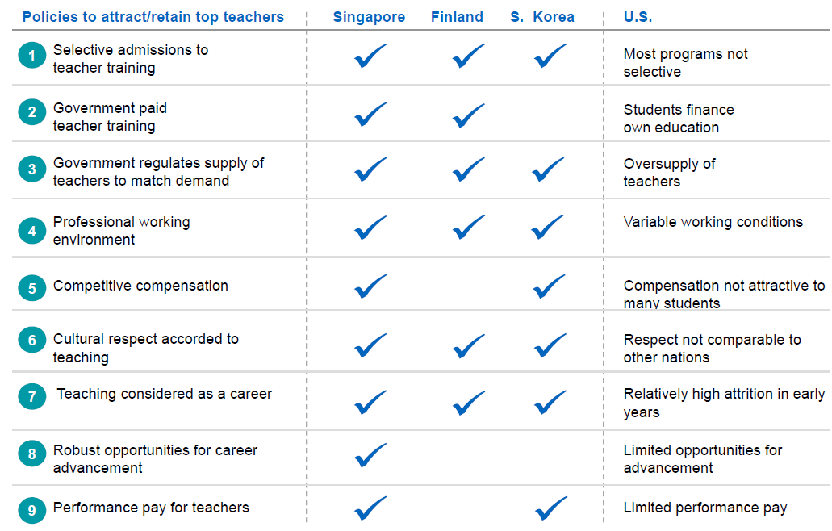
What is common in teacher education in high performing PISA countries?
McKinsey
&Company
Auguste, B., Kihn, P., & Miller, M. (2010) Closing the talent gap: Attracting and retaining top third graduates to a
career in teaching: An International and market research-based perspective. McKinsley & Company

Slide 16
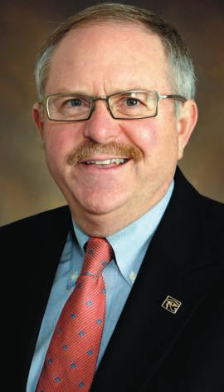
“… most important part of any successful educational system — the teacher”
SCIENCE, 13th January 2012, Vol 335
Recruit the best and the brightest to be teachers, and train them well.
Give them the independence from centralized authority, and time to prepare lessons and ...
.... Finland acknowledges the central role of teachers in society, as demonstrated by the respect
Editor
John E. Burris

Slide 17
Framework for designing a teacher education programme at the University of Helsinki
Research on
teaching and learning, engagement, development and needs of learners, policy, history, ... → Content to the program
Research on teachers and teacher education
- Professional/effective teacher,
- Structure and origins of teacher
knowledge,
- Teacher identity, agency, ...
- University pedagogy. → Content
and type of activities
Program for Pedagogical Studies
EU and National strategies
- Teacher education
strategy,
- National level curriculum;
Forms and role of
assessment.
Feedback
- Students’ learning outcomes and
evaluations,
- Staff members’ self-evaluations
of the programme,
- Municipality stakeholders’
feedback.

Slide 18
National Teacher Education Strategy:
The teacher education programmes should help students to acquire:
high-level subject knowledge, pedagogical content knowledge, contextual knowledge, knowledge about nature of knowledge, …
social skills, like communication skills, skills to use ICT,
moral knowledge and skills, …
knowledge about school as an institute and its connections to
the society (local contexts and stakeholders),
skill to co-operate with other teachers, parents, …
skills needed in developing one’s own teaching, the
teaching profession and the local curriculum,
academic skills, like research skills, ...
high quality
knowledge
base
networks &
partnerships
Not only the content of teacher education courses is important but how studies are organised in teacher education…
life-long-
learning

Slide 19
A secondary (middle and high school)
STEM teacher
typically teaches at grades 7 to 12 (ages 13 to 19)
teaches typically one major and one minor subjects (e.g. math and physics)
A primary (elementary) school teacher
(a class teacher)
teaches at grades 1 to 6 (ages 7 to 13)
teaches typically all 13 subjects

Slide 20
Teacher education at the University of Helsinki
University of Helsinki (11 faculties, 38 000 students, 7 400 staff members)
Faculty of
Behavioural
Sciences
Faculty
of
Arts
Faculty
of Science
Faculty
of
Biosciences
Faculty
of
Theology
Faculty
of
Social Sciences
Dept. of
Teacher
Education
Teacher Training
Schools
Secondary teacher education:
pedagogical studies + subject studies
Primary teacher education

Slide 21
Structure of the Master’s degree of a secondary teacher: 3 + 2 years, 300 cr
180
160
140
120
cr = 27 hours of work
Study credits
100
80
60
40
20
0
Major
Subject
Minor
Subject
Pedagogical
Communication
studies
and language
studies

Slide 22
Structure of the Master’s degree of a secondary teacher: 3 + 2 years, 300 cr
Teachers
benefit of the
research orientation
while they make
the school curriculum,
plan, implement
and evaluate
teaching and
learning
Bachelor’s level (180 cr)
Master’s level (120 cr)
180
160
140
Master-
thesis
120
Subject
matter knowledge,
knowledge about
teaching and learning,
and school practise
are integrated into
the students’
own personal
pedagogical
view
cr = 27 hours of work
Study credits
100
80
BSc thesis
60
Ped. thesis
40
Teaching
practice
20
0
Major
Subject
Minor
Subject
Pedagogical
Communication
studies
and language
studies

Slide 23
The structure of the pedagogical studies in secondary teacher education programme in Finland
Pedagogical studies
in Finland
(60 cp.)
General courses on
Subject pedagog
y (PCK)
Educational research
Teaching practice
educatio
n, teaching and
17 cp
10 cp
20 cp
learning
13 cp
-
Psychology of
-
Psychological basis of
-
Research
-
Supervised
basic
development and
teaching and learning
methodology in
teaching practice 7 cp
learning
4 cp
of a subject
5 cp
education
3 cp
-
Supervised applied
-
Special needs
-
Curriculum
-
Teacher as a
teaching practice
5 cp
education
4
cp
development and
researcher
-
seminar
3 cp
-
Supervised advanced
-
Social, historical, and
planning of teaching
-
Minor thesis in
teaching practice 8 cp
philosophical basis of
5 cp
pedagogy
4 cp
-
Ref
lection supported by
education
5
cp
-
Evaluat
ion of teaching
portfolio assessment
and learning,
work
evaluation of a
curriculum 7
cp
In Finland huge amount of PCK is taught also at the departments of Physics, Chemistry,…

Slide 24
Psychology of development and learning, 4 cp
Objectives:
A student becomes familiar with development of an individual and group and identifies the special characteristics of the different groups.
The student develops readiness to understand different views on the growth, development and learning of the human being and from the significance of the interaction between an individual and a group and takes the psychologic principles of the learning into consideration in the teaching.

Slide 25
Psychological basis related to the teaching and learning a subject (~ PCK), 10 cp
Objectives:
The students learn to design teaching (learning) through taking into consideration
- the curriculum (incl. subject matter knowledge),
- the research on teaching and learning (learners),
- the epistemological and ontological views.
The student develops readiness
- to examine the school as an learning environment,
- to understand the basic values of education,
- to use versatile teaching methods and ICT,
- to analyse social situations at schools and
- to analyse development of his/her own teacher profession.

Slide 26
Special Courses at the Department of Physics for Physics student teachers
Master level courses
Concepts and structures of physics I: Classical physics
Concepts and structures of physics II: Modern physics
Structures and processes of school physics
Experimentation in school laboratory
History and philosophy of physics
Physics teachers‘ master thesis seminar

Slide 27
Concepts and structures of physics I: Classical physics
The structure and methods of physics are discussed:
how the physics' knowledge structure guides the physics teaching.
The interplay of theory and experiments.
The physical way of thinking and teaching of physics.

Slide 28
Experimentation in school laboratory
In the course students study in small groups of two or three students. In the interactive lectures the methods of experiment-based teaching is discussed and 19 experiment-based teaching unit* of school physics are introduced. A group chooses from those units 5-10 units, which includes certain experiments, which group has to conduct. Part of experiments the group has to plan themself. The designing of a unit also includes a constructing of concept map, which represents the proceeding of concept formation. The execution of a plan has to be based on a well-defined conceptual goals. The units have to proceed to these goals so that every experiment supports concept formation. The units include qualitative experiments and quantitative experiments.

Slide 29
Special Courses at the Department of Chemistry for Chemistry student teachers
Bachelor level courses
Introduction to Chemistry Education (3 p)
Chemistry in The Living Environment course (4 p)
The Central Areas of Chemistry Education I course (6 p).
Master level courses
The Central Areas of Chemistry Education II (4 p)
Chemistry as a Science and as a Discipline (5 p)
Practical Work in Chemistry Education I (5 p),
Practical Work in Chemistry Education II (5 p),
Models and Visualisation in Chemistry Education (5 p)
Seminar in Chemistry Education and its Research (5 p)

Slide 30
The Central Areas of Chemistry Education I (6 p)
The aim is a research-oriented teacher through studying in-depth
the structure of the chemistry concepts and phenomena from the point of view of teaching and learning,
models used in chemistry, teaching and learning of them,
literature pertaining to chemistry and its teaching as well as publications.

Slide 31
Structure of the master degree of a primary teacher: 3 + 2 years
Finnish language, PCK
Mathematics, PCK
Bachelor
Bachelor
’
’
s level (180
s level (180 cr)
Master
’
s level (120 cr)
Physics, PCK
180
Chemistry, PCK
160
Biology, PCK
Master
Geography, PCK
Master
-
140
-
thesis
thesis
History, PCK
120
cr = 27 hours of work
Religion/ethics PCK
Study credits
100
Pedagogical
studies
Sports
80
Teaching
practice
Arts
60
BSc thesis
Music
40
Crafts
20
0
Major
Multi-
disciplinary
studies
Minor
Communication
Education or
Ed. Psych.
Subject
and language
studies

Slide 32
The pedagogical studies helps the students …
to integrate subject matter knowledge, knowledge about teaching and learning and school practice into their own personal pedagogical view;
to become aware of the different dimensions of the teacher profession: social, philosophical, psychological, sociological, and historical basis of education;
to be able to collaborate in different networks and partnerships;
to be able to reflect on their own personal pedagogical “theory/view” (reflection for, in and on action);
to act as autonomous professional in planning, implementing and assessing teaching and learning;
to develop potentials for lifelong professional development through research orientation.

Slide 33
Teaching Practice - Reflection in Action http://www.youtube.com/watch?v=SDCm1fIPKH8&playnext=1&list=PLEE385BC5A0125995&feature=results_main

Slide 34
Assessment of teachers
 | Finnish trends | Opposite trends (an example)
Qualification | Master degree | Teachers in US apply to the National Board for Professional Teaching Standards (use of portfolio, videotaped lesson, …)
Standards for teachers | No standards | Australian professional standards for teachers
Assessment (appraisal) | Self-assessment and development discussions with the headmaster | External appraisal and writing of evaluation sheets (S. Korea)
Inspectors | No-inspectors | Heavy inspection in UK
Testing | No-national testing | Teachers are valued based on their students’ success in national tests

Slide 35
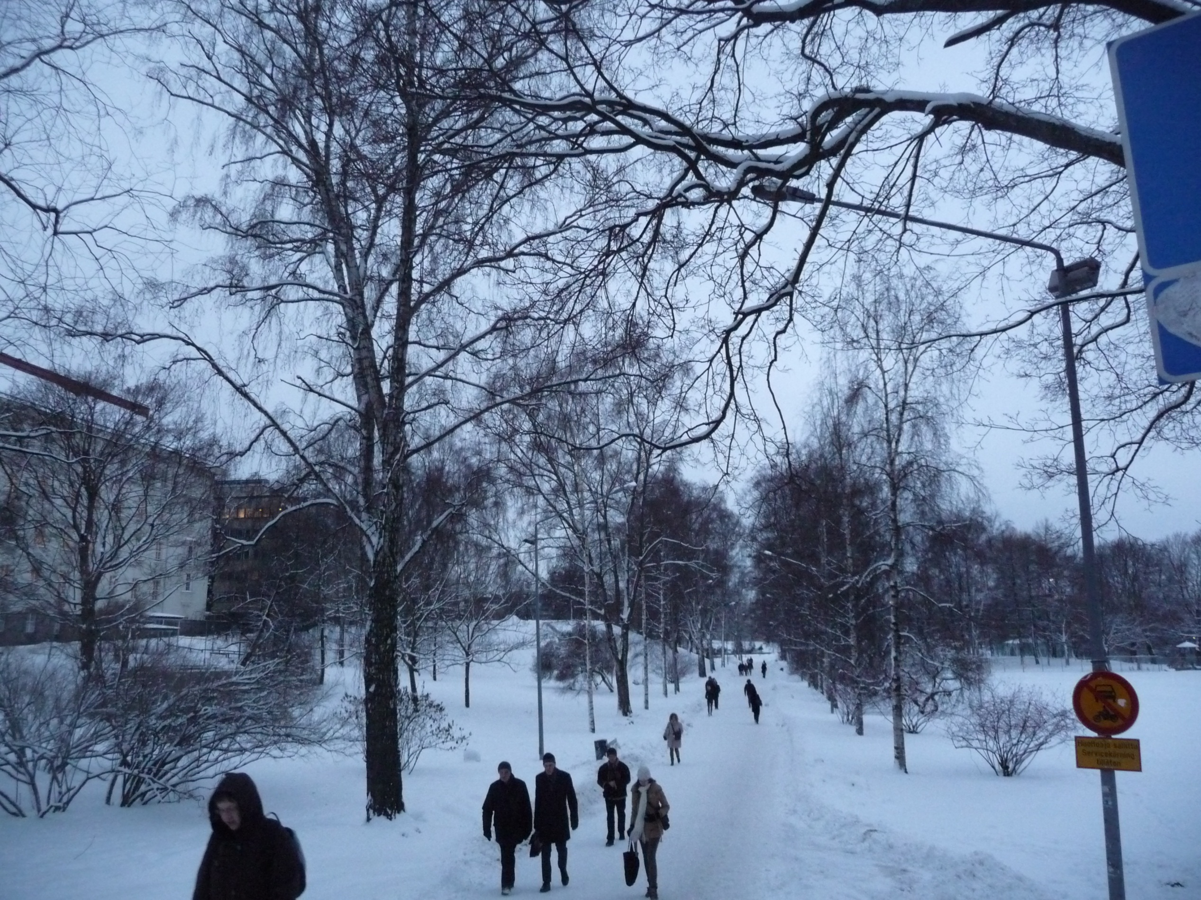
4. Content Analysis of the Finnish (and Korean) STEM Teacher Education Programms.

Slide 36
Content analysis of the aims of the pedagogical studies in Finland and in South-Korea
What kind of support the pedagogical studies offers to the construction of teacher knowledge from the point of view of
- structure of the knowledge
- origin of the knowledge

Slide 38
Number of different aims in the curriculum of the pedagogical studies
Research
orientation
Reflection
Producing educational research
Learning of an individual (13)
Consuming educational research
Learning of a group (7)
Practice
School practice
Korea
Different needs of students (8)
Pedagogy
Learning of teacher's attitude
Finland
School
Learning of educational reality
–
society link (14)
Designing instruction based on
the nature of subject
Use of ICT in learning (3)
Use of ICT in learning
Producing educational research (4)
The role of education in the society
Different needs of students
Consuming educational research (8)
Planning, teaching and assessing
Reflection (13)
0
5
10
15
20
25
0
2
4
6
8
10
12
14
16
Number of aims

Slide 39
Number of different aims in the curriculum of the pedagogical studies
Learning of an individual (13)
RES
Learning of a group (7)
Different needs of students (8)
School
–
society link (14)
PCK
Korea
Finland
Use of ICT in learning (3)
Producing educational research (4)
GPK
Consuming educational research (8)
0
10
20
30
40
Reflection (13)
0
2
4
6
8
10
12
14
16

Slide 40
From the point of view of the origins of teacher knowledge:
Korea
Practitioner
knowledge
Theoretical
knowledge
Finland
0
10
20
30
40
50

Slide 41
History explains the differences of Finnish and Korean programs ...
Finnish teacher-education programs have focused on PCK since the 1970s and balanced PCK & GPK (Simola, 1998; Jakku-Sihvonen and Niemi, 2006).
Educational equality and needs of different learners have been emphasized in Finland since 1960s when the Finnish comprehensive school was introduced.
Since 70s research based knowledge and producing of it has been emphasized in Finnish teacher education (Lavonen & Krzywacki, 2008).
Korean teacher-education programs and institutes have undergone continuous change, but the interest in developing a balance between aims focusing on different domains of teacher knowledge has been minimal

Slide 42
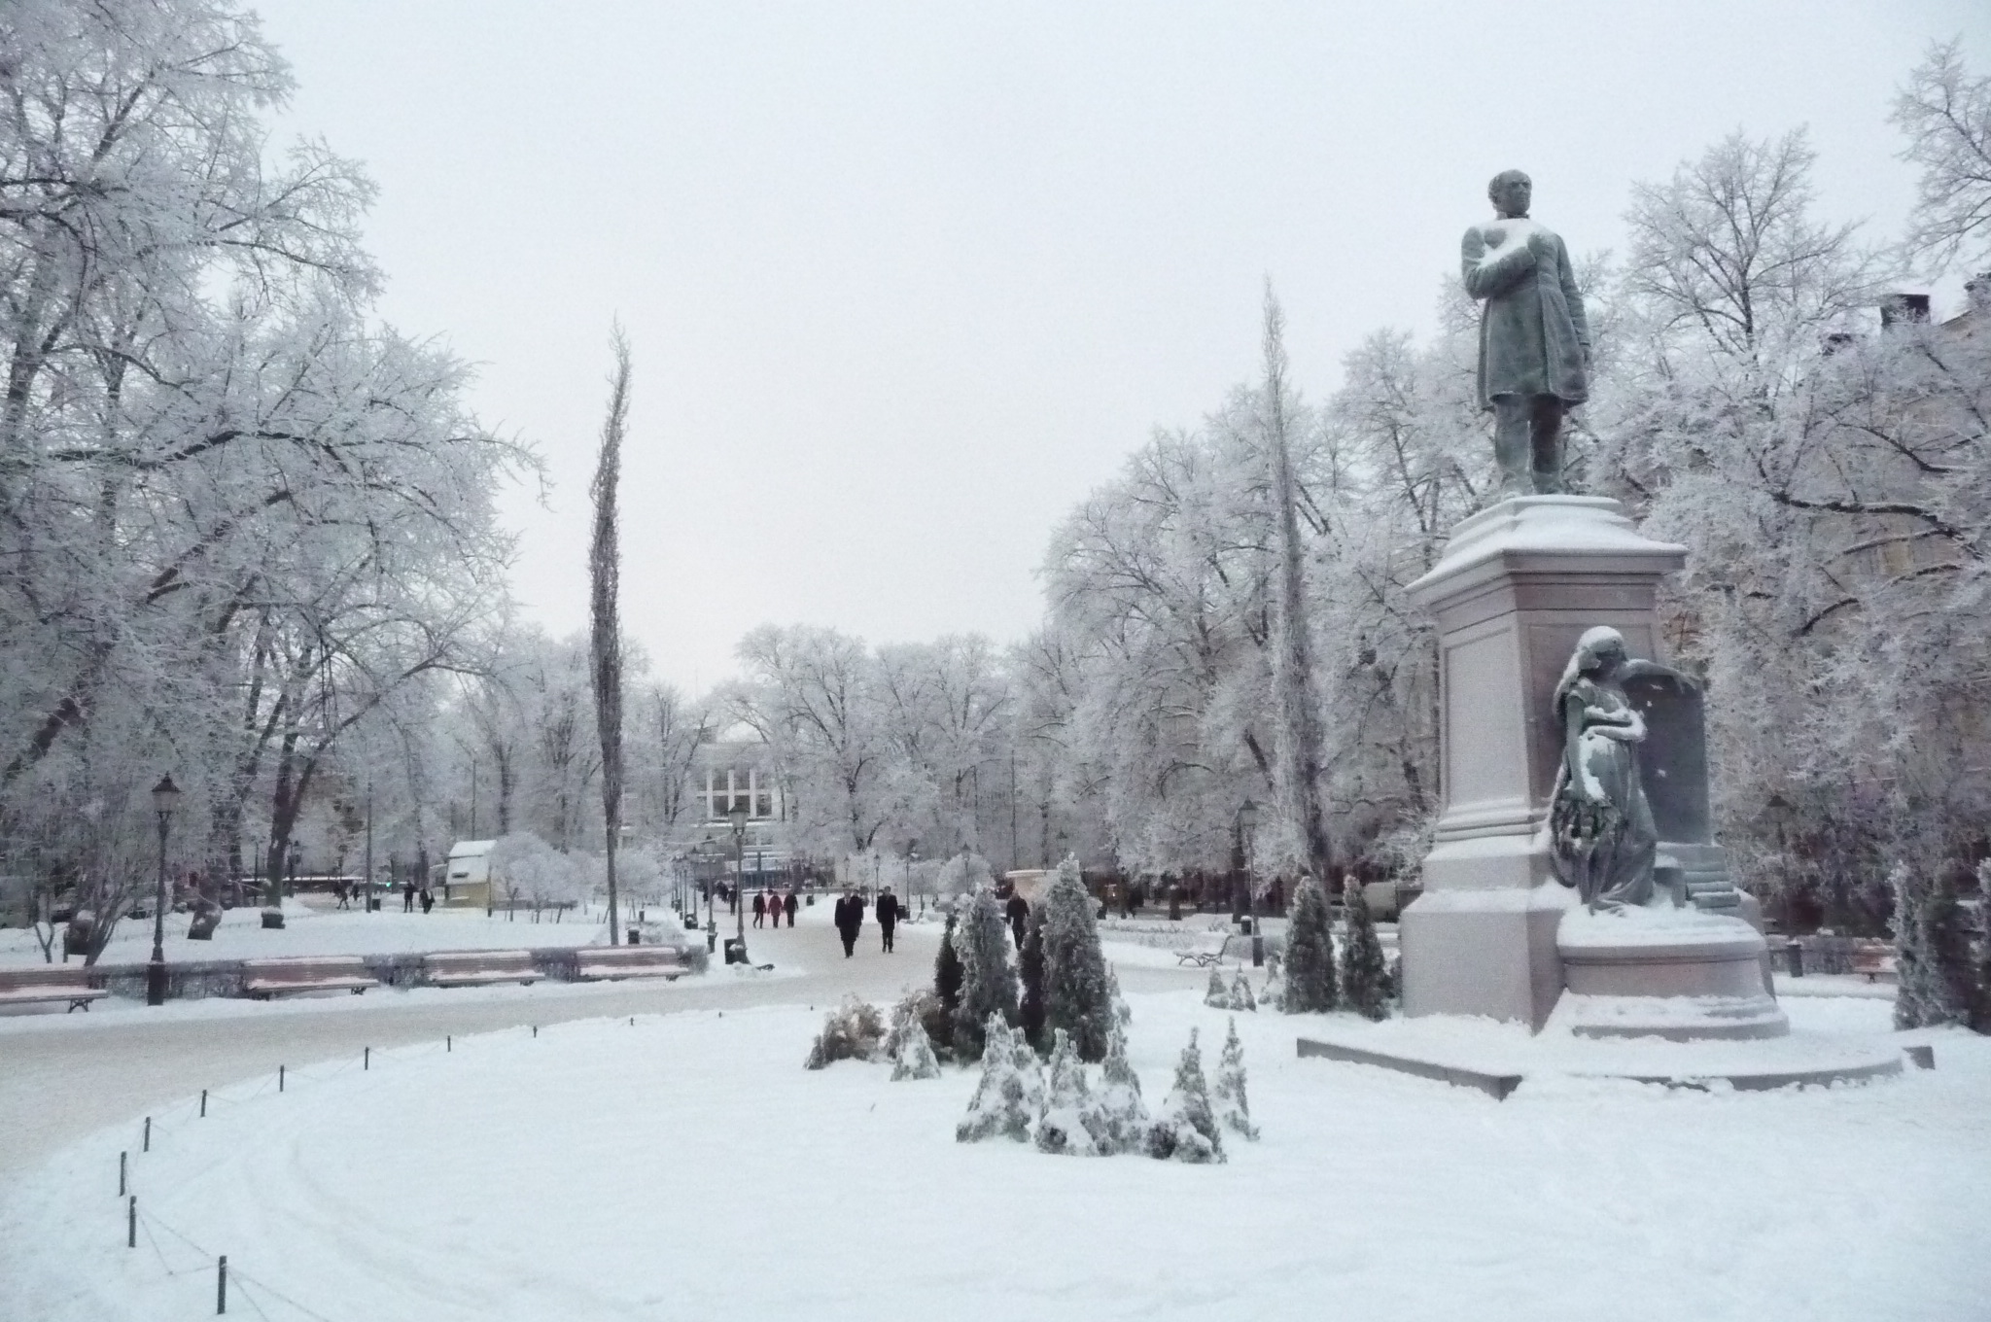
5. Discussion

Slide 43
What kind of STEM teachers we should educate in teacher education?

Slide 44
1. A versatile knowledge base
Subject matter knowledge: the broad meanings of concepts; epistemological, ontological and methodological issues related to the subject.
PCK and GPK, which are needed for (broad) planning (including the local curriculum), implementation and assessment of teaching and learning outcomes.
Understanding the diversities among learners and different needs of the learners
Moral and ethical knowledge in order to work ethically correctly with students and parents.

Slide 45
2. Life-long-learning capacity
Skills needed in producing and consuming research based knowledge.
Skills needed in evaluating and developing the teaching profession;
Self-regulation skills of and -control over the work.
Ability to use assessment data for school development.
A STEM teacher recognises problems around him/her, is able to generate alternatives for solving the problems and able to select the most appropriate solution among the alternatives.

Slide 46
3. Readiness for collaboration and partnership
Readiness for collaboration inside the school; with other teachers and as a member of a multiprofessional team
Readiness for collaboration with parents.
Readiness for school society/industry/… partnership.
Schools are not isolated institutes in a society.
A coach, mentor or a trainer of other teachers

Slide 47
More ... |  | Less ...
collaboration and professionalism | – | competition
equal opportunities for all learners | – | private organizations taking care of education
personalization, decision making and assessment at local level |  | less standardization and national testing
trust based responsibility (self-evaluations, listening of students and municipality people/ parents voice) | – | test based accountability
professionalism | – | bureaucracy

Slide 48

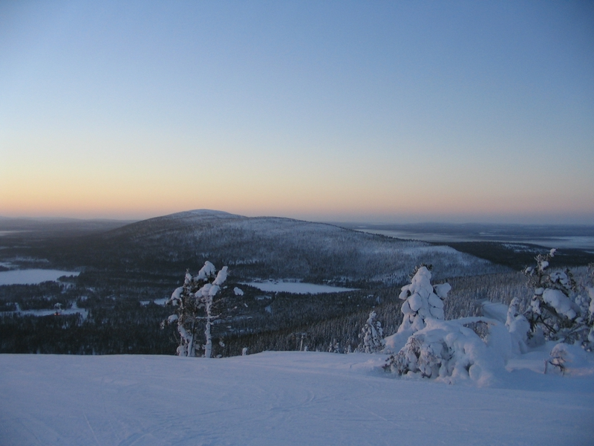
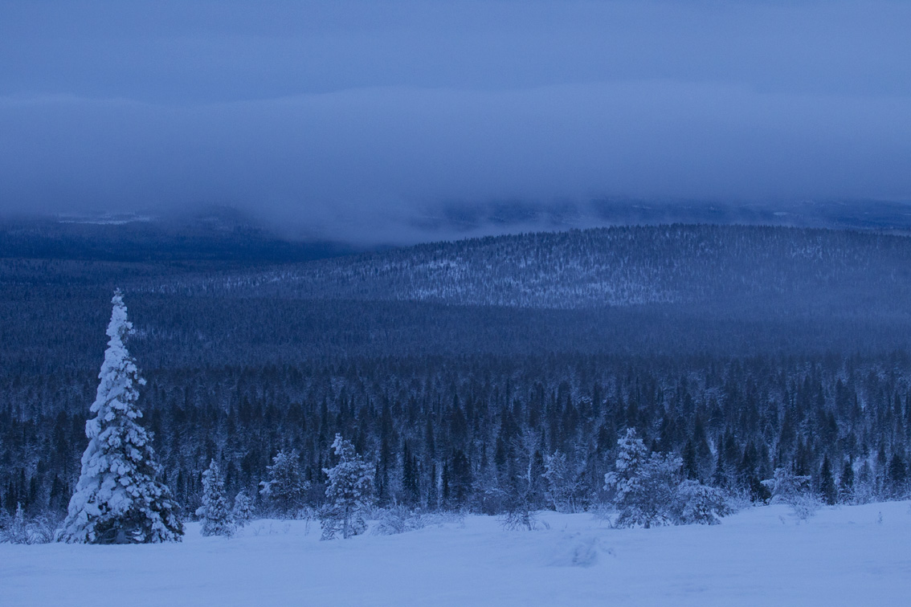
Thank you!

