Slide 1
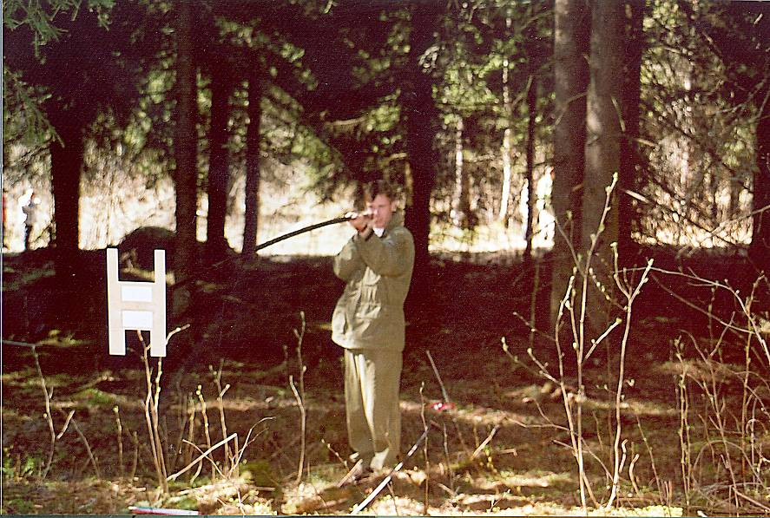
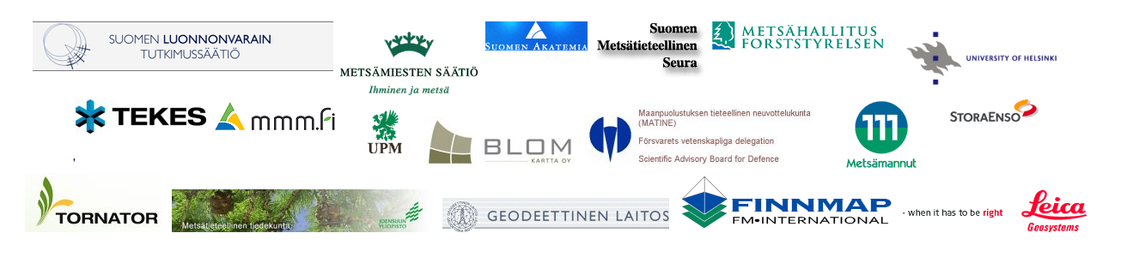
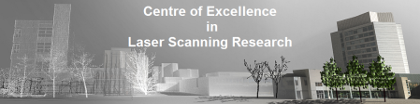


Metsikkökoealaharjoitus
featuring Topical Research vuodesta 2007

Slide 2
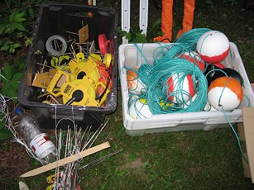
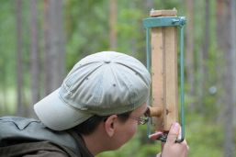
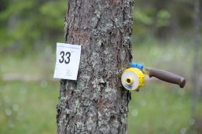
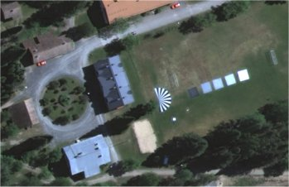
Contents
Some quite historical notes & 3D views
More recent history and background information
on how we got here, and on how you can
contribute to research done at our Department
Instructions for a successful campaign in the next
days to come
Lauri Korhonen 2008 (PhD 2011)
Vertex transponder 2008
Test flights with National Land Survey and FGI 2009

Slide 3
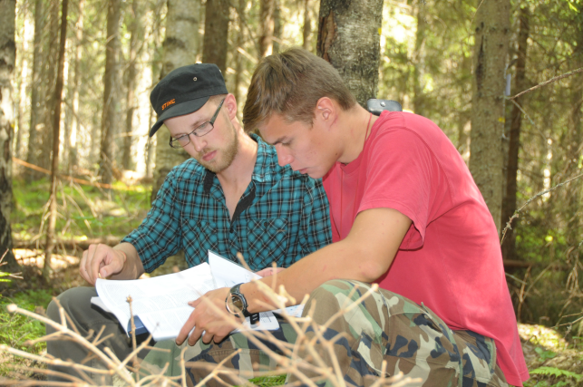
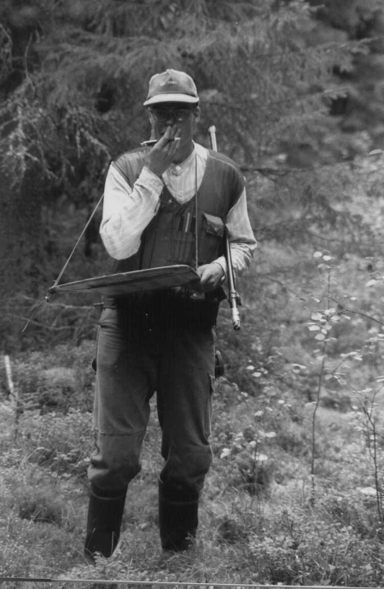
A moment devoted to Hikihelmi

Slide 4
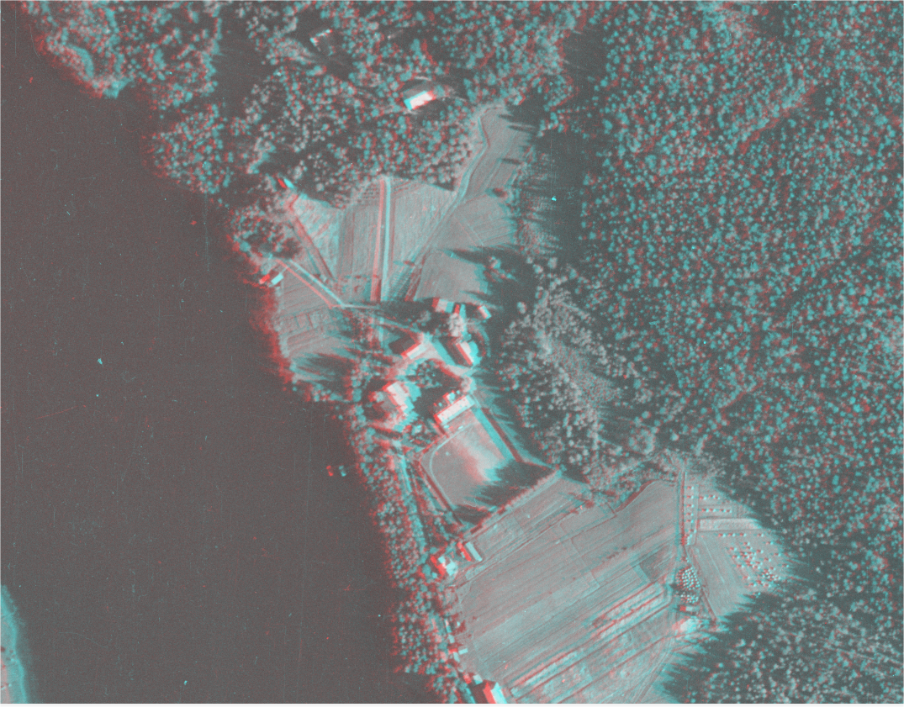
KUVAMITT analyph

Slide 5
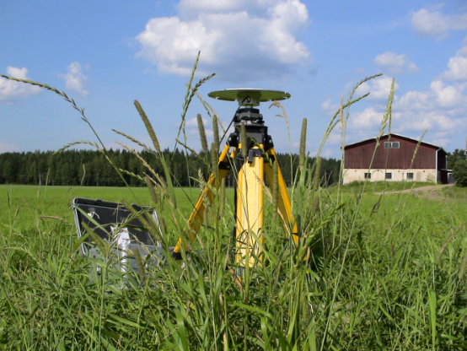
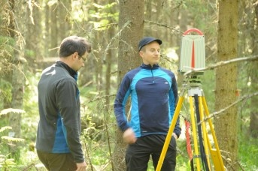
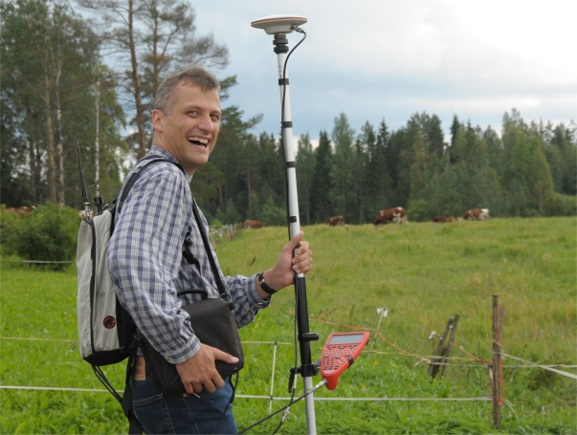
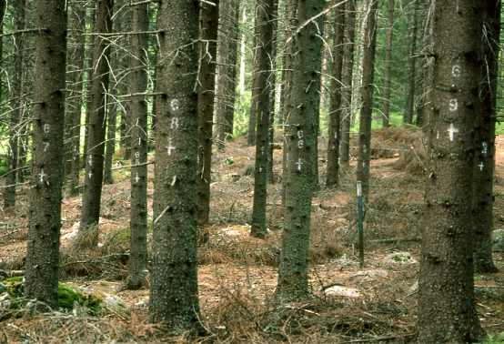
Forest inventory –related research in Hyytiälä
Very little before 1980s
1980s Aerial films, stereo interpretation, 2-phase sampling
designs applying satellite images
1990s Low-altitude images, stereophotogrammetry,
Hyperspectral imaging, Digital photogrammetry in tree mapping
Permanent field plots 1995-
2000s Field observations: ’Relashnikov’, ’Harvester as
mobile caliper’, Terrestrial laser scanning, Terrestrial photography
(outsourcing) and photogrammetry
Allometric biomass modeling
Remote sensing applications: GCP network & aerial image time
series established; Radiometry of aerial imaging in canopies;
Use of UAV images; Single-tree remote sensing with LiDAR and
machine vision; Laser scanning applications in mire ecology;
silviculture; change detection; LAI estimation in LiDAR/Satellite
images, Hyperspectral imaging; Waveform-recording laser scanners

Slide 6
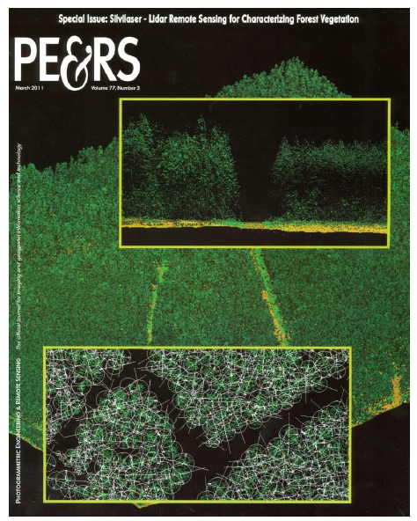
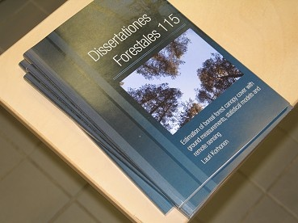
About Metsikkökoealaharjoitus
We will together combine the effort of learning by doing and an ’on-the-side -effort’ of maintaining a permanent remote sensing experiment
The Hyytiälä experiment
Accurate reference data of trees in plots 1995 −
Airborne optical images 1946 −
Airborne LiDAR (laser scanning) data 2004−
Spaceborne images
Terrestrial photogrammetry and imaging of trees, bottom flora, canopy
Terrestrial laser scanning of trees
Co-operation with/between sensor manufacturers, research institutes, PI’s, and research fields resulting in PhD and MSc theses, as well academic and commercial projects

Slide 7
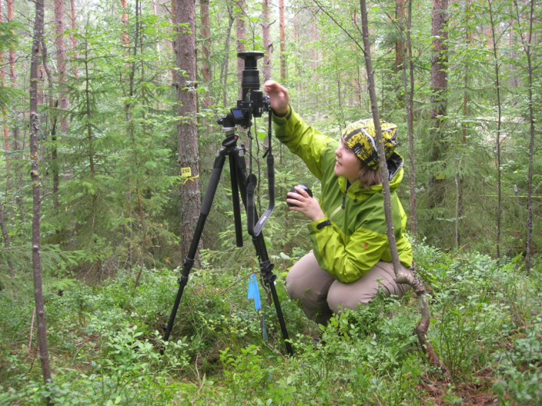
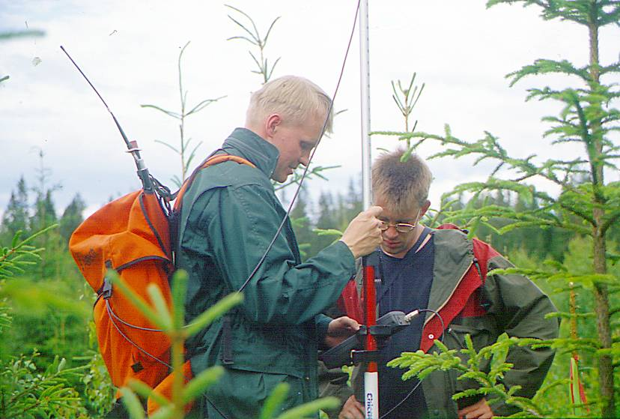
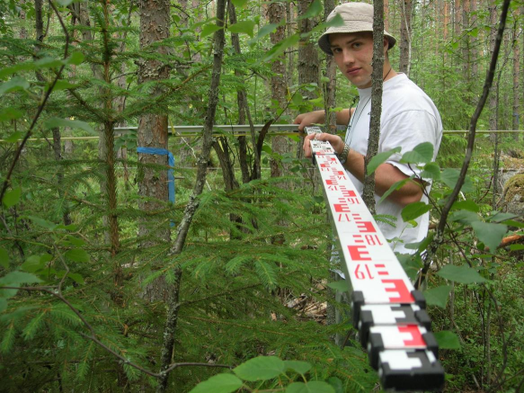
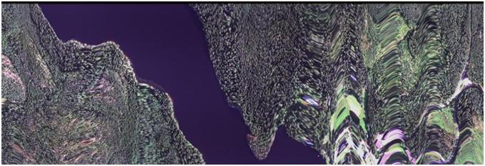
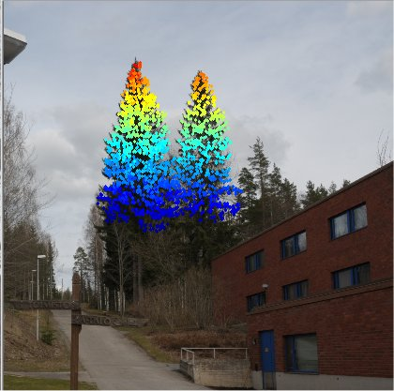
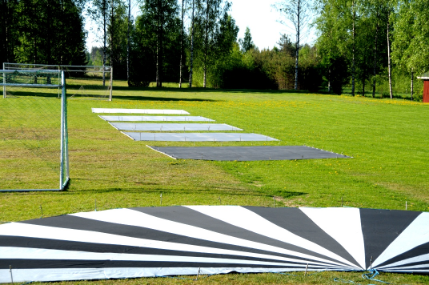
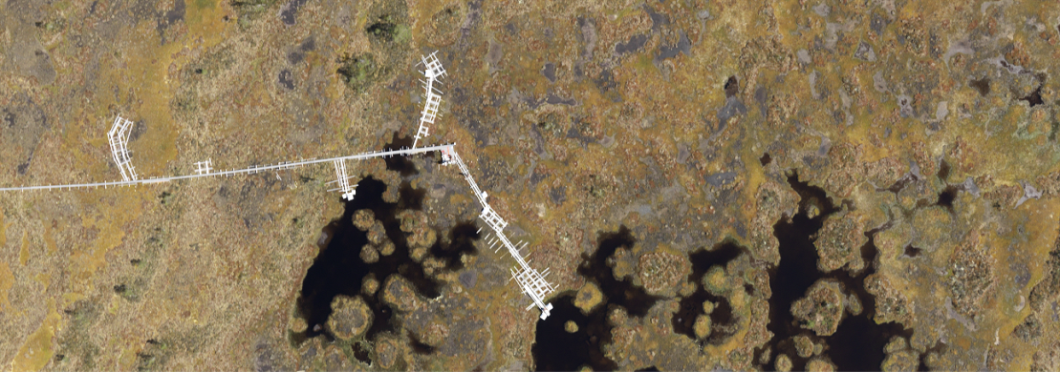
Some qualities of the experiment
Multi-use of plots (LAI detectives)
Accurate georeferencing (RTK in 2000)
Precise measurements
Fun
Joint campaigns: Here with Finnish Geodetic Institute, UH Dpts of Geography and Physics

Slide 8
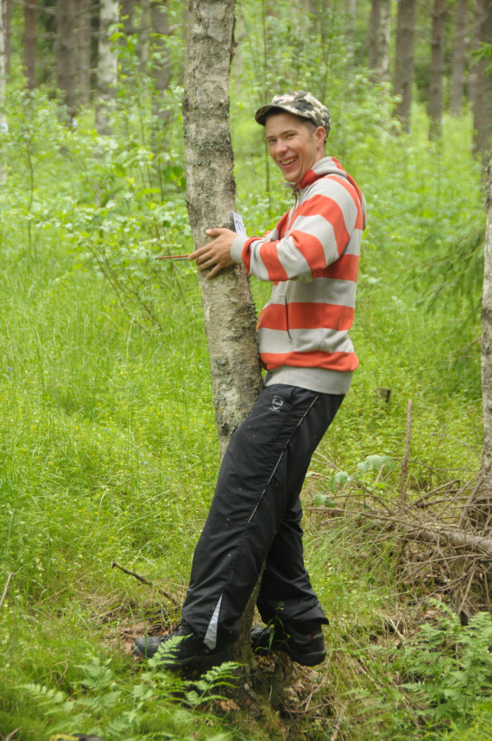
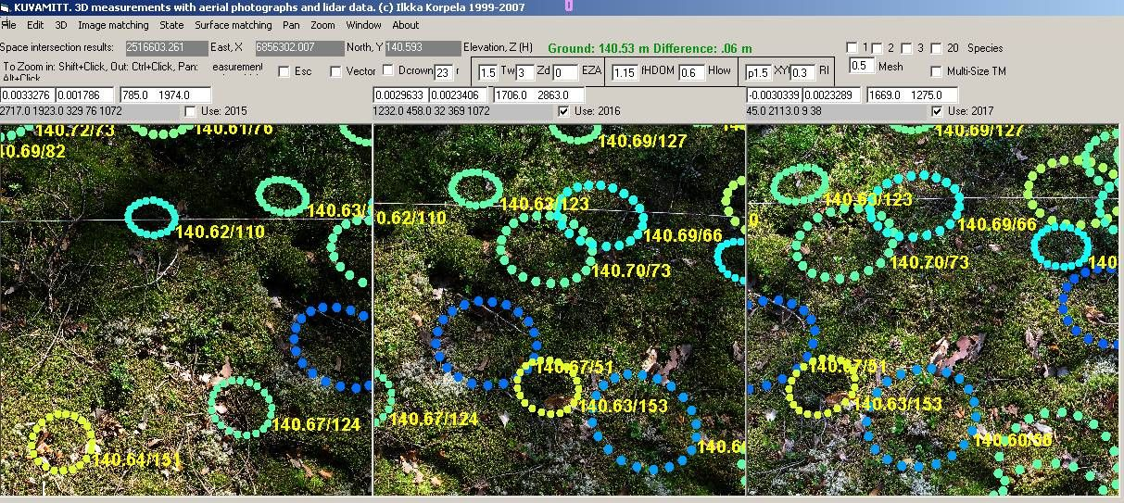
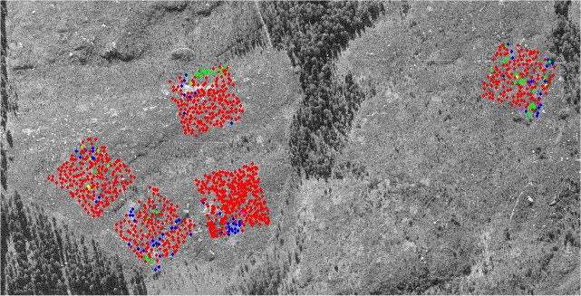
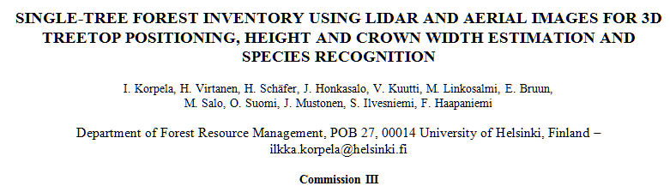
Some qualities of the experiment
One datum: field photogrammetry 2008 and LiDAR footprints of 2006 & 2007
Students participating
Thinning experiment
Redundancy Repetitions, Plenitude of observations, members, treatments
Known accuracy Well-established controlled measurements
One ‘datum’ Co-use of different data, time-series analyses

Slide 9
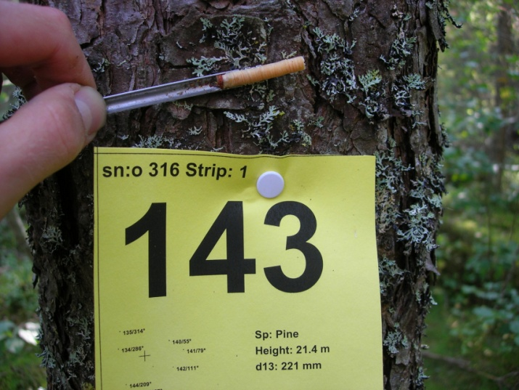
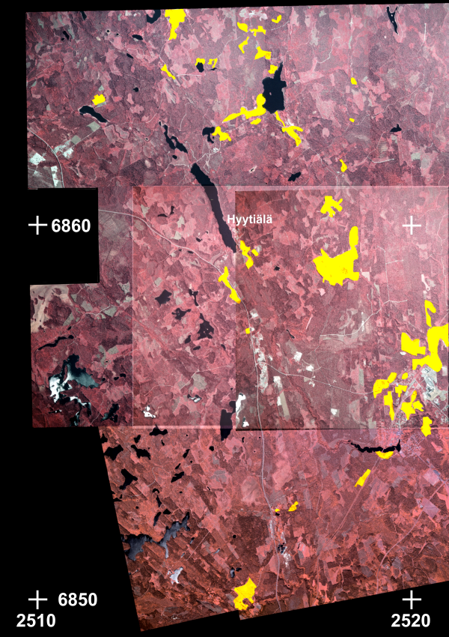
The forests
PLOTS
Rectangular or ’free in shape’ (fixed-area),
diameter criterion
Variation in stand variables
Last est. in 2011
1-4 measurements
TREES
28 000 with 3D coordinates
Species, DBH / d_{1.3}
Status of the crown (new in 2014)
Height (h)
Height of the lowest living branch (h_{c})
Crown diameter (d_{cr}), diameter increment (i_{d})
STUDENTS
Involved since 2007

Slide 10
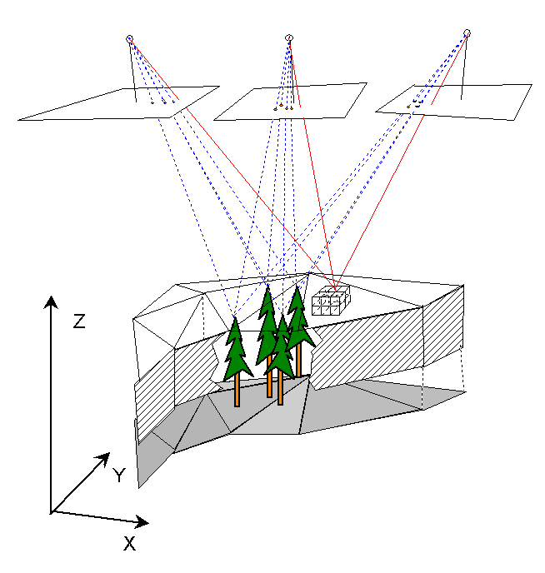
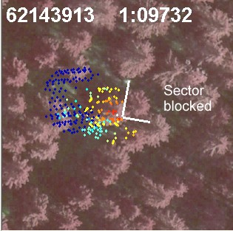
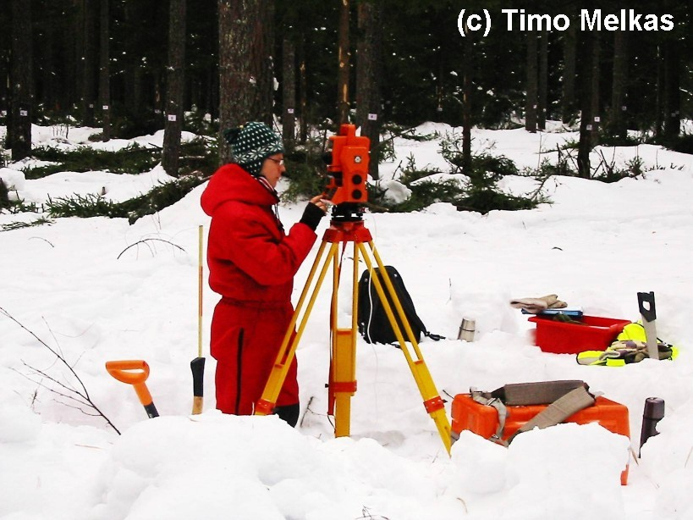
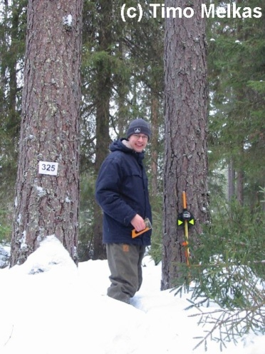
How were the students introduced?
* In 2004-06 research in ’precision forestry’ at its peak of hype
* Georeferenced data were laborious to collect in the forest
Jouni Kalliovirta (Simosol)
Heikki Surakka (Ramboll)
Kuivajärvi Black alder forest (Metadata)
2005 Kartoitus takymetrillä ja puumittaukset:
* Kartoitus takymetrillä 10.5-11.5.2005. Ilkka Korpela & Sirpa Rantanen. Neljä puuta paikannettu etäisyysmenetelmällä.
* Puidenluku ja pituusmittaukset 11.5.2005 Sirpa Rantanen & Mikko Vastaranta

Slide 11
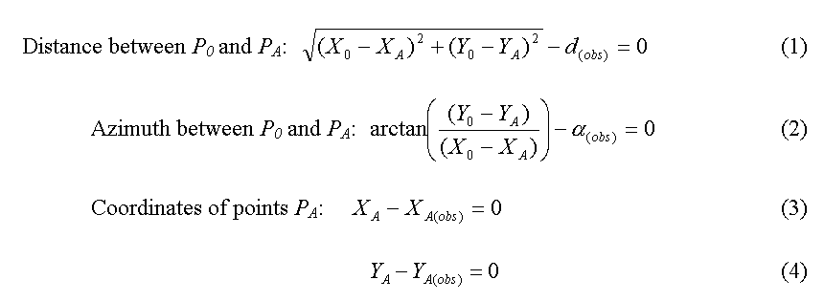
A new ”one-man method” for tree positioning in 2006
Using multiple aerial images, positioning of treetops.
0.1−0.3-m XY, 0.5 m Z accuracy.
- 200−400 trees/h
The tree list is incomplete, ‘height-challenged’, and
may contain false cases as well, thus it needs filling in and polishing.
N
Photogrammetric tree
1. Solve the deviation between Y and N
2. Observe from many non-slant trees the object
3. Each compass azimuth ⇒ half-line
4. Each intratree distance ⇒ circle
5. Find position (X₀, Y₀) such that ||deviations|| is minimal
Y
azimuth
distance
Object at (X₀, Y₀)
X

Slide 12
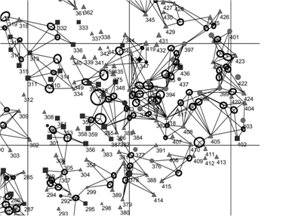
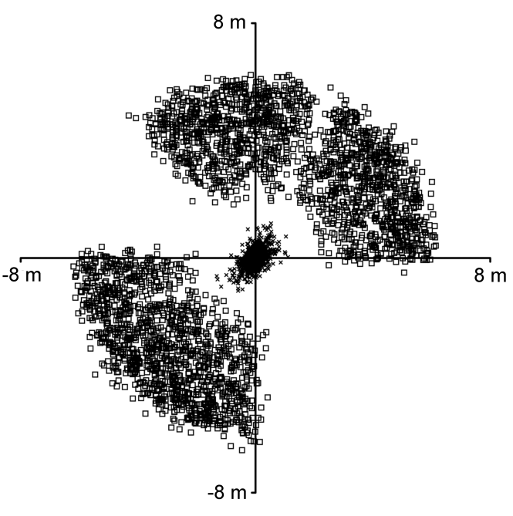
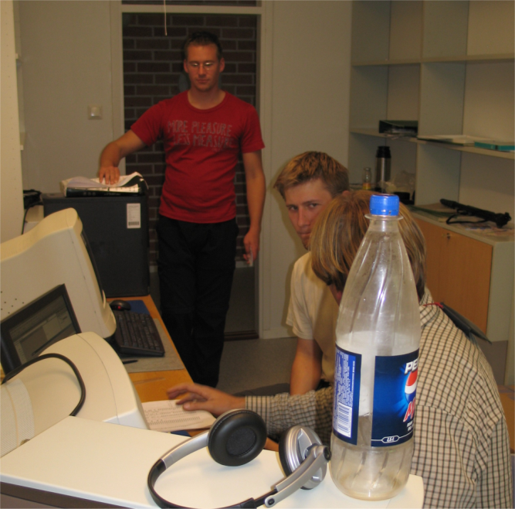
Non-linear regression, partial derivates of observations equations in A, deviations in y, weights in P.
σ_{Xi} = standard errors of unknown coordinates (m)
Error ellipses for the solution.
Math for finding possible gross observation errors.
(standardized residuals).
eig(Q_{xx})
August 2006, Authors of the study (test phase)
Tuukka Tuomola (Silvadata)
Esko Välimäki (Tapio)
Ilkka Korpela (HY/S akatemia)

Slide 13
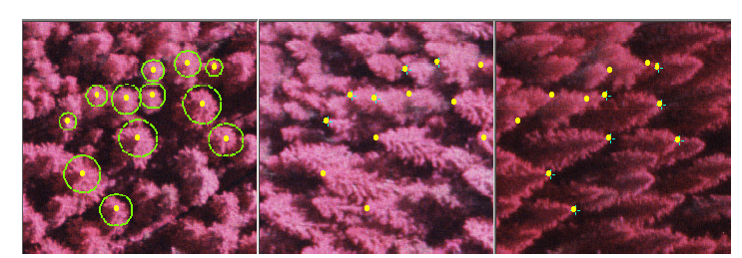
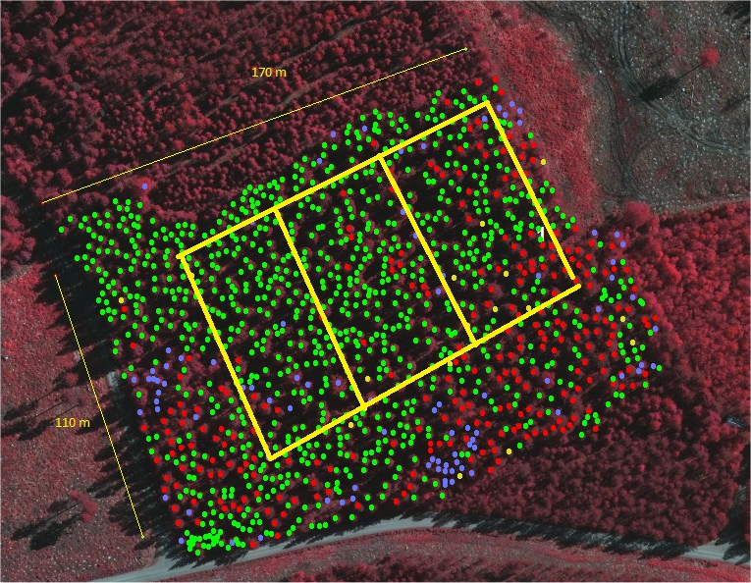
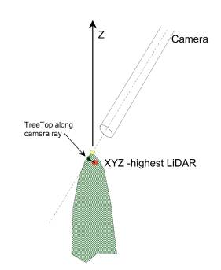
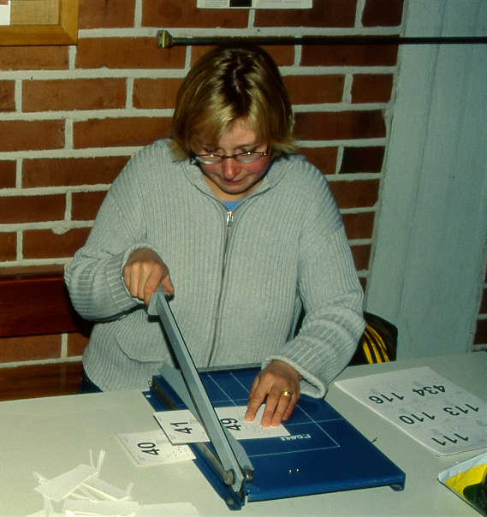
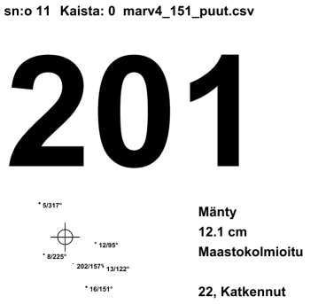
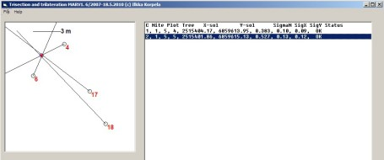
Plot mapping - METHOD
1. Acquire airborne LiDAR / images
2. Treetop positioning in these data
(h_{relative} > 0.5−0.6)
3. Prepare maps and tree labels
4. Identify trees in the field
5. Position the non-visible trees
6. Compute tree positions
7. Whatever measurements on the trees
In 2014: phases 3-7 on established plots.

Slide 14
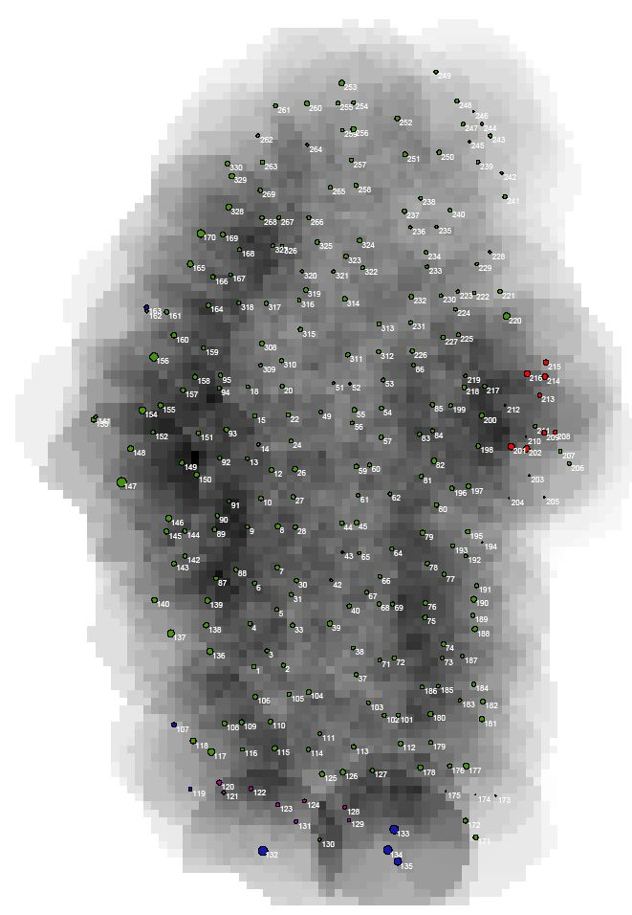
Gain from having tree positions?
Tree-level monitoring becomes feasible
Neighborhood (spatial) analyses for
dependencies in growth, mortality,
diseases etc.
The plots are valuable not only for remote
sensing research

Slide 15
So much for history...

Slide 16
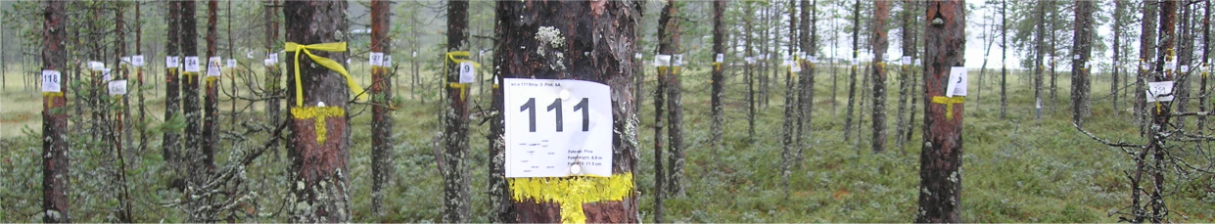
Instructions for a successful learning experience
Forest
The main goal is to learn how to measure the current structure and recent changes of a forest, using
* different ways of selecting the trees of interest (plots),
* by carrying out measurements on these trees,
* by making special measurements on a selection
of trees, and by applying these observations to
existing tree models to predict new variables of
interest
* to construct, for these new variables, stand-specific
models to generalize them to all trees of
interest
The research goals are reached simply by careful and accurate work!
Measurements
Sampling
Models
‘Forest’
in an information system

Slide 17
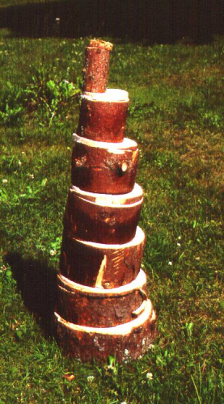
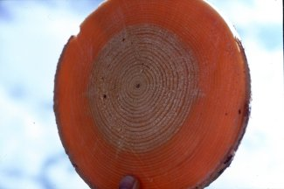
TREE
AboveGroundTree == Σ TruncatedCones + Weighted branches
- Sampling; observations; assumptions
- Data for allometric TreeModels (some of which you applied also)
Tree_variables: species, classes, sortiment potential, DBH (d_{1.3}), d_{x}, h, h_{c}, v, i_{r}, i_{d}, i_{v}, b, age_{x}, …
Tree_models: taper curves, volume functions, increment functions, age models, …

Slide 18
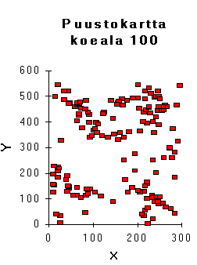
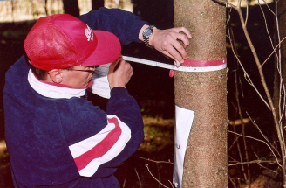
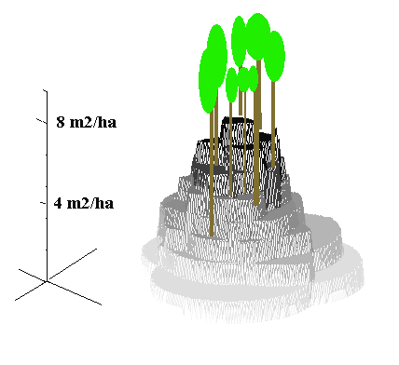


TREE SETS and STANDS
A) Forest == Σ Trees
- Forest is characterized by trees sampled by given probabilities
- A tree is characterized by direct/indirect observations and model estimates
- Results apply to a 2D point (e.g. m³/ha) or an area (m³)
B) Forest == ’Flux of cylinders’
- Volume = Form-correction × ’Cylinder Density’ × Cylinder Heights (V=FGH)
- ’Cylinder Density’ = Basal area, m²/ha with a relascope
- FH = f (species, height, BA); Pine stands FH = 0.4116-0.04275*H^1.5+0.6359*H
Results apply to a 2D point (m³/ha)
Size of trees ⇒ Height and diameter observations and models needed
quick ’n dirty -method
Stand_variables: species proportions by X, site class, D_{gm}, D, G (BA), ’density’,H_{L}, H_{dom}, age(s), treatment proposals, soil type, etc.
Stand_models: FH-functions (relascope tables), diameter distribution models, height models, timber sortiment models, growth models,…

Slide 19



BY REMOTE SENSING A and B have ’counterparts’
A) Forest == Σ Trees
⇒ Single-tree remote sensing
d13 = f₁(species, height, crown size) v = f₂(species, height, d13)
http://www.helsinki.fi/~korpela/Hyytiala/Espoonlahti.avi
B) Forest == ’Flux of cylinders’ ⇒ Area-based remote sensing
Basal area ≈ canopy density
Stem volume, m3/ha
Lakkasuo, pristine part
Percentage of pulses absorbed by the canopy (Lakkasuo ombrotrophic parts)
Percentage of pulses reaching ground (400 m² plots)

Slide 20
What will the 2014 data used for...

Slide 21





Topical research
* Simulation of LiDAR signal from canopies http://www.helsinki.fi/~korpela/Liisi/birch_animation.gif
* Enhanced tree species classification: a) using so-called waveform features, b) directional reflectance signatures in images, c) Novel geometric and radiometric LiDAR features

Slide 22
What next...

Slide 23

Another moment devoted to Hikihelmi

Slide 24
Flow of the Metsikkökoealaharjoitus
0. Lecture and practice in Hyytiälä
⇒ forest
1. Getting to know the large rectangular forest plot with Hikihelmi
2. Finding the trees and attaching labels 1.3 m AGL; stripwise ordering; in two teams.
If needed, labeling and positioning of trees by means of triangulation.
3. Careful tally tree measurements of each existing tree for the five variables:
{Species, Canopy layer, Timber sortiment potential, Crown status, DBH}
⇐ office
4. Systematic selection of ’sample trees’ representative of the DBH-distribution
by species and canopy layers. Used later for building functions for the indirect estimation of
volume, timber volume and past volume growth of trees of particular size and species.
⇒ forest
5. Very careful sample tree measurements on height, height of the lowest living branch,
and the 6-meter diameter. A subset of trees is measured for variables needed in growth
estimation.
6. Measuring the trees of interest using an angle cauge and a circular delineation
⇐ office, data delivery (paper sheets, 1:1 with xlsx-file of the plot), permission to continue
7. Generalizing the results, using sample tree information into estimates of the stand
volume, timber sortiments, value, growth etc.

Slide 25
”MITÄ?, OHO ja HUPSISTA!” --- On accurate work
’Evidence from observations’
Labeling: Built-in error control
Tallying: Communication, documenting and data typing errors;
Q/C against old data; Watch out for odd caliper scales; 1.3 m height
SampleTree measurements: Communication, gross errors such as reading the wrong hypsometer scale, adding when supposed to substract, 6m caliper at wrong height or recording i_{r} for i_{d}, or B for 2xB. Recording wrong units.
How to control? Re-measured sample ⇒ deviations, their mean and dispersion are informative of systematic (bias) and random errors. Logical reasoning for known dependencies and thinking of a reasonable range of values.

Slide 26

Devote yourself to reading Hikihelmi

Slide 27


Slide 28



Slide 29
LATVUSLUOKITUS
11 Jos puusto on hoidettua ja terve; ”normaali” latvustyyppi vallitsee.
LISÄMÄÄREET
12a1; 12a2 Lisävalta- ja välipuut monesti supistuneita/piiskaantuneita yhdeltä (a1) tai useammalta puolelta (a2) (latvus ei siis ole ympyräsymmetrinen). Jos poikkeama on yli 50%, kirjataan.
12a3 Joillain puilla voi olla hyvin lyhyt latvus suhteessa muihin saman puulajin puihin. Esim. vallitseva latvussuhde on 40% ja joukossa yksittäisiä puita, joilla se on 15-20% (”tupsu”), yl. väli- tai lisävaltapuumänty tai –koivu.
12a4 Lumi- tai myrskytuhon jäljiltä, elossa olevia puita, joiden latva on poikki
12a5 Latvuksen ylin osa (latva) voi olla kuivunut (esim. versosurma kuusella, tervasroso, koivujen latvojen kuivuminen, latvan piiskaantuminen)
12a6 Puu voi tehdä varmaa kuolemaa.
12a7 Joukossa voi olla harsuja puita, joissa on suhteessa muihin samassa asemassa oleviin puihin nähden alhainen lehtimassa.
ESIM.
11
12a1a5
12a1a3
12a1a7
14a1
21

Slide 30




The h and hc measurements are crucial
h == tree height
h_{c} == lowest living branch
(needle, leaf)
a
b
e
c
leveled
d
’metsurinmitta’
Option (for the use of optical distance fixes)
1. Choose d ’freely’ and fix e, the scale in hypsom.
2. Observe a, b and c.
3. Record a, b, c, d and e.
4. Deduce h and hc in the office
Effect of hand tremor on the absolute error in height measurement at different distances for a 20-m-high tree

Slide 31
What are available?
Tree labels, ordered in strips, n = N, thick paper
http://www.helsinki.fi/~korpela/MARV1_2014/Numerolaput/
2N pins
A4-size forms to document measurements (water proof), the files are here
http://www.helsinki.fi/~korpela/MARV1_2014/Maastolomakkeet/
Printed and covered tree maps n = 2
http://www.helsinki.fi/~korpela/MARV1_2014/Puukartat/
http://www.helsinki.fi/~korpela/MARV1_2014/Resection/marv_2014_puut.csv
File with existing measurements, with tree-records, used with RESECTION
HIKIHELMI!

Slide 32


Program
Assigning you with a plot and an assistant, and the per-plot material.
Forest walk to see 24 different tree crowns
Reading-the-Hikihelmi-and-consulting-the-assistant-so-as-to-know-exactly-what-you-are-about-to-do-next – session
Lunch and off to the forest
Tel. 0400-218305
Forest walk - route

Slide 33

Challenge!

