Slide 1
How to give a good presentation:
- what to do
- and what not to do?
Kai Nordlund
Department of Physics
University of Helsinki, Finland

Slide 2
Introduction
This presentation gives some subjective advice on how a good presentation should be given
  Mostly it is about the technical aspects – “how to talk well” is a more difficult question and depends strongly on personality
    Rule of thumb on the talking: just be yourself
Comments based on my personal experience on > 50 conferences and > 1000 presentations heard…
NOTE: Due to their special theme, these slides themselves are not a very good example of a good presentation

Slide 3
Terminology
Presentation graphics (”esitysgrafiikka” in Finnish, ”presentationsgrafik” in Swedish) is the fully correct term for ”powerpoint-presentation”
  Powerpoint is just Microsofts software, but of course people use it all the time…
”Slide”:
  In Swedish ”transparang”, ”slide”
  In Finnish: ”dia”, “kalvo”, ”kuultokuva” (yes, sounds stupid)

Slide 4
Think of the public!
Always start by thinking of the public
  What do they know from before?
  What do they want to hear?
  How can you impress or interest them the most?
Introduction important
  Where does this belong in society/your field/...
  Should make it clear what the aim of your talk is
To talk to a high school class is entirely different from talking to a specialist crowd
But in any case, avoid jargon and abbreviations (unless everyone is a specialist)
  The only abbreviations all physicists can be assumed to know are those of the elements!

Slide 5
Think of the public
Example
I have given talks with (essentially) the title ”radiation damage in fusion reactor materials” for numerous different crowds. This is how I do it:
General public (eg. high school kids, studia generalia, ...)
  50% introduction to fusion, 20% on the current state of fusion reactors, 20% on reactor materials and 10% on the own best ever results in the research
Conference on radiation damage
  About 30% introduction to fusion materials, 20% background on the own research, and 50% on own recent best results in research
Conference on fusion reactor materials
  About 30% introduction to radiation damage, 20% background on the own research, and 50% on own recent best results in research
Meeting for specialists on radiation damage in fusion reactors
  About 10% background to own research and 90% recent own results in the research (including not-so-good results!)
Absolutely no equations
Almost no equations
Almost no equations
Equations
as needed

Slide 6
How to talk?
Look at the public!
  If it just is technically possible, place your screen so that you can look towards the audience
    ”Double screen” makes this possible
Avoid talking towards the actual projected slides – then your back is towards the public!
Go to the speaking booth/place in advance and check how and that things work:
  Mouse/remote/microphone/laser pointer/...
    Seems unprofessional if you cannot handle them
  Think of how you will stand and hold the stuff
Only tell jokes if you are very good at it
  But dry humor often works well
Do not apologize for anything

Slide 7
How to talk?
Train! Train! Train! Rehearse! Rehearse!
  If you have trained well, you know what you want to say without looking at your slides – and thus can talk directly to the public
When I was still new to giving speeches, I used to give the whole presentation 3-4 times in whole, alone, until I knew all I want to say by heart
  If it is a very important talk (say your first speech in an international conference or your lectio praecursoria), give a general repetition with public e.g. to the own research group and ask for feedback

Slide 8
How to talk?
Training is also crucial for timing!
  It is extremely boorish (and common ☹ ) that people can not time their presentation to about into the allotted time
    Everyone hates you if you talk way too long!
But training with a watch solves the problem perfectly
Still, be always mentally prepared to jump over some stuff near the end in case your time still runs out
  Better than to forcibly exceed the time
Then, once you are used to talking, you can estimate the time pretty well from the number of slides

Slide 9
Before the talk
It is important to be able to concentrate on the talk during it
HENCE:
  Do not check your emails, facebook, whatsapp, whatsoever, for at least an hour before the talk
    If something urgent or disturbing is in these, you would lose to concentration to the talk!

Slide 10
Little text vs. much text??
Basic question: should one write out just a few keywords, or all you want to say?
Depends on the context of the talk:
  If the presentation is to be dealt out on paper or in the net afterwatds, having pretty much text is necessary
    This presentation belongs to that category
  If not (e.g. a pure conference or propaganda presentation), very little text is enough
    You can use the powerpoint/openoffice/PDF area for “notes” for your internal notes if needed
Full sentences are not needed in any case
  Liberties with grammar are allowed

Slide 11
If much text – split it up!
Problem with much text: people tend to read it in advance rather than listen to it
Solution: presentation effects; put the text (and associated pictures) come piece by piece
  Powerpoint and OpenOffice:
    Animations tab -> Animation pane or Slide show -> Custom animation
    Latex + PDF
    Latex packages make this possible

Slide 12
Presentation effects
To split the text is often good
  Human eye notices motion well
But too much is too much – too many types of effects in the same slide or presentation may make it seem restless or annoying
Corollary: do not used too many colors and fonts in the text on the same slide
  Rule of thumb: at most 2 fonts and 2 colors on the same slide

Slide 13
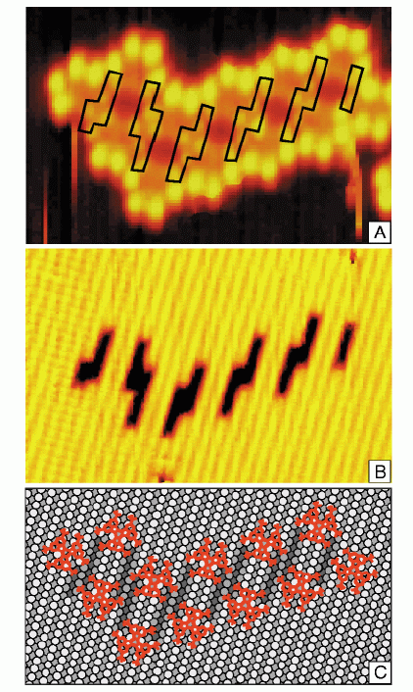
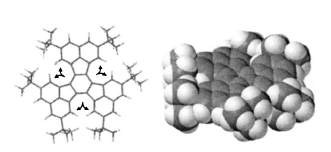
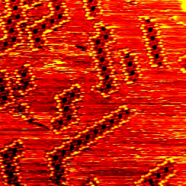
Presentation effects
How not to do:
In Aarhus University in Denmark a molecule has been fabricated which
moves on metal surfaces and picks up atoms one at a time
  Atomic harvester ☺
☺

Slide 14
Presentation effects
How to do
We illustrate our results as a cross section
Material
Ion

Slide 15
Presentation effects
How to do
Take one of the perfectly amorphous silica cells made by the WWW method
Relax with Watanabe-Samela potential (parcas MD code) → the number of coordination defects is negligible after relaxation.
a-SiO₂
Cut a hole and insert a compressed nanocrystal ball.
Flyura Djurabekova, IBMM talk (2008)

Slide 16
How much material/slide?
In the old transparancy times and A4-format one often had a lot of stuff on the same slide
  This was possible due to high resolution (300 dpi or more)
  Reasons: slides were expensive and heavy, so reducing their number made sense
Now the situation is pretty exactly opposite:
  Resolution is limited to 1024x768 pixels (less than on a display)
  One more slide costs nothing
Rule of thumb: Little material/slide: large
font, at most 2 figures/slide

Slide 17
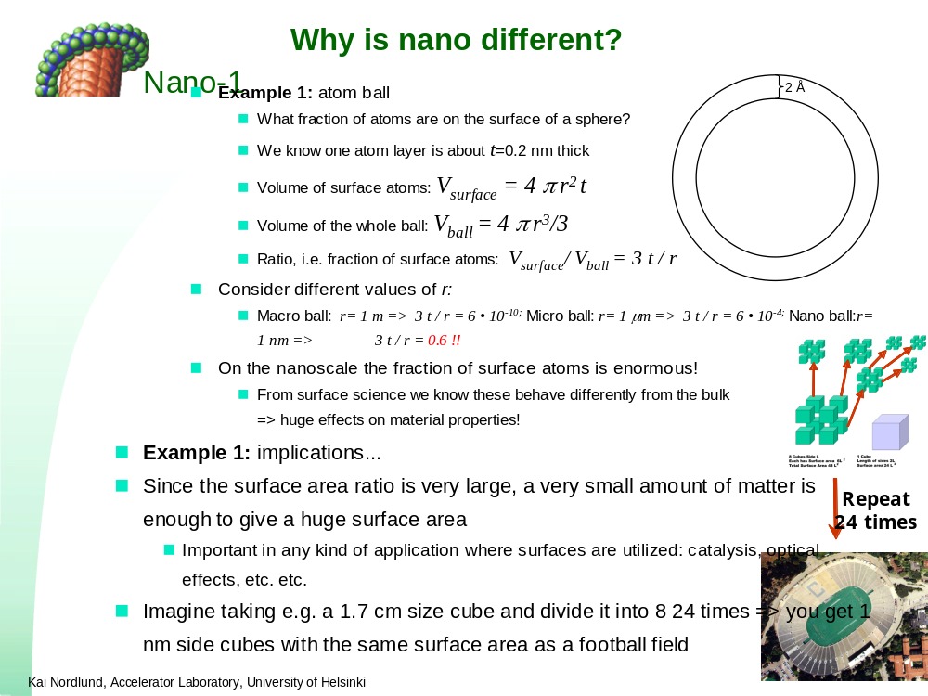
How much material/slide?
How not to do?

Slide 18
Uniform layout!
It is important and useful to have a common layout (”Master slide”) which makes all slides look somewhat similar
  Otherwise too restless
  ”Master slide” allows changing layout, logos etc. automatically in the whole presentation
Powerpoint, OpenOffice, Latex all have good examples
  But do not use the Powerpoint default, that gives an amateurish impression! ☺
Most big organizations have their own formats – e.g. the University of Helsinki format is quite good after minor tuning
  And it can also be fun to make your own

Slide 19
Uniform layout
What should the layout put on all slides?
Organization logo
  Possibly also collaborator logos
Your name and affiliation
  For people who arrive late, or wake up in the middle of the presentation
Not the place and date of the presentation
  This is not sooo crucial, most people do know where they are...
  In fact it can lead to embarrassing situations if you have forgotten to update it from the previous presentation

Slide 20
Master slide – minimum usage!
Learn to use Master slide enough to at least replace the default text ”My Name” or ”Place” or ”Affiliation” with the real ones!!
  Especially if you get a slide example from somebody else, make sure to replace at least the name!
  Caveat: modern (post-2010) powerpoints allow for endless amounts of different Master slides in the same presentation: be careful if you borrow slides from elsewhere to check the layout/template changes to your own
    Or edit the new layout separately from the old one

Slide 21
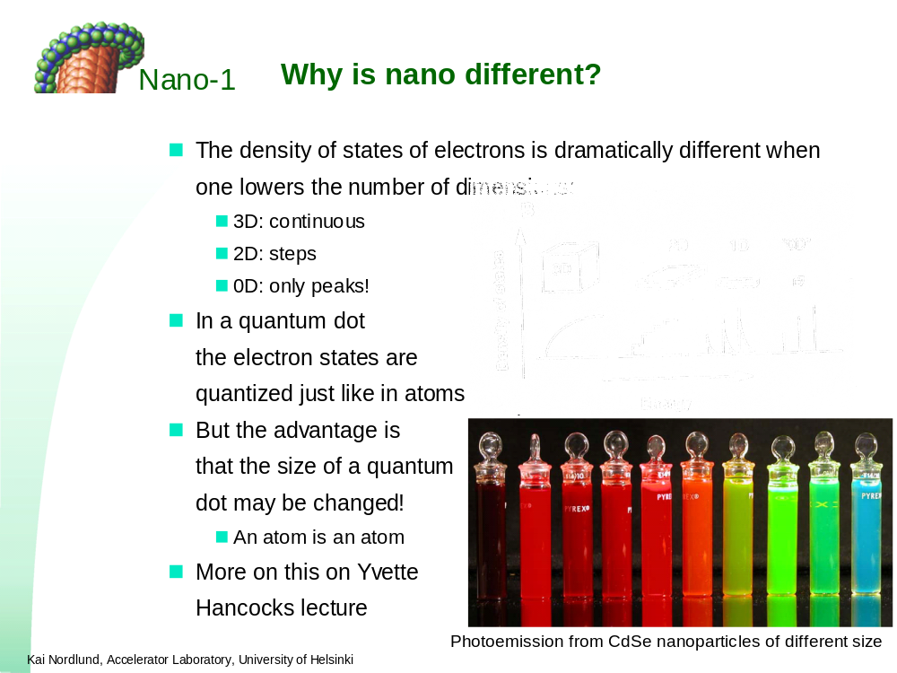
Uniform layout - example
Layout made by University graphic desginer for Nano I – IV courses:

Slide 22
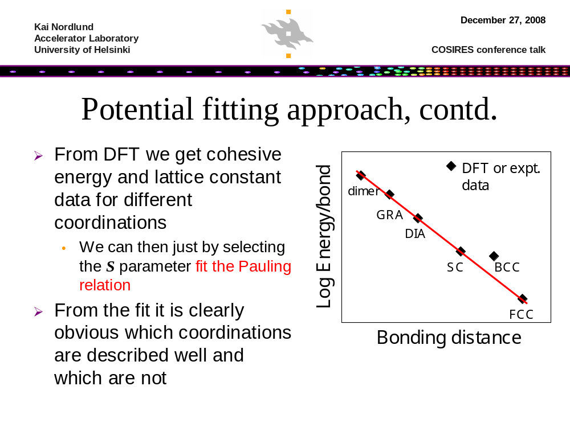
Uniform layout - example
My old personal own layout
  The bar was made from my research results

Slide 23
Pictures
It is almost always good to have pictures in the presentation
  ”One picture tells more than a thousand words”
  E.g. pictures on structures/equipment, pictures on what is studied, …
Schematic pictures!
  Even if your topic is such that it is not possible to find pictures of relevant physical objects, schematic diagrams may be extremely useful for illustrating complex concepts
    Can be easier to absorb information – and to explain

Slide 24
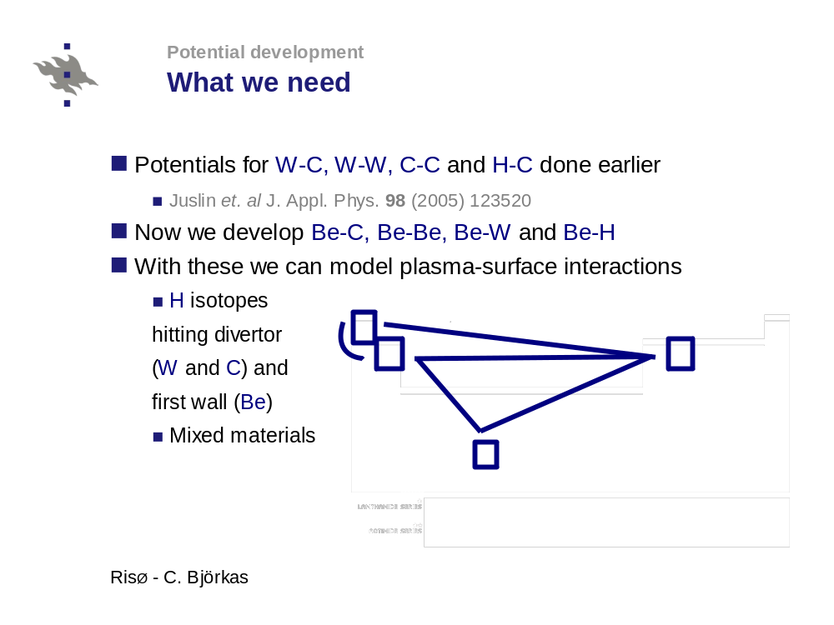
Schematic pictures - example

Slide 25
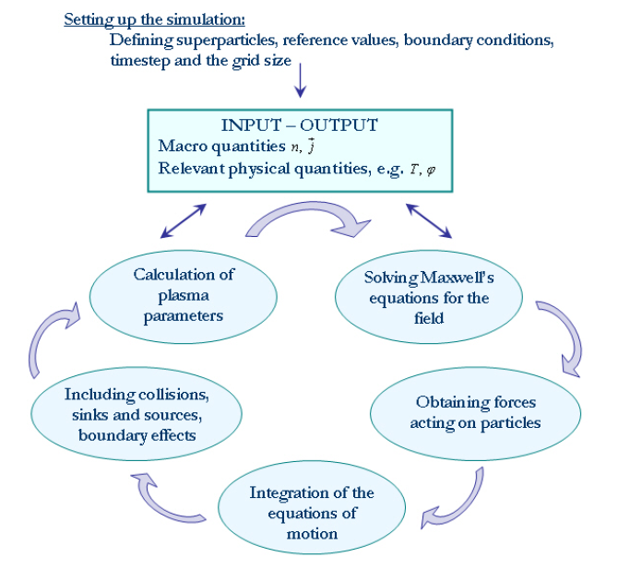
Schematic pictures - example
Helga Timko, M. Sc. Thesis (2008)

Slide 26
Schematic pictures - example
Note also the powerpoint effect in this one:
Give atoms initial r^{(t=0)} and v⁽⁰⁾ , choose short Δt
Get forces F = − ∇ V(r^{(i)}) or F = F(Ψ) and a = F/m
Move atoms: r^{(i+1)} = r^{(i)} +v^{(i)}Δt + ¹/₂ a Δt² + correction terms
Update velocities: v^{(i+1)} = v^{(i)} +aΔt + correction terms
Move time forward: t = t + Δt
Repeat as long as you need
Kai Nordlund, 2005

Slide 27
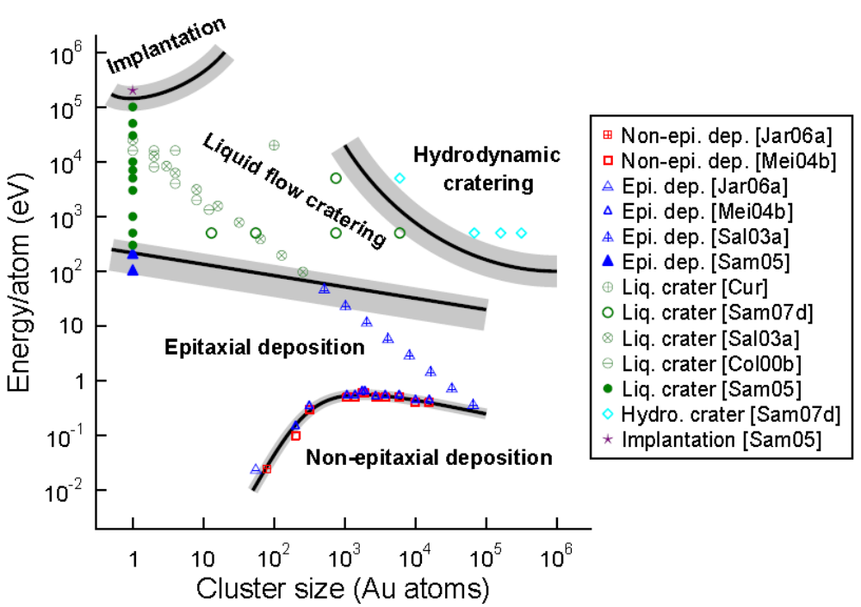
Schematic pictures - example
Phase diagrams are often good to illustrate regimes of 2 variables
Kai Nordlund, 2008

Slide 28


Decorative images?
If you have otherwise only text, it may be good to have illustrating images which have no information value in themself, but light up the slides
  But then the pictures should be neutral so people do not wonder about them instead of listening to you
  Clipart sometimes good
  But pictures somehow related to the subject usually better
But animated clipart is often just
plain annoying

Slide 29
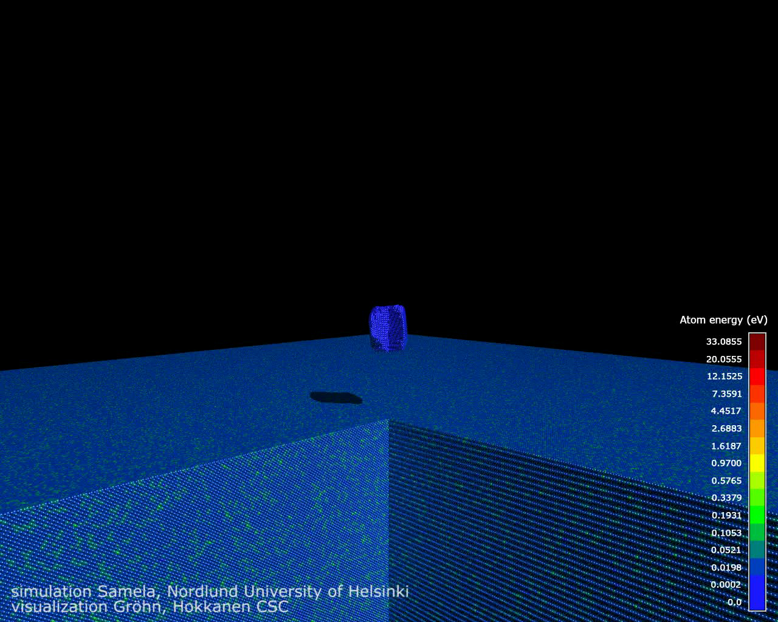
Movie
If you talk about time-dependent phenomena, it can be extremely good to have a movie that illustrate what is going on
  Requires of course some technical knowledge
Powerpoint 2010:
  Insert -> Video from file
  Note: select “Link to
  file” instead of “Insert”
  not to blow up file size
After insertion, click on
the movie, then in
Animations tab select Play:
this way the movie plays
without having to move
the mouse over it!
[The animation below won’t work unless you have the file on your own computer]

Slide 30
Movies in Powerpoint 2010 on
Before, movies were always separate files, which made it difficult to transfer from one computer to the next – also the movie file had to be copied
As of Powerpoint 2010, the default is to insert the entire movie content into the powerpoint file
  Plus: ensures transferability (provided other computer also has Powerpoint >= 2010)
  Minus: file size grows easily huge
  Hence my recommendation is still to select Insert -> Video -> select instead of “Insert” “Link to file”
  But you can always later on insert all movies into file for a transferable file: select File tab -> Info -> Optimize media -> View links. Here you can “break link” which inserts the movie into the powerpoint

Slide 31
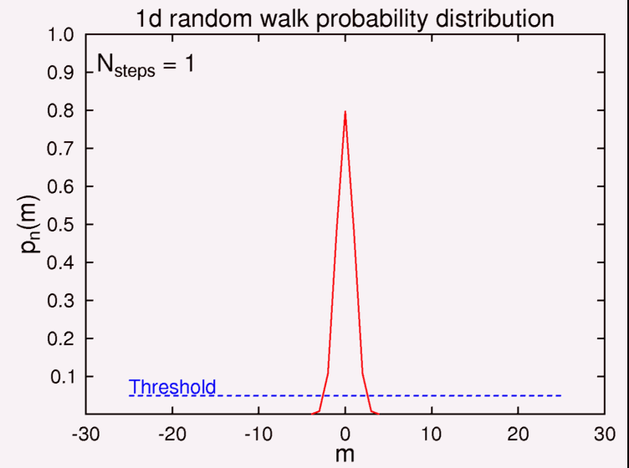
Movies of graphs
But also normal graphs can be animated – this can be sometimes quite illustrative
  Simple example:
[This animation should work in any Powerpoint > 2010 … it is inserted in the powerpoint file]

Slide 32
Graphs
Remember the projector resolution limits!
  Almost all projects in the world are still 1024 x 768 pixels
  Not too thin lines! Repeat: Not too thin lines!!!
  If you are uncertain, set the resolution on your screen to 1024x768 pixels to check it out
Use colors
  All projectors have colors, and it is much easier to distinguish between lines by color than line style
  BUT: remember red-green-color blindness (7% of all men) => avoid combinations of red and green close to each other
Explain with words what the graph shows
  Rule of thumb: explain the y and x axes

Slide 33
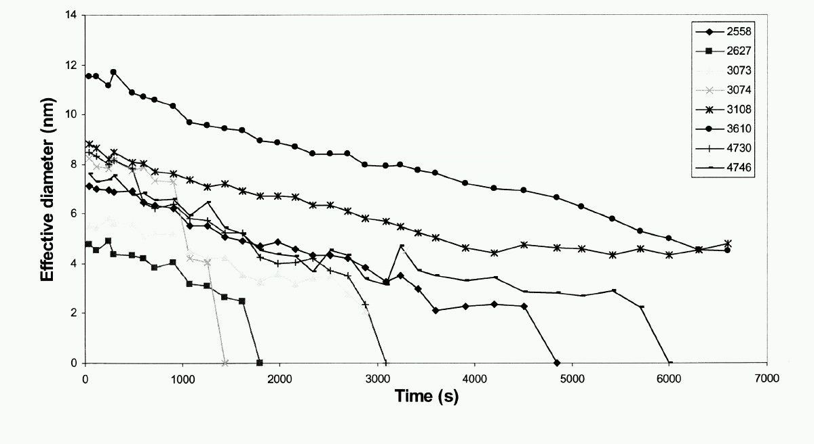
Graphs
How not to do?
Bad: thin lines, weak colors (some invisible), small font in legend

Slide 34
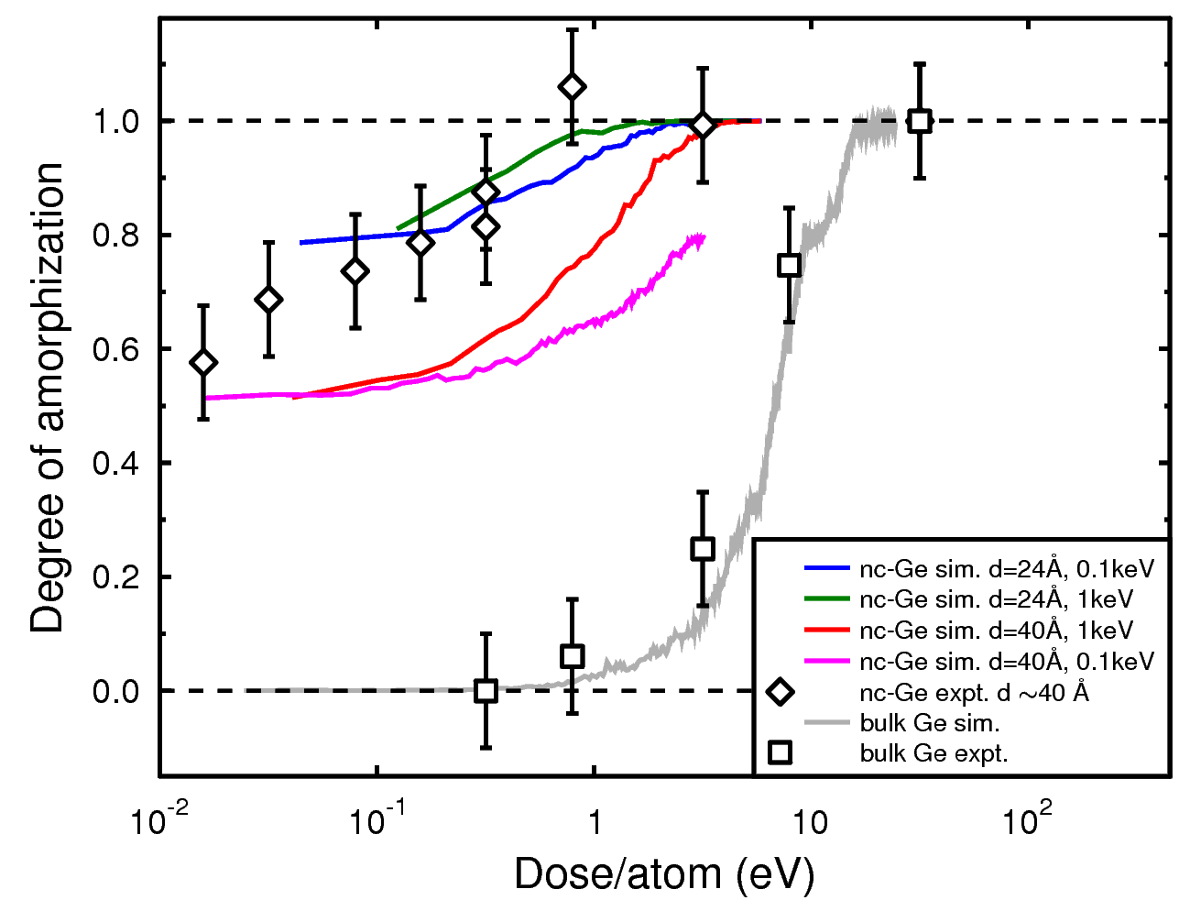
Graphs
How to do?
Marie Backman (2008)
Good: thick lines, large clear symbols, different colors, antialiasing used in import

Slide 35
Equations…
How to present equations is an eternal problem in physics and chemistry presentations
Rule of thumb: show no equations at all!
  In general physics or chemistry conferences one can not assume the audience knows any equations!
    E.g. a meteorologist likely does not need the Schrödinger equation for anything, or a particle physicist the Navier-Stokes equation, so they may not remember them at all!
Corollary:
  In specialist meetings it may be quite appropriate and even important to show equations
  But even then:
    Only show the really necessary equations
    Emphasize with graphics or effects the important parts

Slide 36
Loads of equations do not make you look smart!
Some theorists seem to think that putting a load of complex equations in their slides makes them look smart
  However, one should realize that any idiot can cut-and-paste a load of equations to their slides
Having loads of complex equations is motivated only if they really are crucial for understanding your message
  E.g. they are new, the crucial result of the work, and you describe all the parts of the equations during the talk
  But such cases are actually rare
Otherwise all the equations are just annoying; pick out only those parts you really need

Slide 37

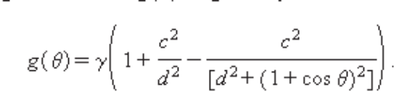
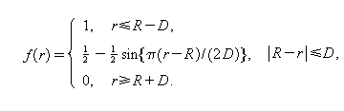
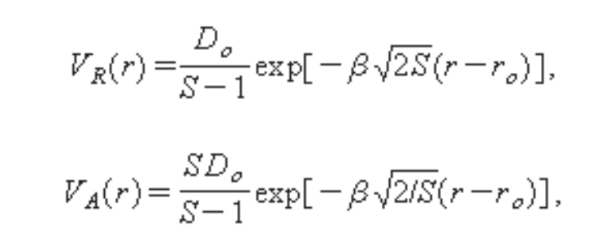
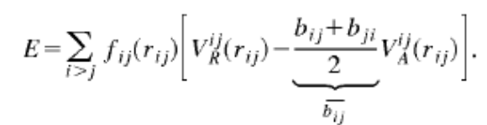
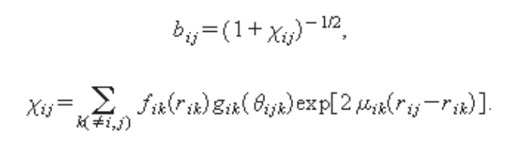
Equations...
How not to do?
We have modified the Tersoff potential to describe better
the interatomic interactions
Bad: poor resolution; lots of equations ⬄ not clear what is important; non-specific statement (what is better described??)
Notes:
Fel: ickespecifikt uttalande, massa Equations... med dålig resolution, inte klart vad som är viktigt

Slide 38
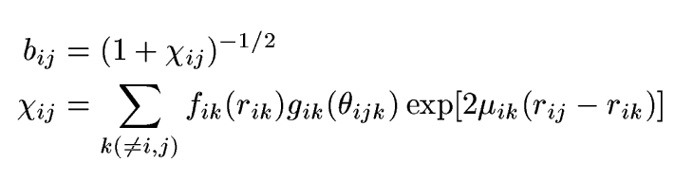
Equations...
How to do?
We have also modified the Tersoff potential description of the angular part to be physically better motivated
Three-body part:
  Second-moment approximation exponential
  No power of 3
  ik-dependent angular term to conform to bond order theory
Good: only the modified parts are shown, and the important aspects are highlighted with arrows

Slide 39
Equations...
Or maybe instead:
We modified the description of the angular part to be physically better motivated
Our three-body part:
  conforms to the second-moment approximation of tight binding
  Calculates the bond order from k atoms
  Has no power of 3, which can lead to artificially high forces
Good: physics emphasized, no equations

Slide 40
Tables
If you show tables, make a version where only the numbers really needed in the presentation are shown
  Powerpoint has its own table-making function
Or if you really need to show all numbers, then use presentation effects to highlight the most important parts
  E.g. arrows, boxes, showing numbers in sequence

Slide 41
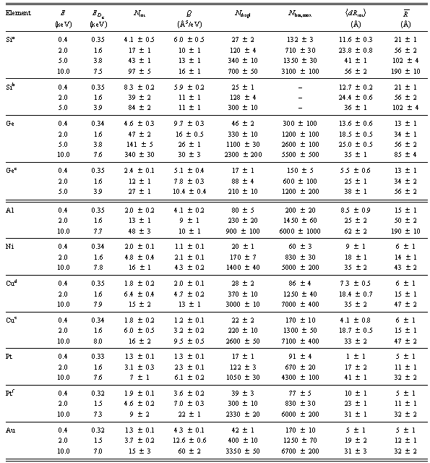
Tables
How not to do?
Our results clearly show that there is more damage in semiconductors than in metals

Slide 42
Tables
How to do?
Our results show that there is more damage in semiconductors (Si, Ge) than in the corresponding metals (Al, Ge)
Element | Energy (keV) | Damage (Frenkel pairs)
Si | 2 | 17 ± 1
 | 10 | 97 ± 5
Al | 2 | 13 ± 1
 | 10 | 48 ± 3
Ge | 2 | 47 ± 2
 | 10 | 340 ± 30
Cu | 2 | 6 ± 1
 | 10 | 15 ± 2

Slide 43
Sources and references
It is highly recommendable to set out your sources and references in the presentation
  If you copy material from the web, it can be impossible later on even for yourself to figure out where it came from (if you e.g. need to check additional details)
    Same of course true for listeners
  If you present your own research, having references has a double value:
    Listeners can check details
    Reference in a good journal shows that the research is valued also by others – PR value
However, references can be in a small font
  14 or even only 12 pt. in powerpoint/openoffice
[14 point example reference]
[12 point example reference]

Slide 44
Technical hints
Powerpoint:
  F5 puts you directly up in presentation mode
    Shift-F5 at the local transparency
  Choose ”File -> Options-> Advanced” -> choose away ”Show menu on right mouse click” so you can use the right mouse button to go backwards!
  For Movies, click on the movie, then use ”Animation -> Play” to make it play as part of mouse click sequence (no need to move mouse on top of movie)
PDF:
  CTRL-L gets you up in presentation mode

Slide 45
Conclusions
Rule of thumb 1: have at most 4 conclusions
  No human being remembers more than that
Rule of thumb 2: they should fit on a single slide with a large font
  Few things are as annoying as a speaker who has 2-3 pages of conclusions which he/she reads up sloo ... oo .. oowly
    Especially if the speaker is already over time...

Slide 46
Final comment
As in rules of etiquette:
  ”Once you know the rules, you are allowed to break them (only then you know how to do it with style)”

